Slide 1
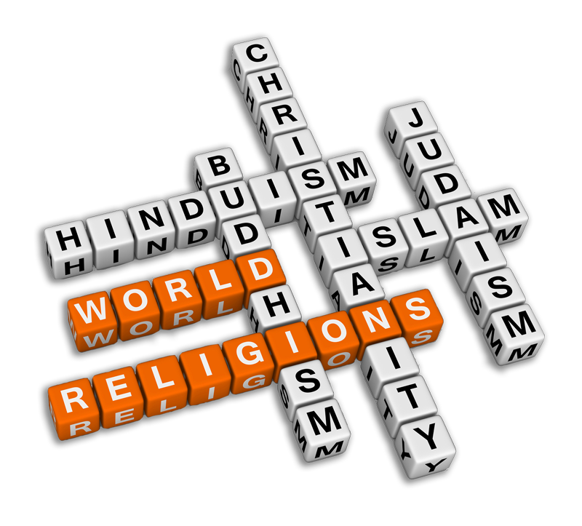
World Religions
6 Common Elements

Slide 2
6 Common Elements of Religion
Religion
Sacred Stories/
Scripture
Community
Beliefs
Actions
Sacred Space
Sacred
Time

Slide 3
◆
Sacred Stories/Sacred Scripture
All religions have sacred stories about how the world began, how humans were created, etc.
Some of these stories may be referred to as myths.

Slide 4
Important Point:
Myths are not false stories, but they are truth stories intended to convey a sacred truth.

Slide 5
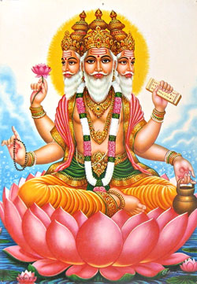
Hindu Creation Myth
What are the sacred truth(s) being conveyed in this story?
Video Link

Slide 6
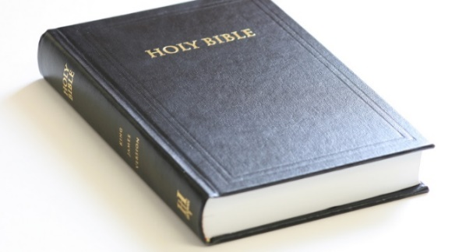
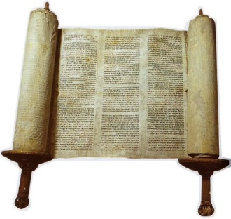
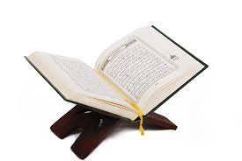
Scripture refers to the holy/revealed writings of the world’s religions.
Christianity = The Holy Bible
Islam = The Qur’an
Judaism = Tanakh (includes the Torah)

Slide 7
❖
Beliefs (spiritual and moral)
All religions have certain spritual truths and beliefs that separate one religious tradition from another.
Some religions have a formal set of beliefs and others are more non-formal.
All religions have a moral code that determines which actions are right and which actions are wrong.
Catholic Creed = A Formal Belief Statement
Video on the Creed

Slide 8
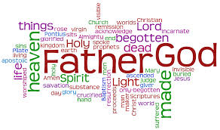
Creed = A Formal Belief Statement
The Apostle’s Creed and the Nicene Creed
Video on the Creed

Slide 9
⬥
Actions
How we act is determined by what we believe.
Religious actions are called rituals (sacred actions).
For Catholics, the sacraments are sacred actions.

Slide 10
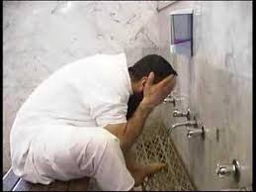
Catholic Baptism Video
How do Muslims prepare
for prayer (Wudu)?

Slide 11

Sacred Time
Times when certain actions are focused on the sacred.
This may be daily, weekly, monthly, yearly.
Muslims – Ramadan
Jews – Passover
Christians – Sunday

Slide 12
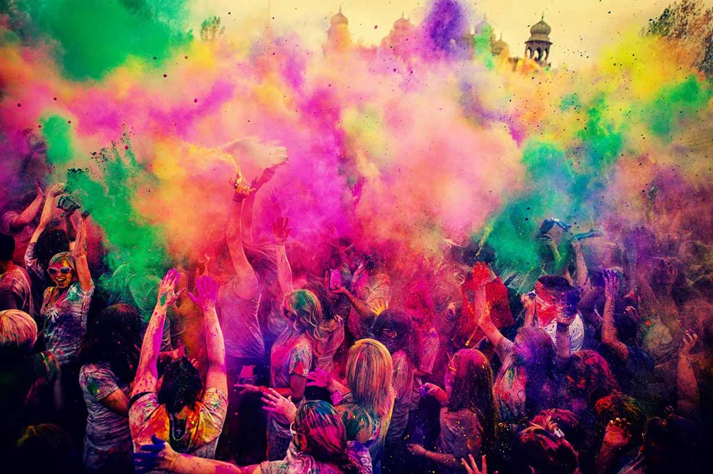
Hindu Sacred Time - Holi
Video Link on Holi

Slide 13
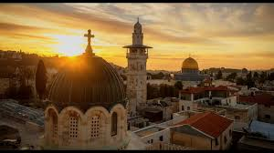

Sacred Space
Sacred space is often the place where sacred times are celebrated.
Places where the religion began or where the founder traveled often become sacred spaces.
Jerusalem is a sacred place for Christians, Jews, and Muslims.

Slide 14
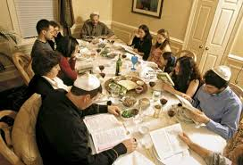
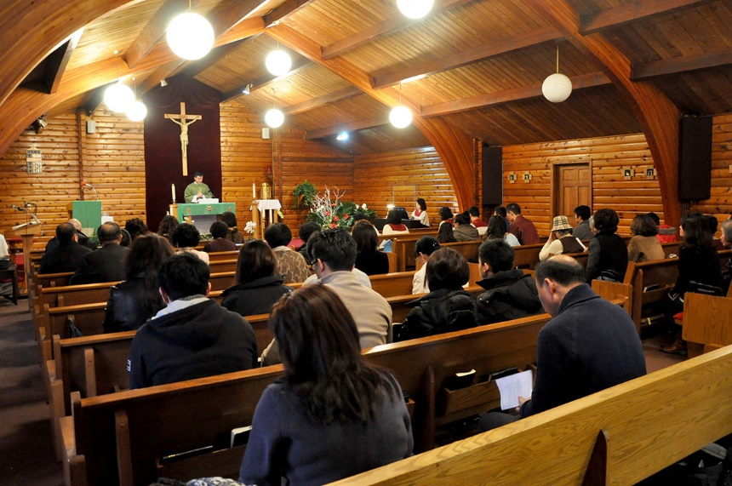

Community
There is always a social element to the religious traditions of the world.
Community connection is very important.

