Slide 1
Aboriginal Rituals

Slide 2
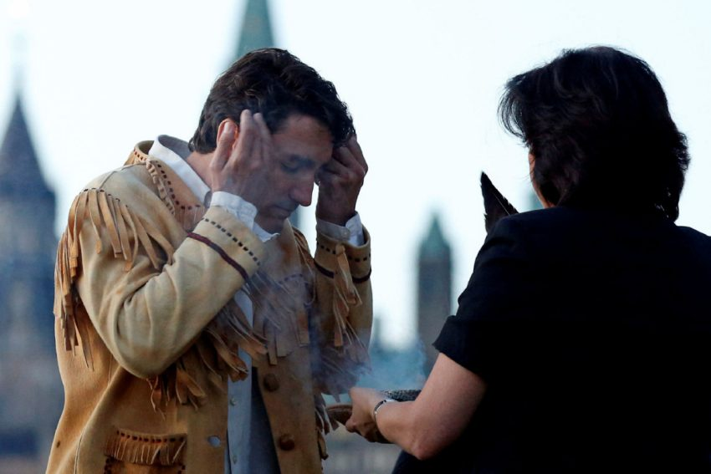
Smudging

Slide 3
Smudging
It is a holy act.
Sacred herbs are burned in a shell or earthen bowl, and then the smoke is brushed or washed over the eyes, mouth, ears, hands, heart, and whole being of each participant.
The cleansing smoke can purify people and places before important events.
The ashes are holy.
The ashes are returned to the earth after the ceremony.
Video clip: https://www.youtube.com/watch?v=o0UqS2x1yfY

Slide 4
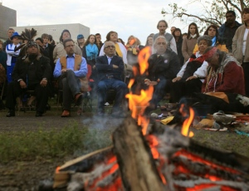
Sacred Pipe Ceremony

Slide 5
Sacred Pipe Ceremony
One of the most powerful and sacred spiritual rituals for Aboriginal peoples in Canada.
Pipe symbolizes unity and harmony of the world.
Pipe carrier will pray that the whole universe and all it contains will be transferred to the pipe.
The Great Spirit is all that the pipe contains when it is lit.
Stone bowl of the pipe represents truth.
Stem represents the way we are to live (eg. In harmony with nature)
Bowl represents the woman and stem represents the man.
Joining the bowl to the stem symbolizes unity and balance between man and woman.

Slide 6
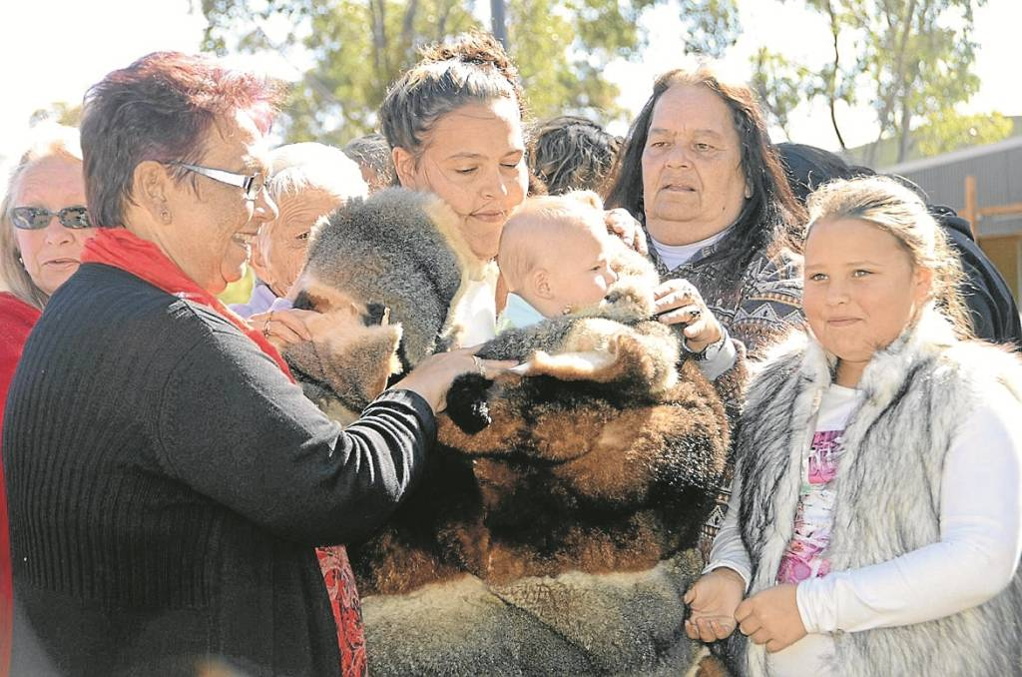
Birth and Naming Rituals

Slide 7
Birth and Naming Rituals
The name giver (child’s grandparent or elder) will enter into a time of fasting, meditation, prayer, or dreaming.
The name is revealed by the Spirit.
The name is given during a special ceremony.
The name expresses the identity of the person, which consists of his or her relation to the spirit power.

Slide 8
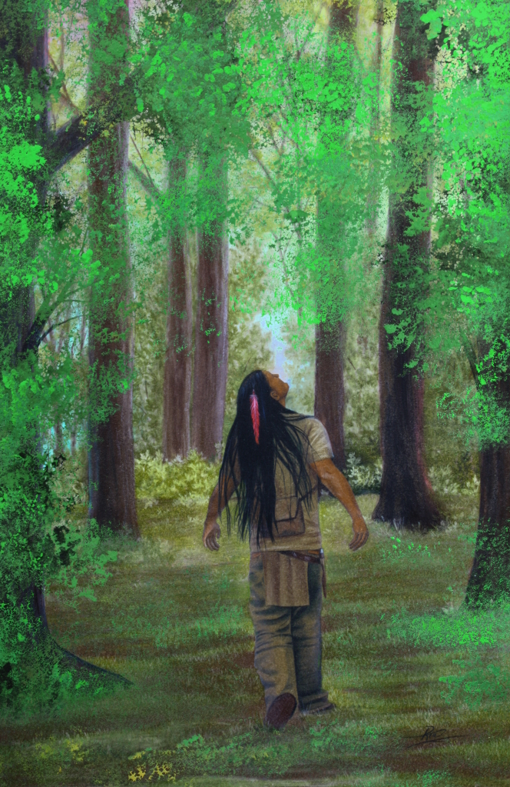
Puberty – Vision Quest

Slide 9
Puberty – Vision Quest
Most young Aboriginals go on a vision quest.
A vision quest is an intense, solitary spiritual experience for those seeking direction in life.
Young people prepare for about 1 year and go when their parents and elders deem them ready.
The vision quest must be completed for the young person to be accepted as an adult in the community.

Slide 10
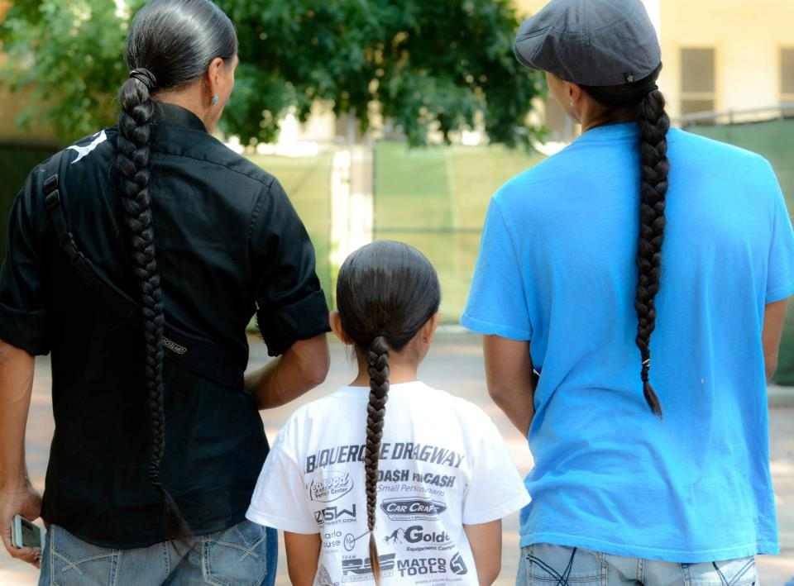
Hair

Slide 11
Hair
Long, uncut hair is considered sacred by some Aboriginals.
The braids or uncut hair worn by an Aboriginal generally signify the spiritual and cultural importance of the individual and reinforce his or her sense of belonging to a particular First Nation.
Three braided strands signify the body, mind and spirit.
Cut hair can be sign of mourning.

Slide 12
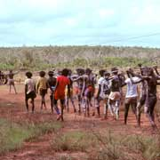
Death

Slide 13
Death
Death rituals and beliefs vary.
Many believe that that those who have died need to relearn what it is to be a spirit.
The time varies
Usually a waiting time of a year
After a year has passed, a Death Feast is held for the spirit of the person who has left
Separation from the body does not mean that all ties to people are gone (eg. Cree believe that spirits can communicate with people in visions).
A wake and round dance may be held in Cree communities as part of the healing process.

Slide 14
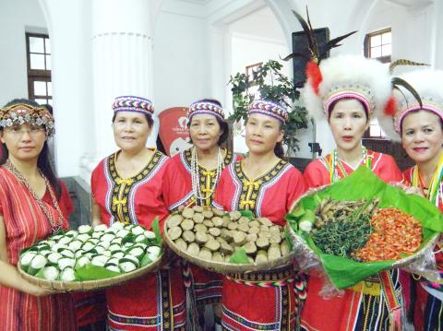
Harvest Feast

Slide 15
Harvest Feast
It is commonly celebrated by Aboriginal peoples who are farmers.
It recognizes the spirits that acted on behalf of the people to give the people food.
It also helps renew the earth.

Slide 16
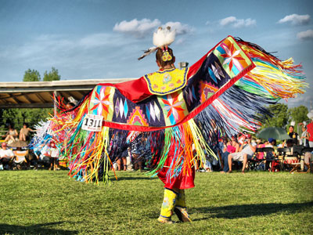
Powwow

Slide 17
Powwow
A dance of renewal for the restoration of right relationships and the healing of all of creation.
A community celebration (eg. Celebrate one’s identity, heritage, and language).
Takes place in a holy circle.
Dancers and singers enter the circle from the east and move in a clockwise direction – the same direction as the sun moves.
Drumbeat symbolizes the solemn rhythm of creation, the heartbeat of Mother Earth, and the rhythm of the mother’s heartbeat that all hear in the womb.

Slide 18
Learn 360 Clip: What it feels like to dance in a Powwow
Let’s watch!

Slide 19
Source:
World Religions: A Canadian Catholic Perspective. Toronto: Novalis Publishing Inc., 2011.

