Slide 1
An Introduction to the 1920’s

Slide 2
Canada at the start of the 20’s
The 1920’s was a decade of change and prosperity.
The war was over and people were happy.
William Lyon Mackenzie King was Canada’s Prime Minister at the time.
People liked King because he was loyal to Laurier during the conscription crisis and his style was very similar to Laurier’s.
King was not one to take sides, and always looked for compromise to satisfy the majority of people.

Slide 4
The Roaring Twenties?
The 1920’s were often referred to as “The Roaring Twenties” for the following reasons:
The economy experienced good times.
It was a golden age for sports in Canada.
The new inventions were endless.
Life was at a high, not only for men but for women as well.
The 1920’s was especially a decade of change for women.

Slide 5
The economy in 1919
The price of goods was rapidly increasing during 1919.
This is called inflation.
Wages were not increasing at the start of the decade.
Soldiers had difficulty finding work upon returning from the war.
Trade unions and strikes became more common.
Few people were living the exciting and glamorous lives as seen in the media.
Many Canadians did benefit from a steady job, new clothes, and home appliances.
A new approach to purchasing goods developed:
“Buy now, pay later!”
Purchasing goods on credit caused many people to overspend their budgets.

Slide 6
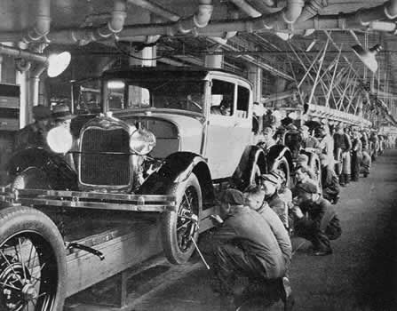
Signs the economy was improving
Wages for workers increased as the decade progressed.
There was a stock market boom (largely American investment).
There were more jobs in forestry, mining, and farming available.
New industries developed (ex. Radio,
automobiles).
Canada was becoming and industrial nation.

Slide 7
Key industries in the 1920’s
Wheat farming: the prairie provinces were supplying the world market.
Pulp and paper: the newsprint industry was increasing; demand was especially high in the U.S. because it depleted its resource.
Hydro-electric power: it was used more than coal and the demand in the home was high.
Oil and gas: were needed for automobiles, heating, and cooking.
Mining: copper, nickel, lead, and zinc were usually mined.

Slide 8
The economic cycle of the 20’s

Slide 9
Sources
Bolotta, Angelo. Canada: Face of a Nation. Toronto: Gage, 2000.
Cruxton, J. Bradley, and W. Douglas Wilson. Spotlight Canada. 4th ed. Don Mills, Ontario: Oxford University Press, 2000. p. 149-152.
DesRivieres, Dennis, et. al. Decades: Forces of Change, 1896-1960. Scarborough, Ontario: Prentice-Hall, 1996. p. 20-21, 24-25.
Mr. Berlin.Com. “The Impact of the Automobile on the Roaring 20s.” http://mrberlin.com/theimpactoftheautomobileontheroaring20spowerpointpresentation.aspx

