Slide 1
Intro to drawing

Slide 2
Line and Drawing
Line is an element of design that plays a crucial role in drawing.
Recall: line is the path of a moving point.
Let's practice identifying the element of line in various works of art!

Slide 3
Recognizing the element of line
Q: Where do you see the following types of line:
Zigzag
Curved
Straight
Short
Broken
Artist info: Henri Matisse, French, 1869–1954 Woman Seated in an Armchair, 1940

Slide 4
Line: What types of line do you see?
Artist info:
Joan Miró Spanish, 1893–1983 The Farm, 1921–1922 oil on canvas, 123.8 x 141.3 x 3.3 cm (48 3/4 x 55 5/8 x 1 5/16 in.) National Gallery of Art, Gift of Mary Hemingway

Slide 5
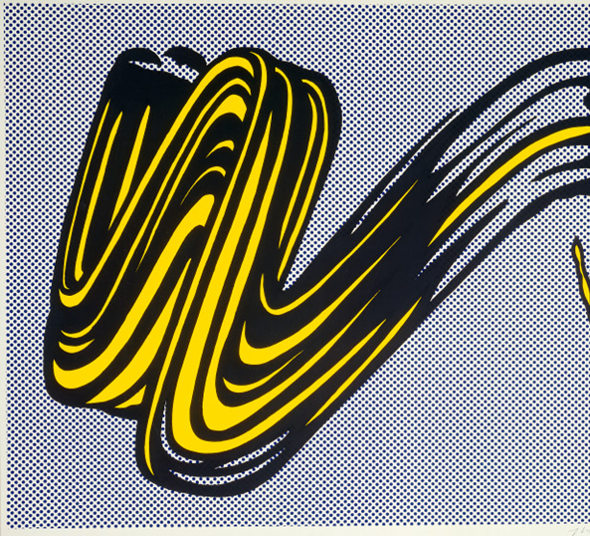
Lines can evoke emotions and ideas
Q: What words would you use to describe these lines?
(1) Calm, serious, quiet
OR
(2) Energetic, fun, dynamic
Art info: Brushstroke, Roy Lichtenstein, 1923–1997

Slide 6
Line impressions
Q: Which group of words best describes the lines in this painting?
1) Solid, serious, organized, planned
OR
(2) Silly, energetic, dynamic, in motion, chaotic
Artist info: Charles Sheeler American, 1883–1965 Classic Landscape, 1931

Slide 7
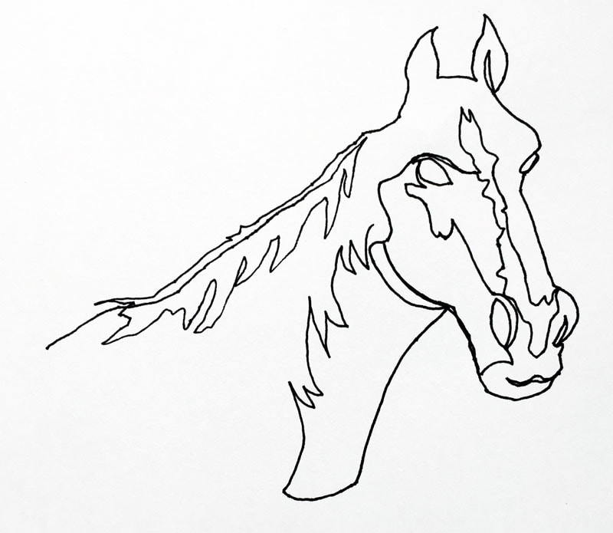
Contour drawing
When you intend to do a drawing of a person, place, or thing, you will first need to become familiar with the contours (or edges) that define your subject matter.
Many artists begin their drawing projects by completing basic contour/line drawings of their subject matter.
Activity: Take out a pencil or other item from your bag and do a quick contour line drawing of it.

Slide 8
The importance of Value
Value is another important element of design to keep in mind when you are drawing.
Recall: Value is the lightness or darkness of a surface.
There are several different ways we can create value – can you think of any examples?

Slide 9
Value scales: Practice each one
Practice creating value through using these techniques.

