Slide 1
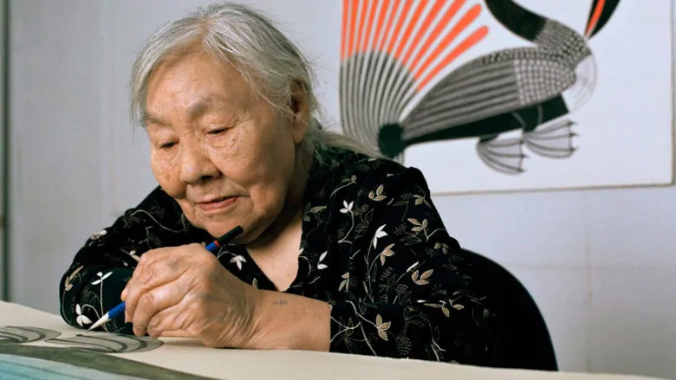
Kenojuak ashevak

Slide 2
Who was kenojuak ashevak?
Kenojuak Ashevak was an Inuit Canadian artist who lived between 1927 – 2013.
She rose to fame mainly because of her contributions to the graphic arts.
Most importantly, she helped draw attention to Inuit art during her career.

Slide 3
Early years
Ashevak was born on a camp ground in south Baffin Island called Ikirisaq.
As a child, her family moved frequently and settled on various camp grounds in the south Baffin Island region and in arctic Quebec.
She got married at a young age to a man named Johnniebo.
In the late 1950's, Ashevak and her husband began to produce art through drawing and carving.
After settling in Cape Dorset with her family, she started to create prints for the "famed Cape Dorset print collections."
In 1961, the National Film Board created a film about Ashevak's lifestyle and artistic style.
This film was "instrumental in introducing her to the world beyond Cape Dorset."

Slide 4
Notable Achievements
Ashevak's Enchanted Owl (1960) was "reproduced on a stamp commemorating the centennial of the Northwest Territories."
In 1993 Canada Post "selected her drawing entitled The Owl to be reproduced on their .86 cent stamp."
Ashevak's "art and life were the focus of the limited edition book entitled Graphic Arts of the Inuit: Kenojuak."
Her and her husband produced a mural for the 1970 World's Fair in Japan.
She received honorary degrees from several universities.
In 2008 Ashevak was given the Governor General’s Award in Visual and Media Arts.

Slide 5
Think-Pair-share:
The piece that is displayed is one of Ashevak's most recognized and celebrated works of art. It is called "Enchanted Owl."
With a partner, write down any words that you would use to describe Ashevak's style of art.

Slide 6
"The arrival of the sun"

Slide 7
"Six-Part harmony"
2012
Stonecut and stencil

Slide 8
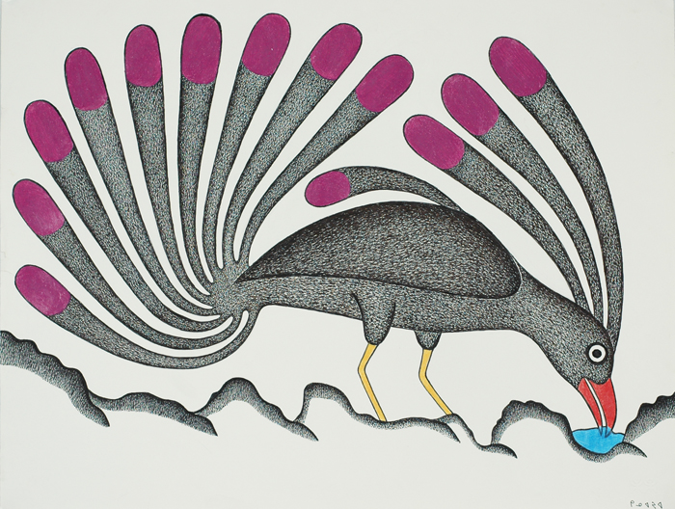
Untitled
2009
Graphite pencil, pencil crayon, and pentel pen.

Slide 9
"Guardian owl"
1997
Etching and aquatint

Slide 10
"Hare spirits"
1960
Sealskin stencil

Slide 11
Heritage minute devoted to ashevak
https://www.youtube.com/watch?v=wypPbnRee0Y

Slide 12
Sources
https://shop.mcmichael.com/products/canad-card-enchanted-owl
http://www.dorsetfinearts.com/kenojuak-askhevak/
https://canadianart.ca/news/kenojuak-ashevak/

