Slide 1
Norval Morrisseau

Slide 2
Who was Norval Morrisseau?
Norval Morrisseau was an Ojibwa Canadian artist who lived between 1931 – 2007.
Morrisseau is known as one of the founding fathers of contemporary Indigenous art in Canada.
Specifically, he is credited with creating a style of art called "The Woodlands School."

Slide 3
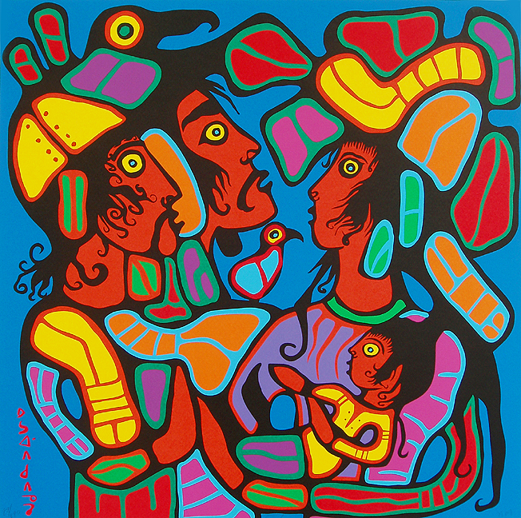
Think-Pair-Share:
This painting is an example of the Woodlands school.
With a Partner, write down the WORDS WOULD YOU USE TO DESCRIBE this ARTISTIC STYLE.

Slide 4
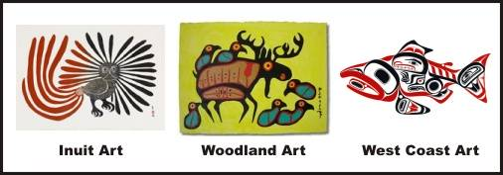
The woodlands school
The Woodlands School uses "traditional Anishinaabe themes and bold lines; it builds on rock art."

Slide 5
Morrisseau's early life
Morrisseau grew up during a time when Aboriginal peoples were not given the same rights and freedoms as other Canadians.
At an early age, Morrisseau was sent to a residential school.
Residential schools "forcibly separated Indigenous children from their families and forbade them from acknowledging their cultures or speaking their traditional languages."
Despite the hardships he faced, Morrisseau demonstrated a strong sense of maturity and independence as a child.
He often preferred to spend his time alone drawing, learning, or listening to elders.

Slide 6
early mentors
Dr. Joseph Weinstein and his wife Esther befriended Morrisseau in the late 1950's.
Like Weinstein, they were supportive of modern art (ex.the work of Pablo Picasso).
The Weinstein's were artists who often gave Morrisseau art supplies to work with.
They encouraged Morrisseau to follow his dream of being an artist and "consider himself a professional artist “in the Western sense, rather than as a producer of tourist souvenirs.”"

Slide 7
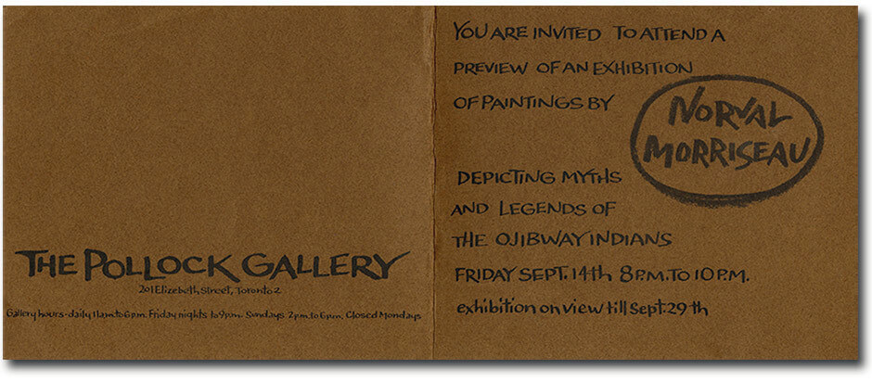
Big moment
In 1962, Morrisseau was given the honour of showcasing his artwork at the Pollock Gallery in Toronto.
This was significant because it "marked the first time an Indigenous artist had shown work in a contemporary art gallery in Canada, and the media hailed the debut as a new development in Canadian art."
Morrisseau became more widely known and respected as an artist after this exhibition.

Slide 8
Storytelling
Morrisseau's artwork often told a story.
Example: As noted by the Glenbow Museum, Morrisseau recreates the story of a dream of an Ojibwa named Luke Onanakongos (Jo-Go Way) in this painting: “In dreams of my youth, my spirit dwelled inside a huge moose, and I was protected from hardships of this earth. In middle life, the moose discharged my spirit from his body and it became one with my earthly self. The moose told me to purify myself spiritually and I did this for a time. Finally, in my old age, I rebelled and left forever the dream that pulled me toward that era.”

Slide 9
Other works of art by Morrisseau

Slide 10
"Herb Picking with grandfather"
"Herb Picking with Grandfather"
Genre painting

Slide 11
"Otter and circle of life"
"Otter And Circle Of Life" circa 1991 acrylic on canvas

Slide 12
"The hunter"
"The Hunter" circa 1995
Symbolic painting

Slide 13
"in the land of giants"
"In the Land of Giants"
Symbolic painting

Slide 14
"as the artist sees himself"
"As The Artist Sees Himself" 1992

Slide 15
"First meeting"
"First Meeting" 1992
Animal painting

Slide 17
Source
https://www.wikiart.org/en/norval-morrisseau/first-meeting-1992
https://www.wikiart.org/en/norval-morrisseau/the-hunter-1995
https://www.wikiart.org/en/norval-morrisseau/in-the-land-of-the-giants
https://www.wikiart.org/en/norval-morrisseau/first-meeting-1992
https://www.wikiart.org/en/norval-morrisseau/herb-picking-with-grandfather
http://coghlanart.com/Norvalpainting.htm
file:///C:/Users/User/Downloads/LimestoneAboriginaArtInCanadaPresentation.pdf
https://www.aci-iac.ca/art-books/norval-morrisseau/biography

