Slide 1
Developing Your Perceptual Skills

Slide 2
What are Perceptual Skills?
Our perceptual skills help us understand our subject matter.
They are basic component skills that should not be confused with drawing skills.
Our perceptual skills call us to develop an awareness of the elements that define the people, places, and things we intend to draw. They include:
The perception of edges
The perception of spaces
The perception of relationships
The perception of light and shadows
The perception of the whole
To draw well, you must see the world around you with the eyes of an artist.

Slide 3
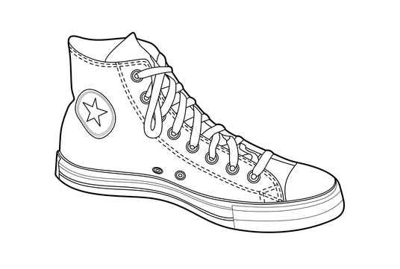
The Perception of Edges
Perceiving edges involves recognizing the contours that define our subject matter.
We need to identify how the element of line relates to the people, places, and things we are drawing.
We must identify the outline of our subject matter.

Slide 4
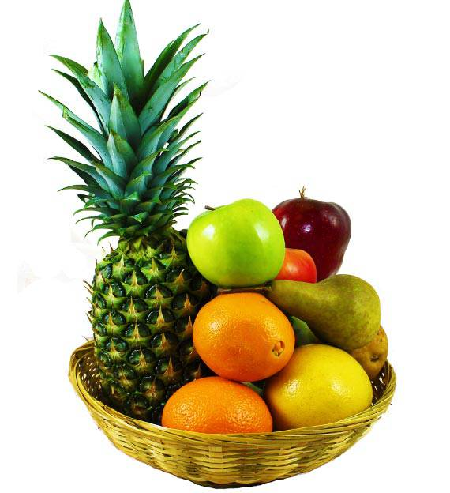
The Perception of Spaces
Look at both positive and negative space to help you draw what you see in front of you.

Slide 5
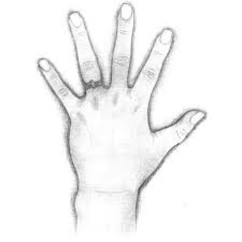
The Perception of Relationships
It is important to recognize similarities and differences between different elements that make up your subject matter.
Making connections will help you achieve the correct shapes and proportions that define your subject matter.
Example: What is the relationship between your pinky finger and ring finger? How big is the pinky finger in comparison to your ring finger?

Slide 6
The Perception of Shadows and Light
It is important to recognize where the light is and isn't hitting your subject matter.
Learning the parts of a shadow will help you (see the next slide).

Slide 7
The Parts of a Shadow

Slide 8
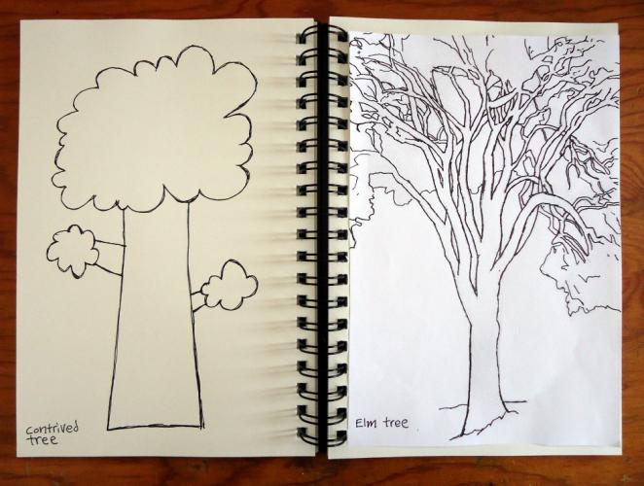
The Perception of the Whole
Step back from your work periodically and compare it to the object you are drawing.
This is where you refine areas that need to look more like what you see, not what you think you see.
When people say they are not good at drawing, the problem is usually not with their drawing abilities – it's seeing things properly that is the problem.

Slide 9
Drawing from the Right Side
Drawing is largely a ‘right brain’ activity.
The right mode is also:
Non-verbal; concrete (relation to things as they are); non-temporal; spatially seeing where things are in relation to one another; intuitive.
The activities we will do will tap into our right mode to help us see better and to draw better.

Slide 10
Benchmark Drawings
In our unit, you will be completing a series of drawings to help you develop your drawing and perceptual skills.
You will draw:
Your hand
A still-life object of your choosing
A human face
You will get 4 work periods to complete these drawings.
These drawings must be completed with graphite pencils.

