Slide 1
Perspective

Slide 2
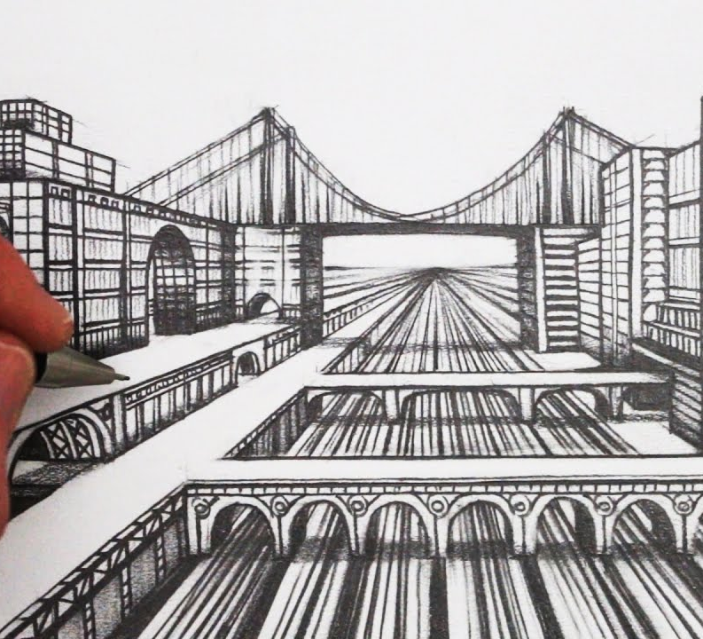
What is perspective?
In drawing, perspective involves showing depth on a 2D surface.

Slide 3
What is Linear perspective?
Linear perspective "is the branch of perspective in which the apparent size and shape of objects and their position with respect to foreground and background are established by actual or suggested lines converging on the horizon."

Slide 4
The vanishing point and horizon Line
A vanishing point (V.P.) "is a point that is located directly in front of the viewer’s eyes, on a ‘horizon line’."
A horizon line "is also known as an ‘eye level line’." The V.P. is situated on the horizon line.

Slide 5
The Vanishing Point and Horizon line

Slide 6
THE VANISHING POINT AND HORIZON line

Slide 7
One-point Linear perspective
The characteristics of one-point linear perspective include:
one vanishing point
lines converging toward the vanishing point
an object’s vertical lines do not relate to the perspective rules of the horizontal lines

Slide 8
ONE-POINT LINEAR PERSPECTIVE

Slide 9
Two-point perspective
In two-point perspective:
there exist two points from which an object’s lines radiate from
the sides of the object vanish to one of two vanishing points on the horizon line
an object’s vertical lines do not relate to the perspective rules of the horizontal lines

Slide 10
TWO-POINT PERSPECTIVE

Slide 11
How to draw one-point perspective
Video:
https://www.youtube.com/watch?v=XRrKohWdpeQ

Slide 12
How to draw Two-point perspective
Video:
https://www.youtube.com/watch?v=XRrKohWdpeQ

Slide 13
Atmospheric or Aerial Perspective
Aerial perspective or atmospheric perspective "refers to the effect the atmosphere has on the appearance of an object as it is viewed from a distance."
"As the distance between an object and a viewer increases, the contrast between the object and its background decreases, and the contrast of any markings or details within the object also decreases."
"The colours of the object also become less saturated and shift towards the background color, which is usually blue, but under some conditions may be some other color (for example, at sunrise or sunset distant colors may shift towards red)."

Slide 14
Atmospheric Perspective

Slide 15
Your task
Practice drawing from one and two-point perspectives.
You may want to create very basic perspective drawings or create perspective drawings that reflect specific scenary (ex. City).

Slide 16
sources
https://www.collinsdictionary.com/dictionary/english/linear-perspective
https://www.studentartguide.com/articles/one-point-perspective-drawing
https://en.wikipedia.org/wiki/Aerial_perspective

