Slide 1
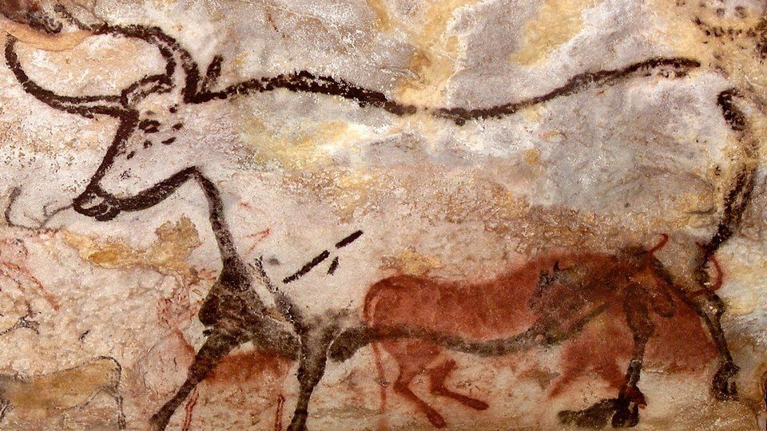
Prehistoric art:
An Introductory Lesson

Slide 2
Think-Pair-Share
1. Make a list of examples of pictures, symbols, or signs that communicate specific information to people in our society (ex. No U-turn traffic sign, no smoking sign, etc.).
2. Why do you think these pictures, symbols, and signs work well?

Slide 3
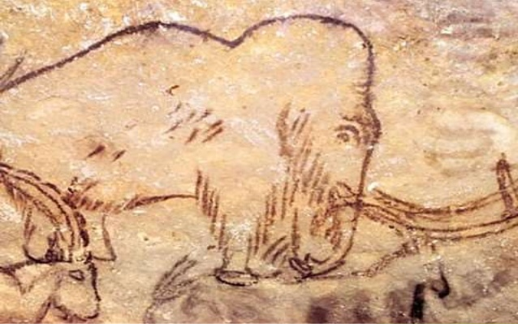
Pictures and Early Human Beings
In the early days of human civilization, pictures played an important role in the world.
In fact, "before people could write or use metal to make tools, they were painting and scratching pictures of animals on the uneven walls of caves and rock shelters."

Slide 4
Prehistoric People: Class Discussion
What do you know about the life of these people?
When and where did they live?
What animals lived when the cave people lived?
What did cave people use animals for?
What tools did they have?
Why do we call them cave people?

Slide 5
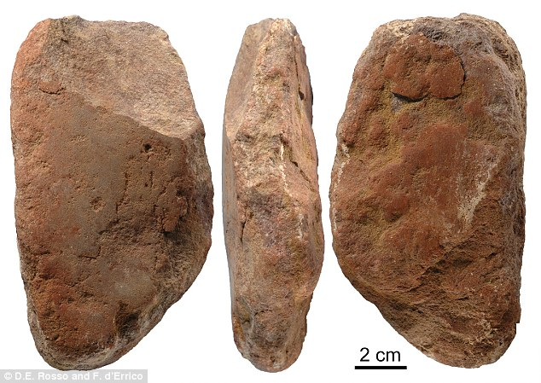
The Paleolithic Period
One significant prehistoric period was the Paleolithic period.
It is otherwise known as the "Old Stone Age."
The Paleolithic Period "is the historical period believed to have lasted from 30, 000 B.C. until about 10, 000 B.C.

Slide 6
The Cave Paintings of Lascaux
Chinese Horse. Cave Painting. Lascaux Caves, Dordogne, France. C. 15,000-10,000 B.C.

Slide 7
What is the Lascaux Cave?
It is a famous Paleolithic cave in the Dordogne region of southern France.
Fun fact: "Close to 600 paintings – mostly of animals - dot the interior walls of the cave in impressive compositions."
Discovery: "On 12 September 1940 CE four boys examined the fox hole down which their dog had fallen on the hill of Lascaux. After widening the entrance, Marcel Ravidat was the first one to slide all the way to the bottom, his three friends following after him. After constructing a makeshift lamp to light their way, they found a wider variety of animals than expected; in the Axial Gallery they first encountered the depictions on the walls. The following day they returned, better prepared this time, and explored deeper parts of the cave. The boys, in awe of what they had found, told their teacher, after which the process towards excavating the cave was set in motion. By 1948 CE the cave was ready to be opened to the public." (Ancient History Encylopedia).

Slide 8
A Virtual Tour of Lascaux
http://archeologie.culture.fr/lascaux/fr/visiter-grotte-lascaux/salle-taureaux
http://archeologie.culture.fr/lascaux/fr#/en/00.xml/index.html

Slide 9
The Cave Paintings of Altamira
Another set of intriguing prehistoric caves can be found near Santillana, Spain.
It was discovered in 1868.
The three main forms of art at Altamira include coloured paintings, black drawings, and rock engravings.
Colour is one word that is commonly used to describe the cave paintings here.
Colours were made of natural minerals.
Red, yellow, brown, and black were the most common colours produced.
It has been noted that "Altamira's paintings of bisons and other wild mammals are still the most vividly coloured and visually powerful examples of Paleolithic art and culture to be found on the continent of Europe" (Encyclopedia of Stone Age Art).

Slide 10
The image below is an example of a cave painting in the Altamira Caves that features bison. What stands out to you about this painting?

Slide 11
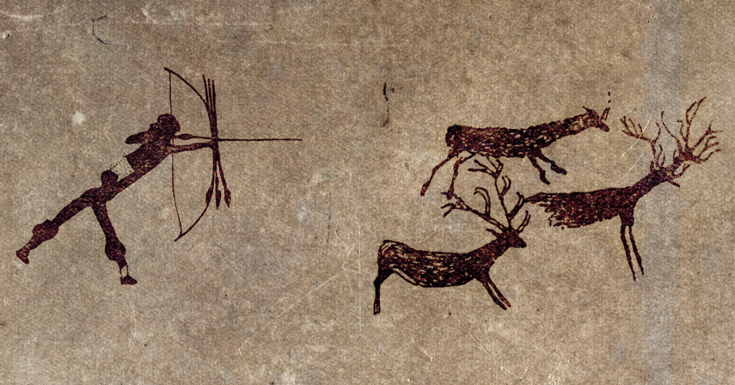
Paintings and Hunting Rituals
Animals were the most common subject matter for the prehistoric cave paintings.
Why? Animals were crucial to the survival of prehistoric peoples.
Prior to going on a hunting mission, there was likely a ceremony "in which an image of the animal was painted on the wall or ceiling above the cave."
Magical idea: Hunters may have believed that "drawing a lifelike picture of an animal [would help them] capture some of the animal's strength and spirit."

Slide 12
Prehistoric Builders
As time passed, prehistoric peoples decided to create more comfortable shelters that were not in caves.
Hunters began using "crude farming tools and shepherds' staffs."
Prehistoric communities evolved into "organized villages surrounded by cornfields and grazing animals."
During the Paleolithic period, it was not uncommon for prehistoric peoples to carve abstract symbols into stone.
Megaliths: They are "large monuments created from huge stone slabs."
Megaliths can be found in Europe, India, Asia, and the Americas.

Slide 13
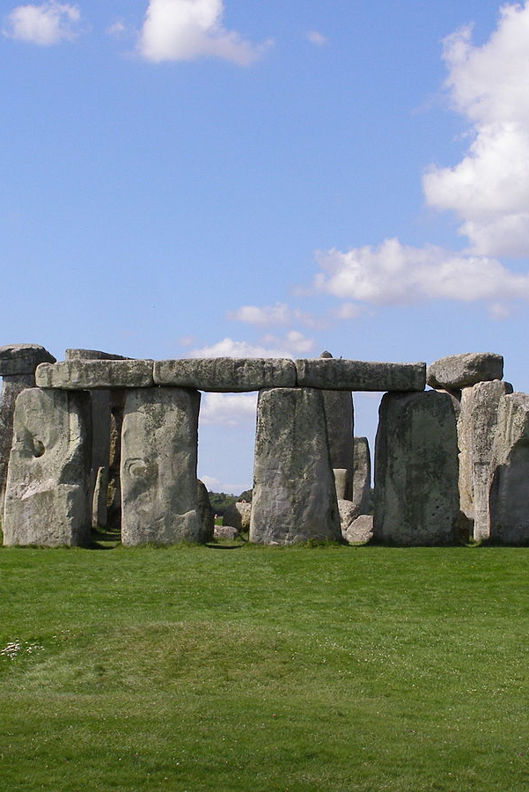
Stonehenge
Beginning in 4000 B.C., people in western Europe began creating arrangements using rough-hewn stones.
Stonehenge is one of the most famous ancient stone arrangements.
It is located in Wiltshire, England.
Stonehenge was likely built in stages starting around 2000 B.C.
Stonehenge consists of "a large ring of stones with three progressively smaller rings within."
It is an example of post-lintel construction.
This is when "massive posts support crossbeams, or lintels."

Slide 14
Discussion
Why do you think Stonehenge was erected?
What feelings or emotions does it evoke?

Slide 15
Sources
Mittler, G. (2006). Art in Focus. McGraw-Hill Companies.
https://edsitement.neh.gov/lesson-plan/cave-art-discovering-prehistoric-humans-through-pictures
https://www.ancient.eu/Lascaux_Cave/
http://www.visual-arts-cork.com/prehistoric/altamira-cave-paintings.htm

