Slide 1
The Elements of Design

Slide 2
What are the elements?
The elements are the things that are involved within making a design.
There are seven elements: line, shape, form, texture, space, value, and colour.

Slide 3
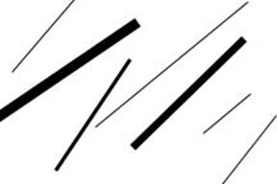
1. Line
Line is the path of a moving point.
Lines define the edges of shapes and forms.

Slide 4
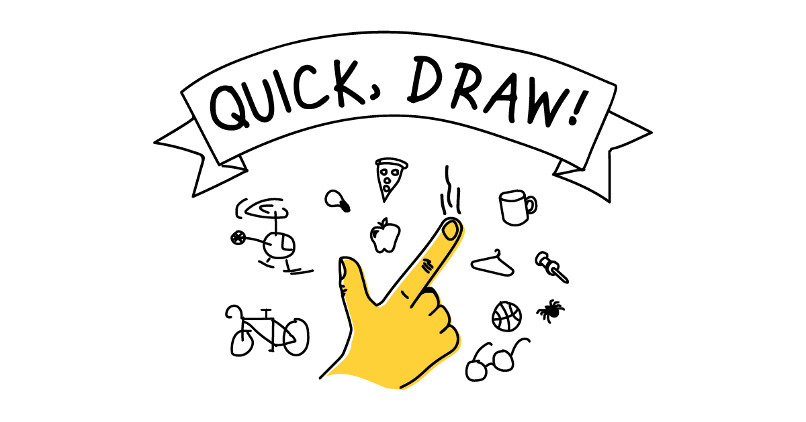
Activity
In your notebook or sketchbook, draw examples of different types of lines.

Slide 5
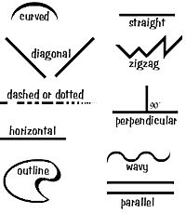
Examples

Slide 6
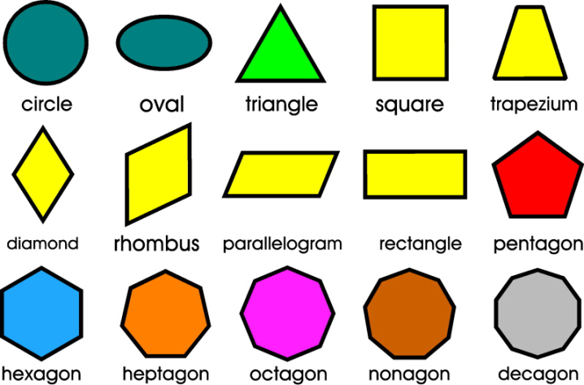
2. Shape
Shape is a closed line.
Shapes can be geometric, like squares and circles; or organic, like free formed shapes or natural shapes.
Shapes are flat and can express length and form.

Slide 7
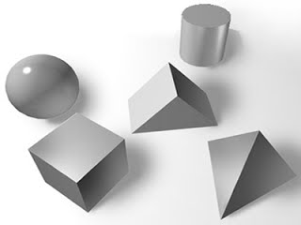
3. Form
Forms are three-dimensional shapes, expressing length, width, and depth.
Balls, cylinders, boxes, and triangles are forms.

Slide 8
4. Texture
Texture is the surface quality of an artwork; how it feels or how it looks like it would feel.
Textures do not always feel the way that they look.

Slide 9
Activity
In your notebook or sketchbook, practice drawing two different types of texture (ex. Soft and rough).

Slide 10
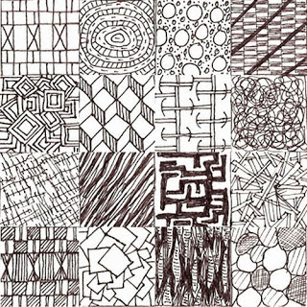
Examples

Slide 11
5. Space
Space is the area between and around objects.
Space can be positive or negative.

Slide 12
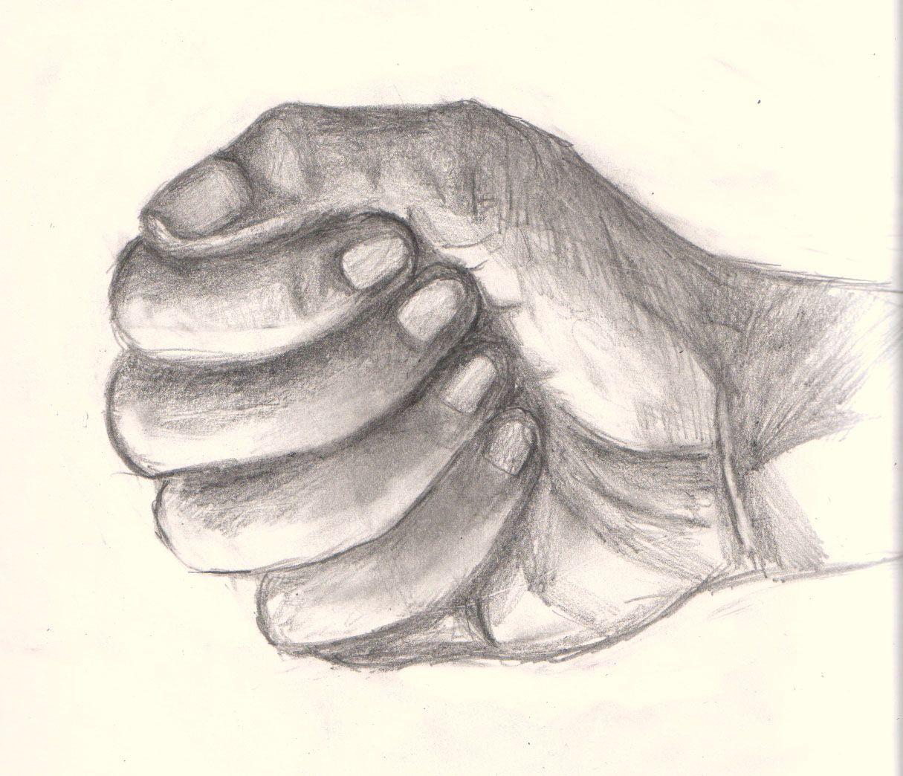
6. Value
Value is the degree of light or dark within an image.
Value is directly related to contrast.
Value helps create form.

Slide 13
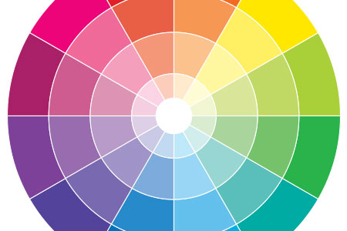
7. Colour
Colour is the use of hue in artwork and design.
It is the most expressive element of art.
Complimentary colours are located opposite to each other on the colour wheel.
Analogous colours are any three colours next to each other on the colour wheel.

Slide 14
Review Video
https://www.youtube.com/watch?v=BwNQkhKg2Ig

