Slide 1
The Principles of Design

Slide 2
What are the principles?
They are the laws of designing anything.
They include: movement, variety, pattern, contrast, emphasis, balance, proportion, unity, and rhythm.

Slide 3

1. Movement
Creating the look and feel of action to guide the viewer’s eyes throughout the work of art.
It can move the viewer’s eyes to a focal point.

Slide 4

2. Variety
It involves combining art elements with slight changes to increase visual interest.

Slide 5

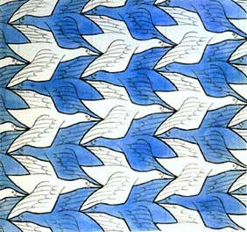
3. Pattern
A regular arrangement of alternated or repeated elements (ex. Shapes, lines, colours, etc.).

Slide 6
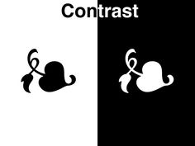
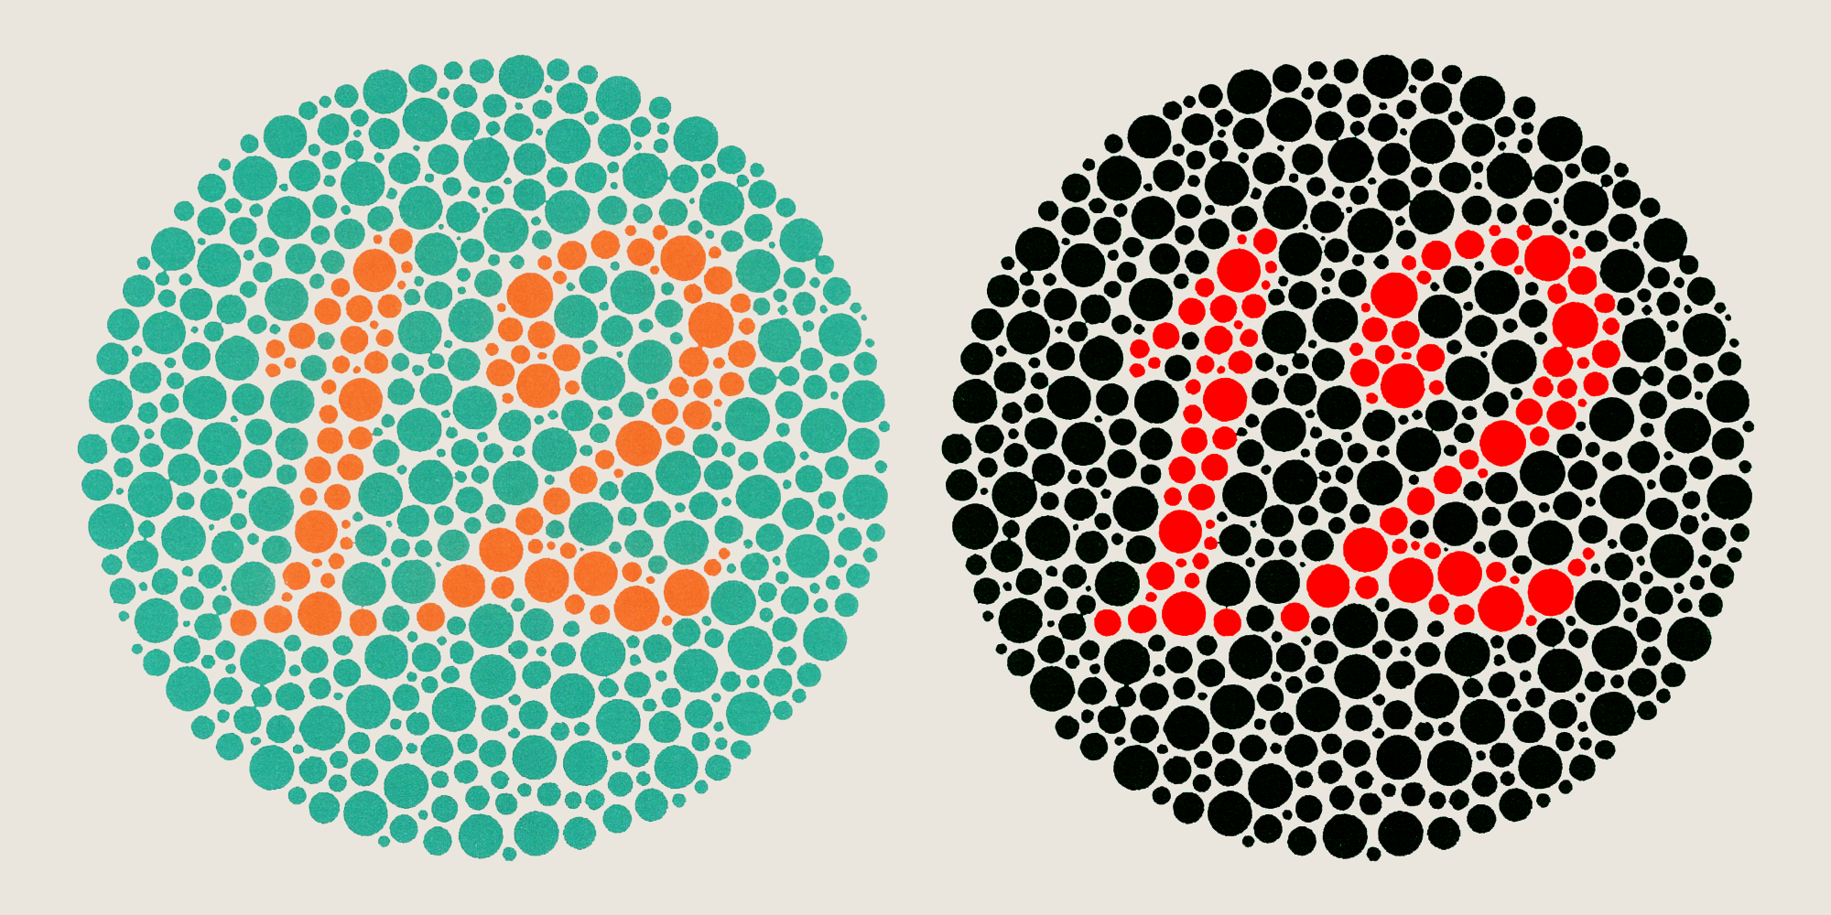
4. Contrast
The juxtaposition of different elements of design (ex. Rough and smooth textures, dark and light values) in order to highlight their differences and/or create visual interest, or a focal point.

Slide 7

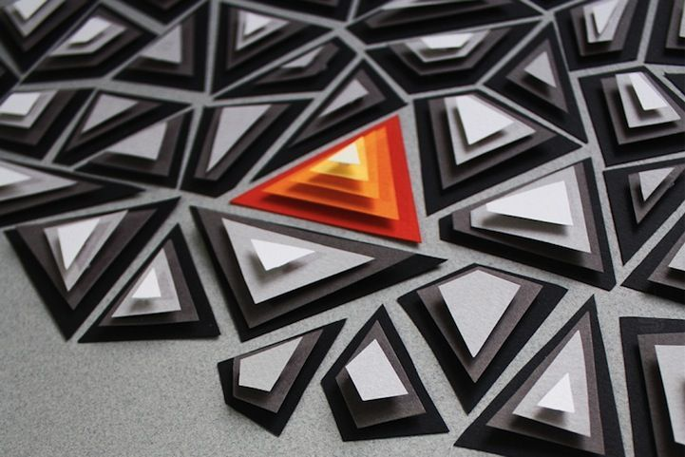
5. Emphasis
Special attention/importance given to one part of a work of art.
Emphasis can be achieved through placement, contrast, colour, size and repetition.

Slide 8


6. Balance
A feeling of balance results when the elements of design are arranged symmetrically or asymmetrically to create the impression of equality in weight or importance.

Slide 9
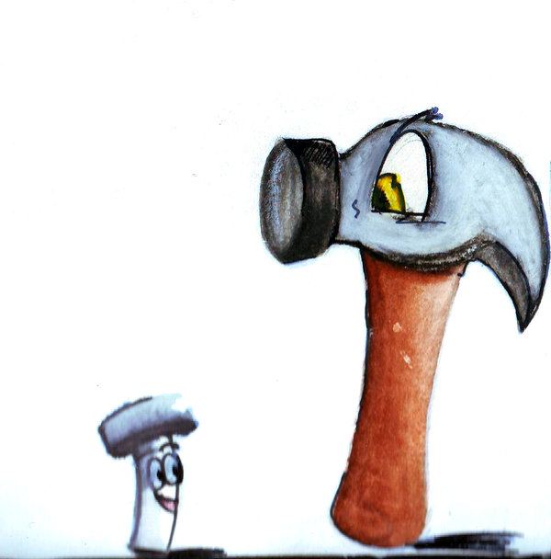
7. Proportion
The relationship between objects with respect to size, number, and so on, including the relationship between parts of a whole.

Slide 10

8. Unity
The arrangement of elements to give the viewer the feeling that all parts of the piece form a coherent whole.

Slide 11


9. Rhythm
Repeating an element of art to make a work seem active or suggest vibration.

