Slide 1
Ancient Greek Art history
Part 1

Slide 2
Instructions
During the lesson, please copy the parts that are bolded.
When you are done copying the note, there is some textbook work you will need to do. Please take out the Art in Focus book at the end of the lesson.

Slide 3
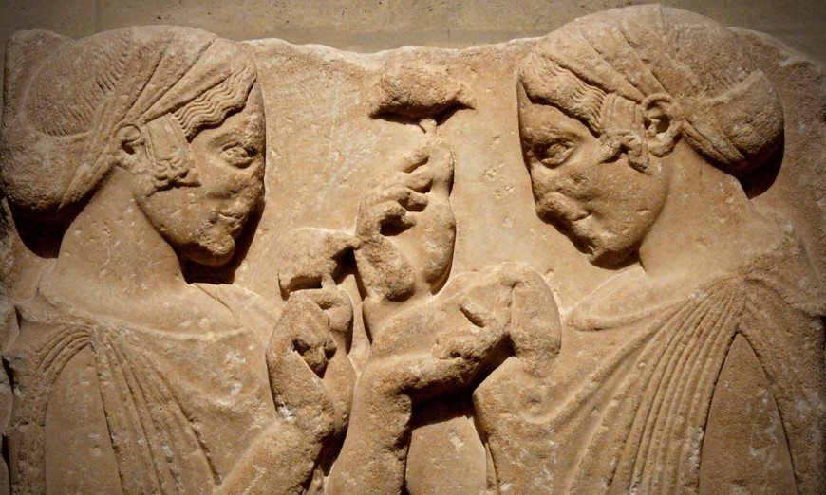
The Birth of greece
Ancient Greece's history began around 2000 B.C.
One of the earliest cultures that became established in Greece was the Mycenaen culture.
As time progressed, the Dorians conquered Greece and the Mycenaean way of life came to an end.
Independent city-states eventually formed in Greece.
The geography of Greece made communication difficult between the city-states.
Local pride and jealously also kept the Greek city-states from becoming a nation.

Slide 4
Joining forces
In anticipation of future invasions by the Persians, a few of the city-states joined forces and created a military alliance known as the Delian League.
Athens, the most powerful city-state, became the head of the Delian League.
Pericles, the Athenian leader, began to use the Delian League's money to rebuild and beautify Athens.
The other members of the alliance were not pleased with Pericles' actions and started a war against Athens in 431 B.C.
Athens initially stood strong during the war.
However, a plague overtook Athens and killed 1/3 of the population, including Pericles.
Power frequently shifted from one city-state to another until 338 B.C. when Greece was conquered by Macedonia.

Slide 5
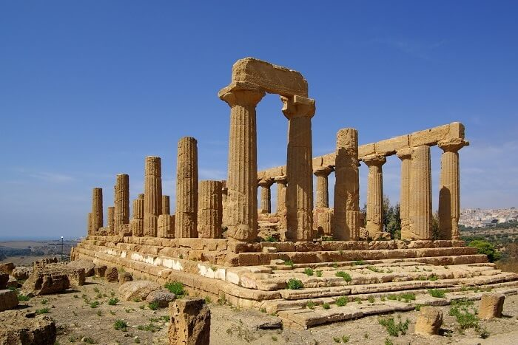
Greek Architecture: The importance of temples
The Ancient Greeks believed that their temples were sacred spaces.
It was commonly believed that gods dwelled within the temples.
From the Greek perspective, it was important to please the gods.
The Greeks believed that the gods directly influenced one's destiny on earth.

Slide 6
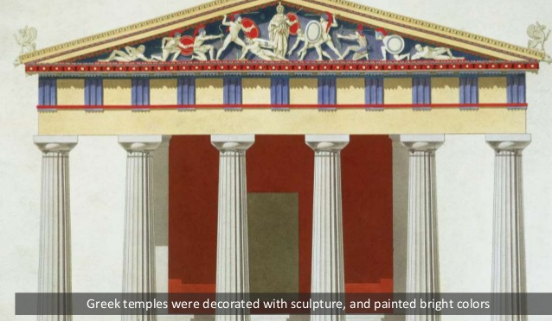
Characteristics of Greek temples
Greek temples were defined by:
Marble
Post-and-lintel construction
Sculptures
The 3-step platform
Bright colours
Blue, red, green, yellow, and gold paint were often used to paint temples.

Slide 7
THE PARTHENON VS THE ACROPOLIS: WHAT'S THE DIFFERENCE?
The Parthenon
It was used as a temple by the Ancient Greeks.
It was built as a dwelling place for Athena, the goddess of wisdom and guardian of the city of Athens.
The Acropolis
It is a mass of rock that rises above the city of Athens, Greece.
The Parthenon is one of the beautiful structures that was built on top of the Acropolis.

Slide 9
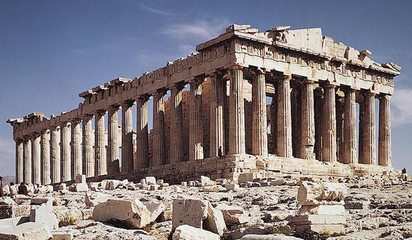
The Parthenon
Discussion: How would you describe the appearance of the Parthenon?

Slide 10
Independent Work
Copy figure 8.7 on page 172.
Read "The Three Orders of Decorative Style" on page 172 & 173 and then summarize each decorative style in your notes.
HW: Create a new decorative style for a pillar. Draw this idea in your sketchbook. You may use pencil or pencil crayon.

Slide 11
Sources
Mittler, G. (2006). Art in Focus. The McGraw-Hill Companies.

