Slide 1
ancient Roman History: Part 1

Slide 2
Think-Pair-Share
What comes to mind when you think of Rome? Discuss this question with your elbow partner(s) and write down any words/ideas that come to mind.

Slide 3
An Overview of Ancient Rome
https://www.khanacademy.org/humanities/world-history/ancient-medieval/roman-empire/v/overview-of-the-roman-empire

Slide 4
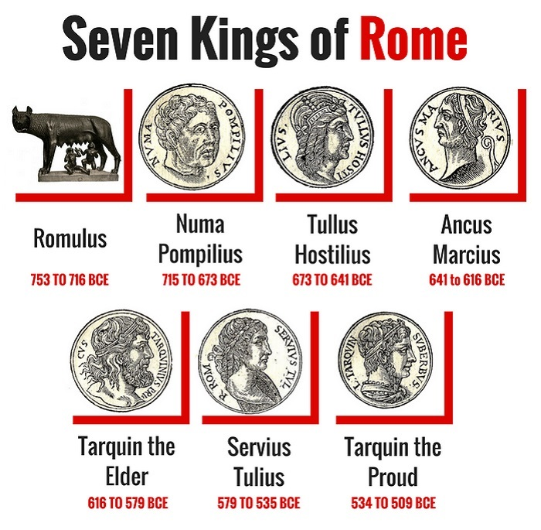
The Rising Power of Rome
Rome increased its power and territory while under the rule of Etruscan kings.
However, the Ancient Romans grew tired of Etruscan rule and turned Rome into a republic in 509 B.C.
A republic is a "form of government in which a state is ruled by representatives of the citizen body."
Rome's autonomy was often threatened by enemy forces.
Despite these threats, Rome managed to "extend its reach and influence until all of Italy was under its control."

Slide 5
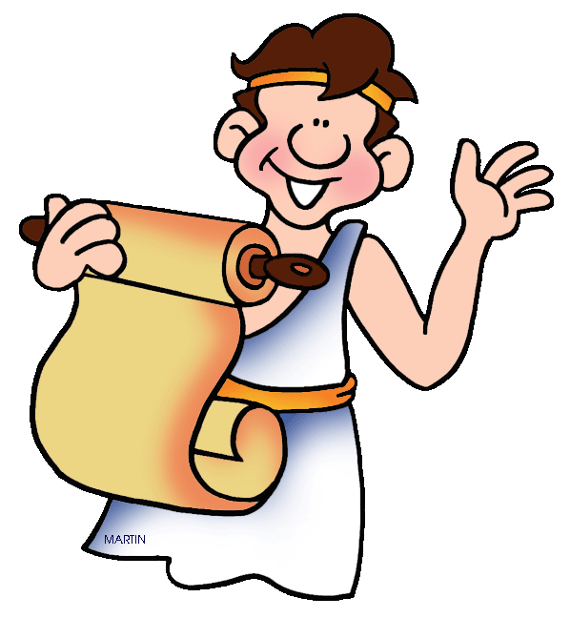
A Greek Influence
There are strong parallels between the art of Ancient Greece and Ancient Rome.
The Ancient Romans respected Greek approaches to art.
The Ancient Romans "imported Greek works by the shipload and even brought Greek artists to Rome to work for them."

Slide 6
Greek vs Roman Sculptures
Greek
Roman
Idealistic portraits
Designed portraits for public monuments
Considered a sculpture of a head or bust (head and shoulders) incomplete
Preferred full body sculptures
Realistic and lifelike portraits
Designed portraits to serve private needs
Reminded viewers of specific individuals
Believed a person's character could be best shown through facial expressions
Head and bust sculptures were common

Slide 7
An Example of a Roman Sculpture
This is a marble portrait of Antoninus Pius, a Roman emperor.
What elements and principles of design do you notice?

Slide 8
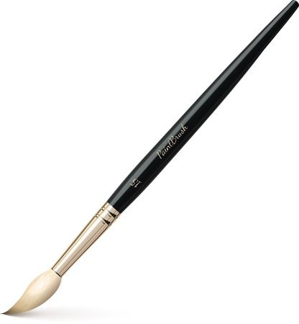
Mural Painting
Wealthy Roman families traditionally did not hang paintings on the walls of their homes.
They would usually hire artists to paint murals in their homes.
Mural: "a large picture painted directly on the wall."
The murals reflected the artists' desire to achieve high realism and showcase the world in a way that made the viewer question whether they were viewing a painting or real scenery.
Landscapes and pictures of buildings were commonly painted.

Slide 9
An Example of a Roman Mural
What stands out to you about the murals in this bedroom from Ancient Rome? Can you identify any of the images on the walls?
It is a Roman bedroom that was preserved by the eruption of the volcano Vesuvius.
The volcano erupted in A.D. 79.
Here are some close-up images of the room:
https://www.metmuseum.org/art/collection/search/247017

Slide 10
Roman Temples
Many temples from Ancient Rome reflect a Greek influence.
For example, both Roman and Greek temples were made using columns.
However, it should be noted that the Greeks used columns as structural supports while the Romans used columns as decoration.
The image on the right is an example of a Roman temple that can be found in Nimes, France. It is called Maison Caree.

Slide 11
The Temple Complex in Palestrina
The Sanctuary of Fortuna Primigenia is another example of a Roman temple that has a Greek influence.
It is located in Palestrina, Italy.
Palestrina "was said to have originated when a peasant found a mysterious tablet in the woods nearby."
The history of Palestrina was apparently written on this tablet even though the town had not been built yet.
A temple (The Sanctuary of Fortuna Primigenia) was eventually built in Palestrina and the tablet was placed inside the temple in a statue of Fortuna.
Fortuna is the goddess of good fortune.

Slide 12
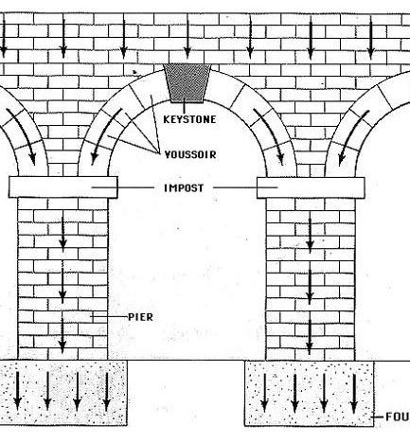
Innovations
Roman builders found innovative ways to construct arches by "holding the stones in place with a wooden form until a keystone could be placed in position."
Keystone: the top stone of an arch.
The Romans also demonstrated innovation when they used concrete.
Concrete allowed the Romans "to construct buildings on a large scale."
Concrete had never been used to the extent that it was in Ancient Rome.

Slide 13
Roman Bridge
This bridge is located in Alcantara, Spain.
It was built in A.D. 105.
Why is this bridge an example of Roman architecture?

Slide 14
Roman Aqueducts
The Roman aqueducts "demonstrate the Romans' ability to combine engineering skills with a knowledge of architectural form."
An aquduct is "a system that carried water from mountain streams into cities by using gravitational flow."
Aqueducts were built through placing a series of arches directly next to each other so they would support each other.
They were built more for practical purposes.
They were not meant to look beautiful.
The Roman aqueduct of Segovia, Spain (right) is seen as "the most important Roman construction in Spain."

Slide 15
Sources
https://www.britannica.com/topic/republic-government
https://www.metmuseum.org/toah/hd/ropo/hd_ropo.htm

