Slide 1
Ancient roman art part 2

Slide 2
Build, build, and build!
The Ancient Roman emperors made building and rebuilding their cities a major focus while they reigned.
These rulers hoped to please their subjects by creating beautiful structures and places for recreation.

Slide 3
The Baths
The Romans built baths in nearly every major city they controlled.
They were not entirely different from our modern-day shopping malls and spas.
The Roman baths were places where one could relax and be cleansed.
However, Roman baths were also "vast enclosed structures that contained libraries, lecture rooms, gymnasiums, shops, restaurants, and pleasant walkways."
A common feature in Roman baths included:
Rooms with pools of progressively cooler water

Slide 4
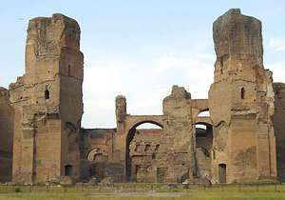
The Baths of Caracalla
The emperor Caracalla commissioned one of the most famous baths in the third century A.D. in Rome.
This bath "sprawled out over 30 acres and had a bathhouse that measured 750 feet by 380 feet."
It also contained a giant central hall that was over 180 feet long and 77 feet wide.
It was made using concrete groin vaults.
A groin vault is "formed when two-barrel vaults meet at right angles."
Groin vaults allowed Roman builders to build over large areas and include windows in their designs.

Slide 5
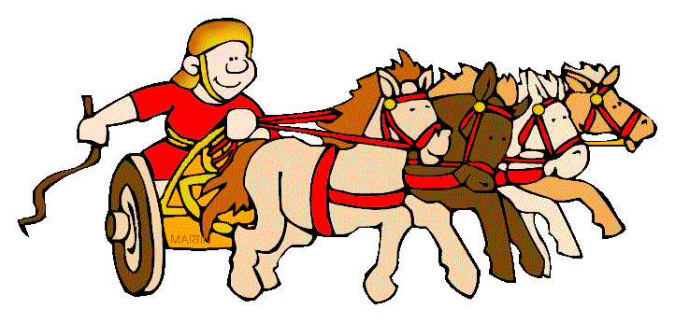
Buildings for Sporting Events
The Ancient Romans enjoyed athletic events.
Chariot races were a very popular spectator sport.
One could expect to see as many as 150, 000 Romans gathering at the Circus Maximus to see their favourite teams.

Slide 6
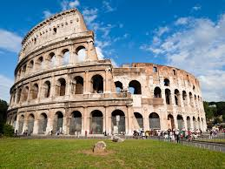
The Colosseum
Armed contests were another popular Roman spectator sport.
These were usually held in large arenas or amphitheatres.
The Colosseum (also known as the Flavian Amphitheatre) was one of the main venues where these armed contests would take place.
It was constructed in the "first century CE under the Roman emperors of the Flavian dynasty: Vespasian (69-79 CE), Titus (79-81 CE) and Domitian (81-96 CE)."
It was named after a "colossal (large) statue of the Roman emperor Nero that once stood nearby."
The Colosseum was made of "locally quarried limestone with internal linking lateral walls of brick, concrete and volcanic stone (tufa)."
Do you see a Greek influence in the design of the Colosseum?

Slide 7
The Colosseum
The best seats in the Colosseum were set aside for the emperor and state officials.
The upper class sat in the second tier.
The general public sat in the upper tiers.
As a safety precaution, a high stone wall was erected to keep the gladiators and wild animals separate from the spectators.
There were areas beneath the floor of the Colosseum which were set aside for machinery, caged animals, and barracks for gladiators.
One major thing that attracted people to the Colosseum was the opportunity to see gladiator fights.
Gladiator: "a person, often a slave or captive, who was armed with a sword or other weapon and compelled to fight to the death in a public arena against another person or a wild animal, for the entertainment of the spectators."

Slide 8
A photo I took of the Colosseum

Slide 9
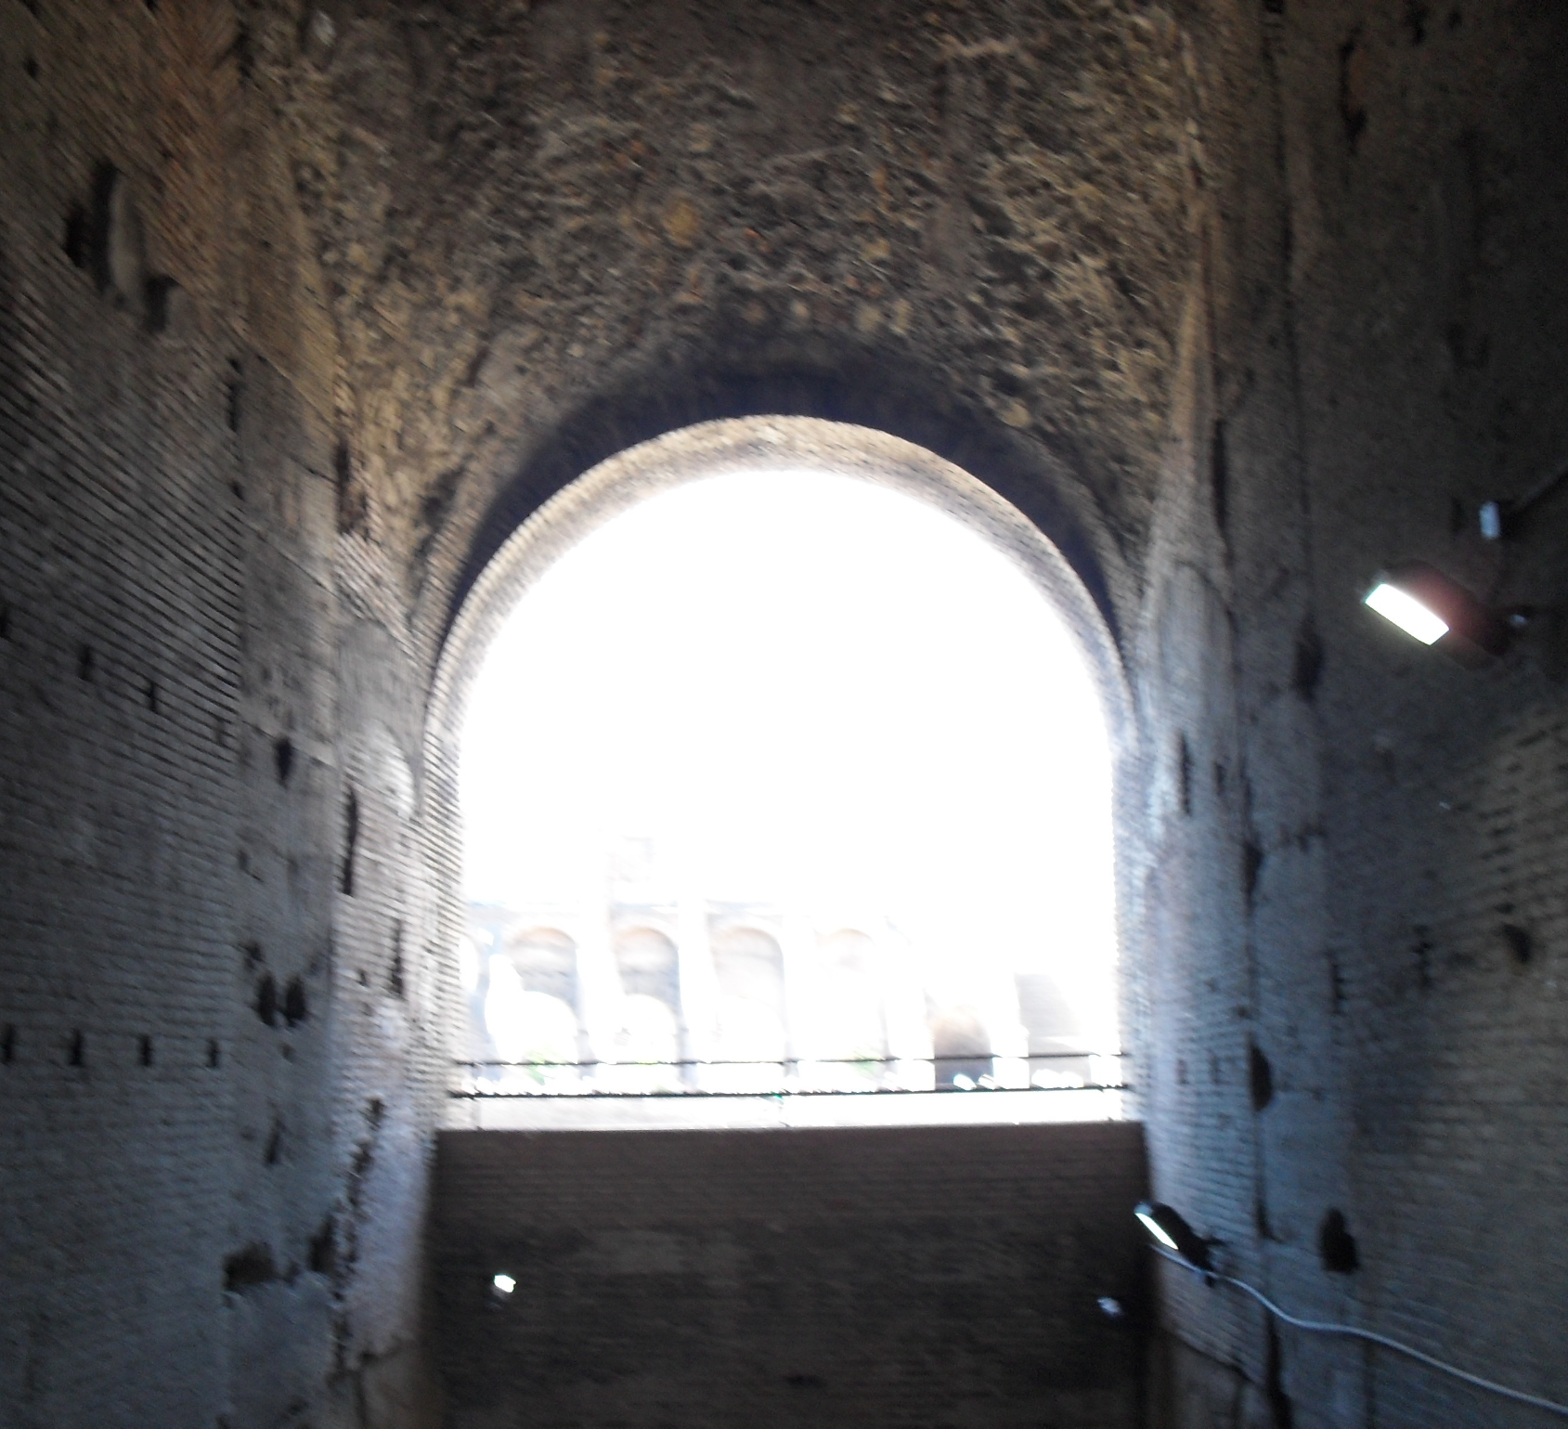
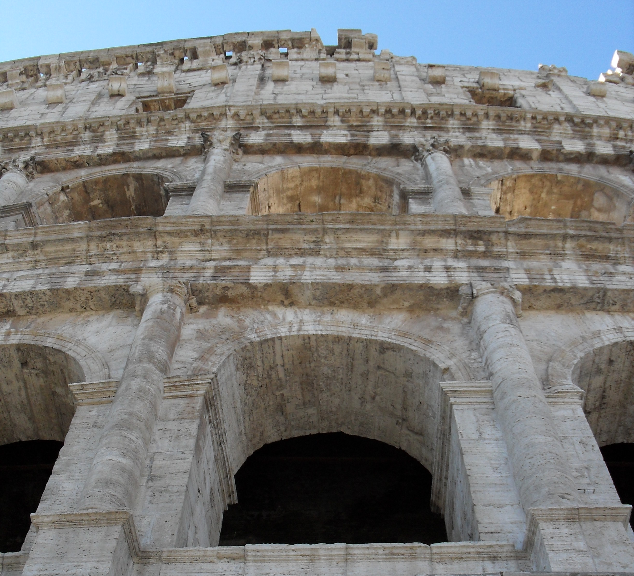
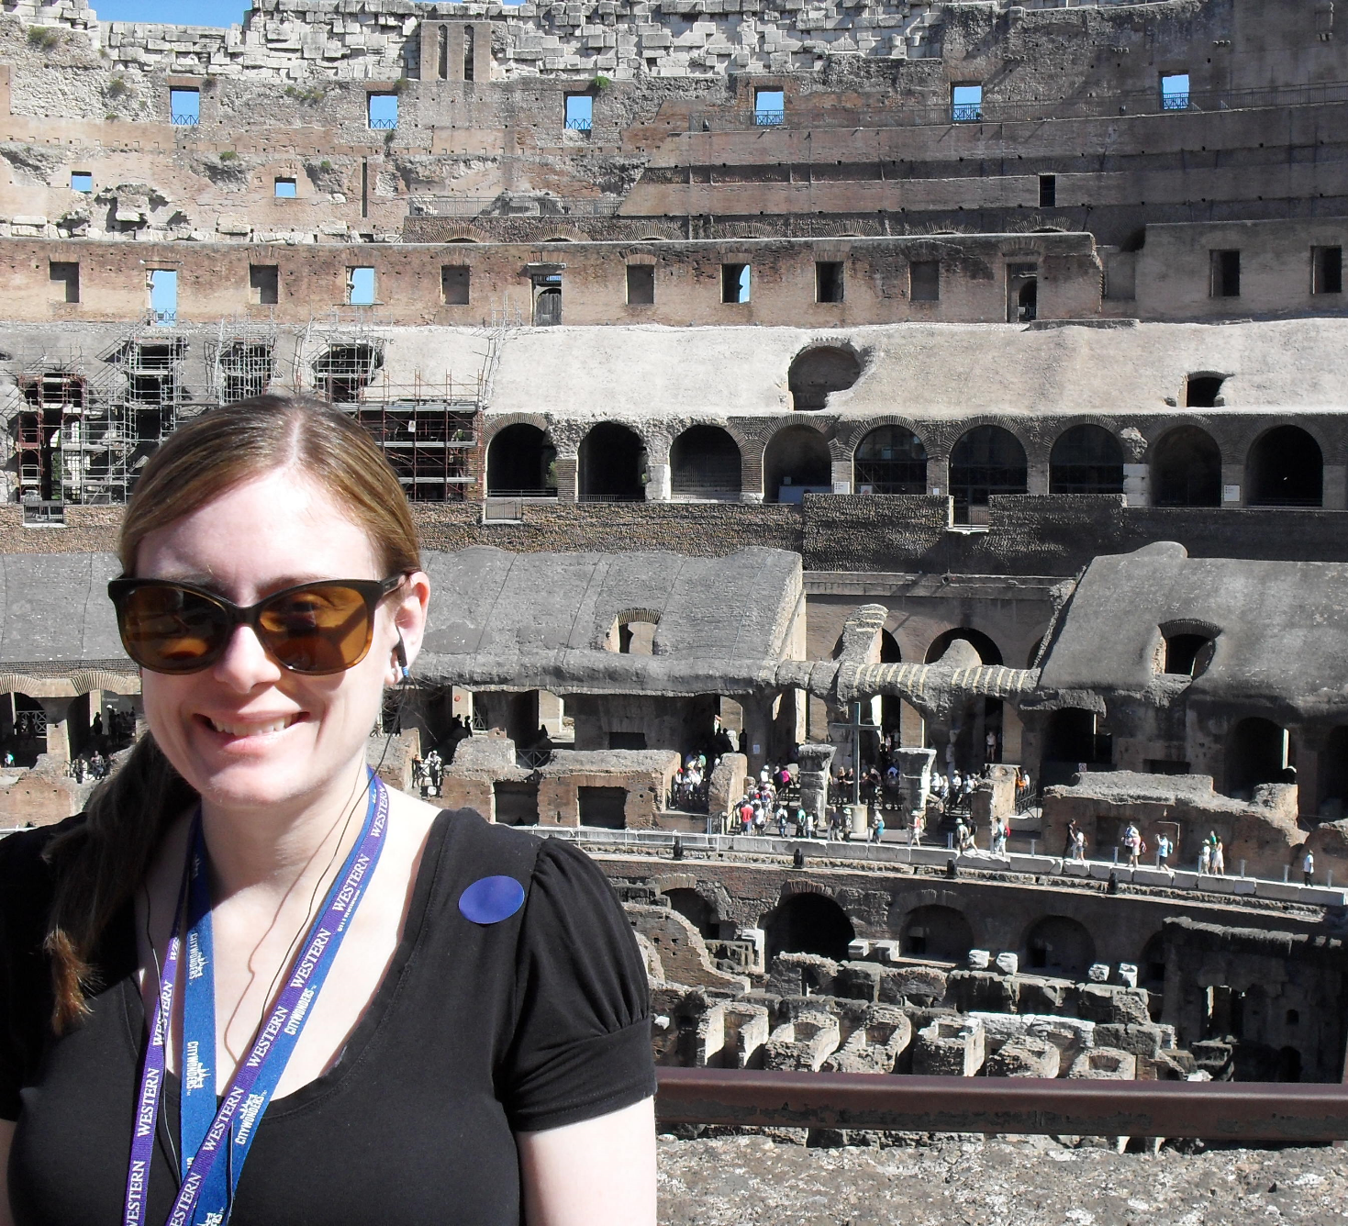
A few of my Photos taken at the Colosseum

Slide 10
Video Clip of the Colosseum – Khan Academy
https://www.khanacademy.org/humanities/ap-art-history/ancient-mediterranean-ap/ap-ancient-rome/v/colosseum-amphitheatrum-flavium-c-70-80-c-e-rome

Slide 11
The Pantheon
The Pantheon is a famous Roman temple.
It was "dedicated to all the Roman gods [and] later converted into a Christian church."
The Pantheon has a large dome made of brick and concrete.
The surface is covered with coffers (indented panels).
The Pantheon is divided into three zones:
Lowest zone: contains 7 recesses in the walls (niches) that may have "contained statues or altars dedicated to the Roman gods of the heavens."
Middle zone: contains the 12 signs of the zodiac.
Highest zone: this is the dome, which likely represents the heavens.

Slide 12
A photo I took of The Pantheon in Rome

Slide 13
Video clip of the Pantheon – Khan Academy
https://www.khanacademy.org/humanities/ap-art-history/ancient-mediterranean-ap/ap-ancient-rome/v/the-pantheon-rome-c-125

Slide 14
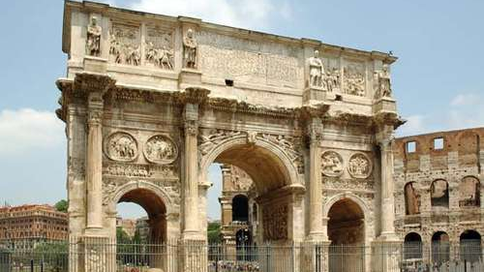
The Arch of Constantine
The Ancient Romans enjoyed constructing monuments to celebrate their successful military campaigns.
Arches were a common feature in these monuments.
The Arch of Constantine "was the largest and most elaborate of the triumphal arches."
Triumphal arch: "a heavily decorated arch."
Constantine was a famous Roman emperor who is most known for declaring Christianity the official religion of the Roman empire.

Slide 15
A photo I took of the Arch of Constantine

Slide 16
The Arch of Constantine
The Arch of Constantine "commemorates Roman Emperor Constantine's victory over the Roman tyrant Maxentius on 28th October 312 CE at the battle of Milvian Bridge in Rome."
This battle put an end to a civil war that had broken out in the Roman empire.
According to historical records, "Constantine was declared emperor at York [in 306], but Maxentius claimed the imperial title in Rome."
Prior to the battle of the Milvian Bridge, "Constantine had a dream: he saw the sun overlain by the figure of the cross. Beneath it was inscribed the simple message in hoc signo vinces, which translates as "In this sign prevail.""
After this dream, Constantine commanded all his troops to paint a cross on their shields.
Constantine saw his dream and victory as a sign from God that Christianity must be the official religion of the Roman Empire.

Slide 18
More Insight into the Arch of Constantine
The monument also pays homage to earlier Roman rulers.
It has been suggested that this monument was Constantine's attempt to link himself to celebrated Roman leaders of the past.
Through "aligning himself with well-regarded emperors of Rome’s 2nd-century C.E. golden age, Constantine was signaling that he intended to model his rule after earlier, successful leaders."

Slide 19
Roman Basilicas
Another notable feature in Ancient Rome: basilicas.
A basilica "was a functional building made to hold large numbers of people."
In Ancient Rome, they were originally designed for more secular purposes (ex. Court of law).
They "served as models for generations of Christian church builders."
They usually had a nave: "a long, wide centre aisle, and two or more narrower side aisles."
They also had a side entrance – a "semicircular area at the end of the nave" called an apse.

Slide 20
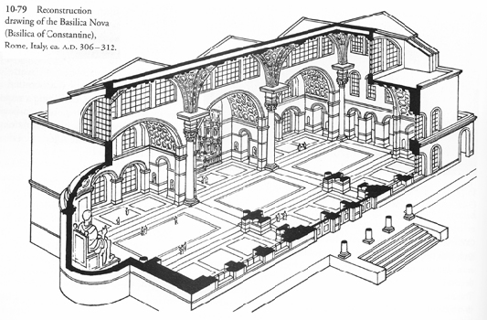

Slide 21
Me checking out the Vatican

Slide 22
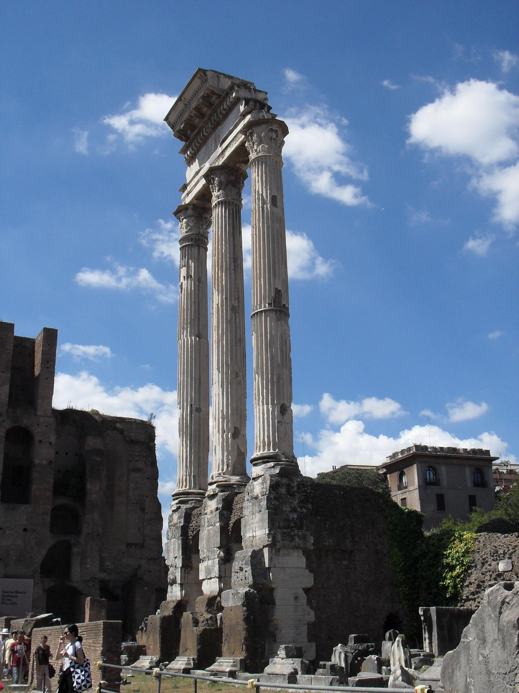
The Ancient Ruins of Rome that I Captured with my Camera

Slide 23
Sources
https://www.ancient.eu/Colosseum/
https://www.dictionary.com/browse/gladiator
https://www.khanacademy.org/humanities/ancient-art-civilizations/roman/late-empire/a/arch-of-constantine
Cartwright, M. (2013). "The Arch of Constantine." Ancient History Encylopedia.
Kerrigan, M. "Battle of Milvian Bridge." Britannica.
Art in Focus. McGraw Hill.

