Slide 1
AVI2O Colour theory

Slide 2
Discussion
Why do you think colour is an important element of design?

Slide 3
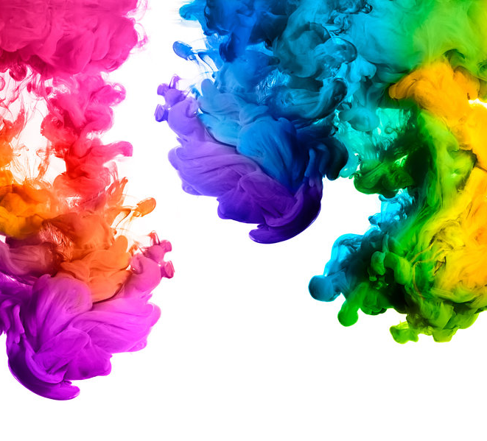
What is Colour?
Colour is the most expressive element of art.
It shares a powerful connection with emotion.
Colour is an element of art that is derived from reflected light.

Slide 4
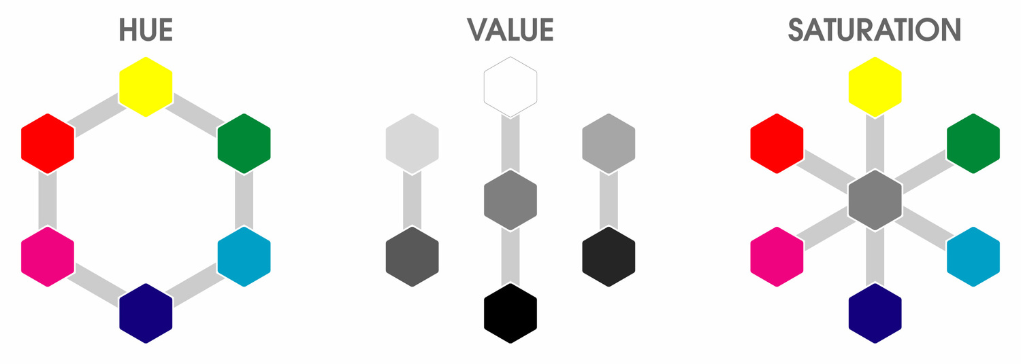
The Properties of Colour
Hue: the name of the colour (ex. Red, yellow, etc.).
Intensity/saturation: the purity and strength of a colour (ex. Bright red).
Value: the lightness or darkness of a colour.

Slide 5
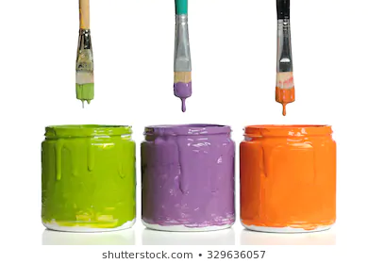
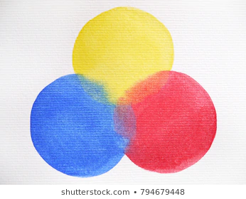
Basic Colour Groups
Primary Colours
Secondary Colours
The primary colours are red, yellow, and blue.
They cannot be made from mixing other hues together.
The secondary colours are orange, green, and violet.

Slide 6
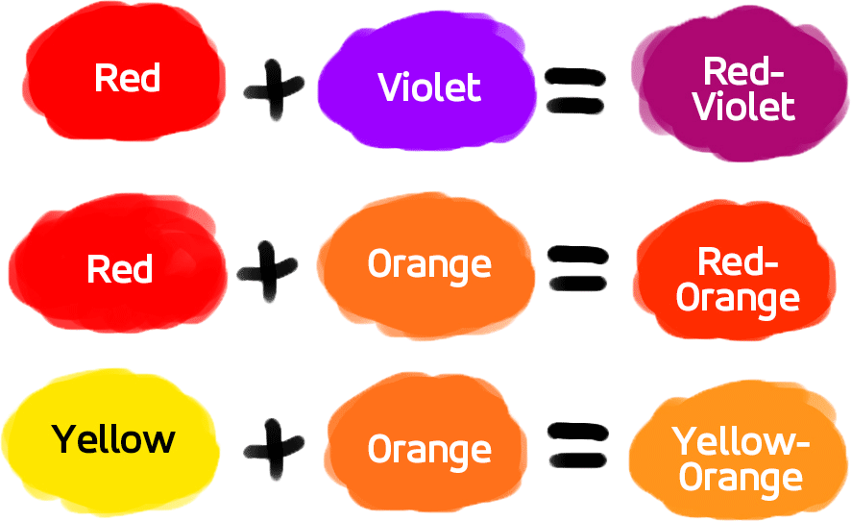
Tertiary colours
Tertiary colours are made by mixing a primary colour with its secondary colour.
Example: Blue + Green = Blue-Green

Slide 7
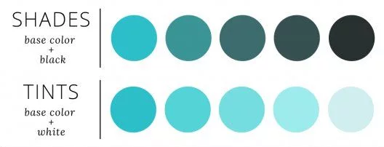
Tints vs shades
Tint
Shade
A light value of a hue is called a tint.
A tint is created by adding white to a colour.
A dark value of a hue is called a shade.
A shade is created by adding black to a colour.

Slide 8
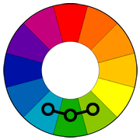
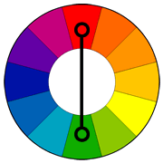
Analogous vs Complementary colours
Analogous Colours
Complementary Colours
This is a colour scheme consisting of any two or more colours that are next to each other on the colour wheel and are closely related.
This is a colour scheme consisting of colours that are directly opposite to each other on the colour wheel.

Slide 9
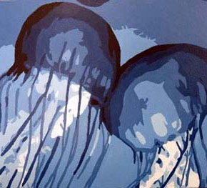
Monochromatic
A monochromatic colour scheme consists of predominately only ONE colour or hue.
It may include the tints and shades of the colour that was used.

Slide 10
Warm Vs Cool Colours: Think-pair-share
With your elbow partner, discuss and answer the following questions:
What colours come to mind when you think of the word "warm"?
What colours come to mind when you think of the word "cool"?
When might an artist would use warm colours?
When might an artist use cool colours?

Slide 11
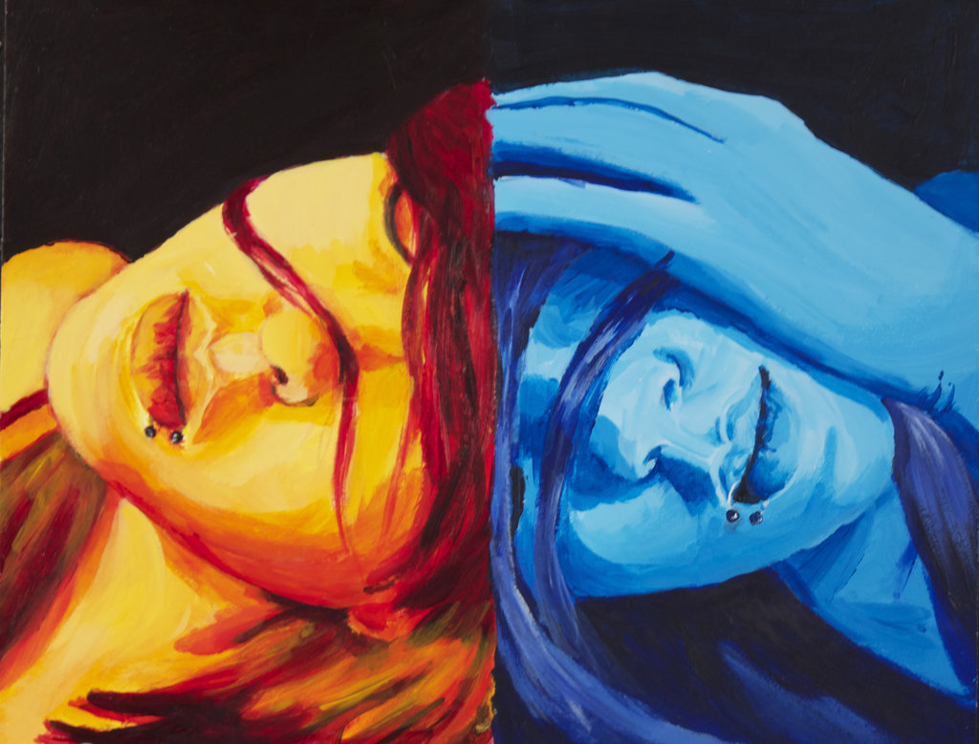
Warm and Cool Colours
Warm colours include red, orange, and yellow.
Cool colours include green, blue, and violet.

