Slide 1
AVI2O Drawing Lesson # 1

Slide 2
Think-pair-share:
In your opinion, what does one need to do or know to create a successful drawing?

Slide 3
Tips for achieving drawing success

Slide 4
Tip # 1: Understand your subject matter
All too often, we make too many assumptions about what our subject matter looks like.
We must take the time to understand the edges, spaces, relationships, shadows, and light that define the person, place, or thing we are drawing.
Drawing is not always as difficult as we imagine it to be.
Truly seeing and understanding our subject matter is where the real challenge lies.

Slide 5
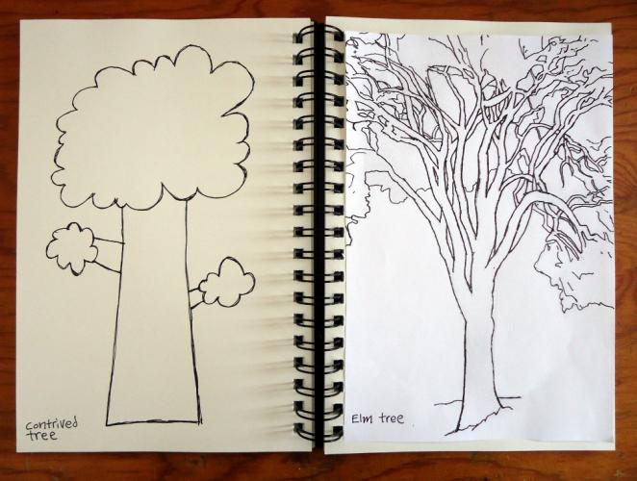

Slide 6
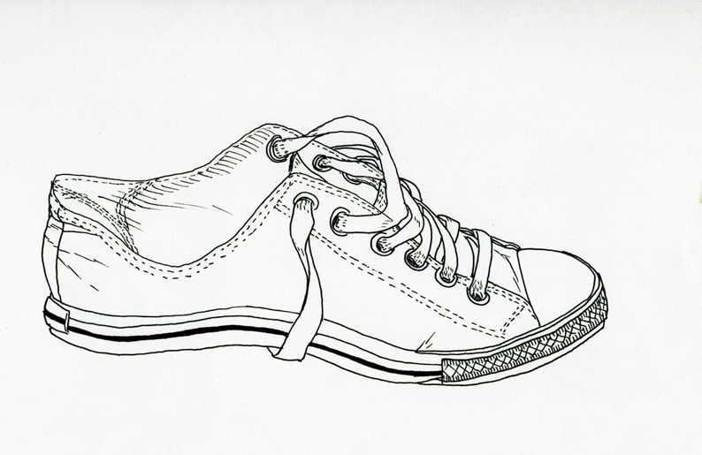
Begin drawing with lines
Completing a simple line or contour drawing of our subject matter is a great way to begin a drawing project.
A contour or line drawing captures the outlines or edges that define the person, place, or thing we are trying to draw.

Slide 7
Activities: contour drawing
1. Create a blind contour drawing of someone else's face. A blind contour drawing involves looking only at your subject matter and NOT at your paper. The result may look silly but it's a good way to develop your perceptual skills.
2. Create a contour drawing of a small, simple object. This time, you can look back and forth, between the object and your paper.

Slide 8
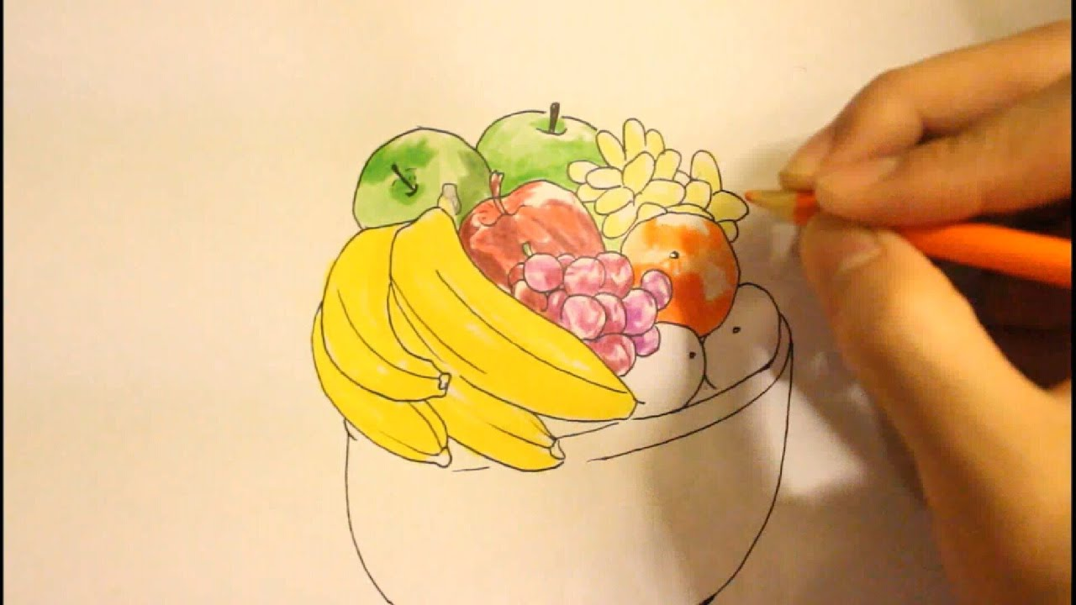
Tip # 2: Draw things that are tangible
A photo does not always reveal enough information about your subject matter.
Whenever possible, draw people, places, and things that are right in front of you.

Slide 9
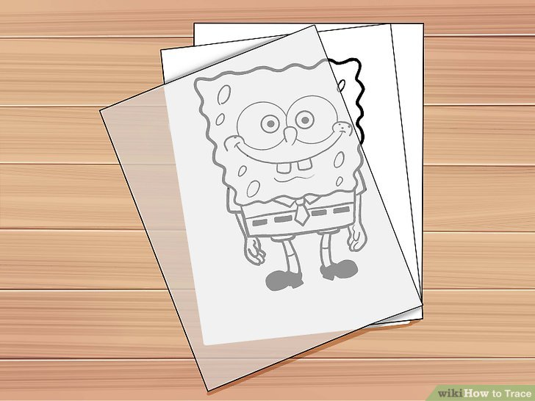
Tip # 3: Avoid tracing whenever possible
When you trace something, you are not truly developing your drawing skills.
You are simply showing you can copy the general outline of something.

Slide 10
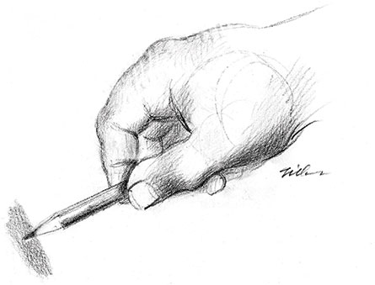
Tip # 4: Pay attention to how you hold your pencil
You do not want to hold your pencil the same way over the course of a drawing project.
You can achieve different effects by holding your pencil at different angles.
For instance, when you are shading, it is helpful to hold your pencil on a side angle.

Slide 11
Tip # 5: Recognize and Use different techniques for creating value
Smooth shading: holding your pencil on its side and softly transitioning between values.
Hatching: creating value through drawing parallel lines.
Cross-hatching: creating value through drawing lines that intersect with each other (lines going in opposite directions).
Stippling: creating value through the use of dots.
Scribbling: creating value through drawing random lines and marks.

Slide 12
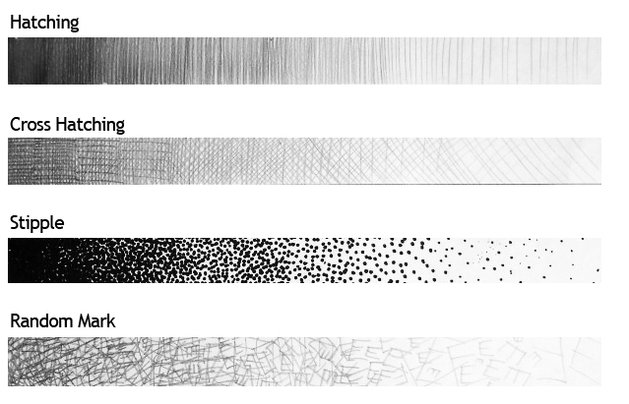
Activities:
1. Create a value scale by smoothly shading with the side of your pencil. Begin by creating a dark value and then fade intensity.
2. Create 4 other value scales, using the techniques displayed on the left (hatching, cross-hatching, stippling, and scribbling).

