Slide 1
Early Medieval art History

Slide 2
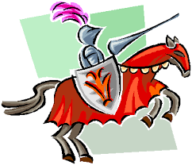
The Three Periods of Medieval History
Medieval history is often divided into three different periods.
These periods include:
1. The Early Medieval Period
2. The Romanesque Period
3. The Gothic Period

Slide 3
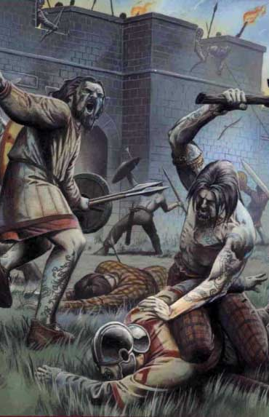
What started the Early Medieval Period?
The fall of Rome is usually closely tied to the beginning of the Early Medieval Period.
The Medieval Period of history is often known as the "Middle Ages" or the "Dark Ages."
It has been called the Dark Ages because it is often thought to have been a bleak period in history.
Despite its reputation, it should be noted that the Medieval Period gave birth to: parliamentary government, common law, present-day languages, modern nation states, and beautiful artistic interpretations of scripture.

Slide 4
A Faith-based Society
During the Middle Ages, many people were dedicated to preserving and achieving the core goals of Christianity.
One goal that was always a priority was preparing for the afterlife.
Achieving eternal life after death was often on peoples' minds.
Most people who lived during this era were members of the Catholic Church.
The Church was expected to be #1 in one's life.

Slide 5
The Carolingian Dynasty
One thing that marked the Medieval Period was the Carolingian Dynasty.
Recall: a dynasty is a period in which a single family provides a succession of rulers.
This dynasty lasted from 750 to 887 C.E.
One of the most celebrated leaders from this period is Charlemagne.
Also known as "Charles the Great," Charlemagne was the first of the Holy Roman Emperors.
He became emperor on Christmas Day in 800 C.E.
Prior to becoming the emperor, Charlemagne was King of the Franks.
The Franks were Germanic peoples from Northern Europe that settled in Gaul (modern-day France).

Slide 6
Charlemagne's Impact
Charlemagne built a large empire that "included all of the Western part of the Roman Empire except Britain, Spain, southern Italy, and France."
Aix-la-Chapelle was the centre and capital of Charlemagne's empire.
Charlemagne made education and the arts priorities.
One of his commands: every monastery had to create a school that provided lessons on arithmetic, grammar, and the psalms.
He welcomed scholars to his court to "rewrite old texts and prepare new ones."

Slide 7
The Carolingian Dynasty after 843

Slide 8
The Rise of Feudalism
One trend that defined the Middles Ages was feudalism.
Feudalism is understood as "a system in which weak noblemen gave up their lands and much of their freedom to more powerful lords in return for protection."
Usually a lord would permit the former owner of the land to continue to live on the land as an administrator.
An administrator was "the servant, or vassal, to the lord."
It is important to note that serfs outnumbered land administrators.
Serfs were "poor peasants who did not have land to give in return for protection."

Slide 9
Medieval Churches and Monasteries
Medieval church builders borrowed ideas and techniques from the Romans.
The Roman civic basilica was the standard model for churches that were built during the Middle Ages.
This type of church was rectangular in shape and "was divided on the inside to form a nave or central aisle and two more side aisles."
One end of the nave was defined by a main entrance and the other end contained a semicircular area called the apse.
An altar was located on the apse "in plain view of the people who assembled in the nave."

Slide 10
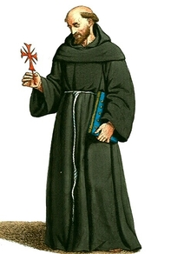
Monasticism
Monasticism is another notable aspect of the Early
Medieval era.
Monasticism "refers to a way of life in which individuals gathered together to spend their days in prayer and self-denial."
Most people who committed their lives to monasticism were monks.
A monk was a devoted religious male who lived in a remote faith community called a monastery.

Slide 11
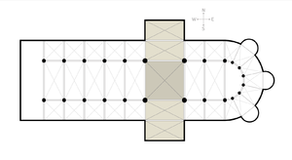
Additions to the Basilica Design
Although the church builders of this era borrowed ideas from the Romans, they had a few new ideas which they implemented.
A transept was added to some churches.
A transept was "another aisle that cut directly across the nave and side aisles."
Transepts helped open up more space in churches.

Slide 12
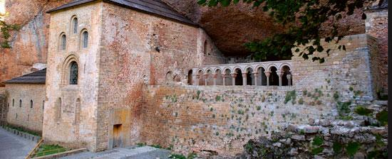
The Monastery of San Juan de la Pena
One of the medieval monasteries that still exists today is the Monastery of San Juan de la Pena.
It is located near Jaca in Spain.
One of interesting parts of this monastery is the cloister.
A cloister is "an open court or garden and the covered walkway surrounding it."

Slide 13
Illuminated Medieval Manuscripts
One form of art that defined the Early Medieval period was manuscript illumination.
Prior to the birth of the printing press, all books had to be copied by hand.
Monks usually had the job of copying books.
Manuscript illuminations were beautiful illustrations and hand-written records of various topics in history.
Manuscripts of the Gospels were often illuminated.

Slide 14
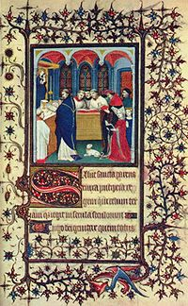
This is an illuminated medieval manuscript.
What stands out to you about this form of art? Pay close attention because you will be creating one on your own!

Slide 15
Sources
www.ducksers.com
Urlhttps://www.britannica.com/topic/Carolingian-dynasty/media/96523/1630
Art in Focus. McGraw Hill.

