Slide 1
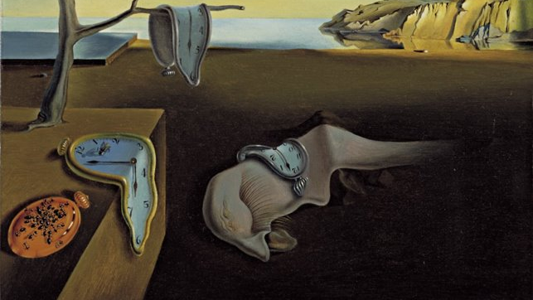
An introduction to surrealism

Slide 2
What was Surrealism?
It was an “artistic, intellectual, and literary movement” between 1924 and 1940.
Andre Breton, a poet, is often viewed as the leader of the Surrealist movement.
Surrealists felt society had become too consumed with logical ideas.
Surrealists were interested in subconscious thoughts.

Slide 3
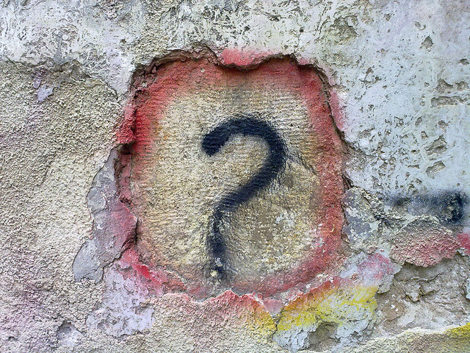
Discussion
Surrealists were interested in our subconscious thoughts.
What does subconscious mean?

Slide 4
The meaning of subconscious
Subconscious refers to "the part of your mind that notices and remembers information when you are not actively trying to do so, and influences your behaviour even though you do not realize it."

Slide 5
Dreams and nightmares
Surrealists were very interested in creating works of art that flowed from dreams and nightmares.
Surrealism grew out of the earlier Dada movement.
Dada artists were frustrated with the beliefs and artistic styles during World War 1 (1914-1918).
Dadaism “sought to expose accepted and often repressive conventions of order and logic by shocking people into self-awareness.”
Key idea: Surrealists did not want people to shy away from their subconscious thoughts and feelings.

Slide 6
Video: Why do we dream?
https://ed.ted.com/lessons/why-do-we-dream-amy-adkins

Slide 7
Breton's surrealist manifesto
In 1924, Breton (Surrealist leader) wrote a manifesto.
A manifesto can be defined as “a public declaration, often political in nature, of a group or individual’s principles, beliefs, and intended courses of action.”
In his Surrealist Manifesto, Breton defined Surrealism as: “Psychic automatism in its pure state, by which one proposes to express…the actual functioning of thought…in the absence of any control exercised by reason, exempt from any aesthetic or moral concern.”

Slide 8
What is automatism?
Automatism can be defined as “the process of writing or creating art without conscious thought. The term was borrowed from physiology, which uses the term to denote involuntary processes that are not under conscious control, such as breathing. The Surrealists later applied to techniques of spontaneous writing, drawing, and painting.”

Slide 9
Source
https://dictionary.cambridge.org/dictionary/english/subconscious
MOMALearning. “Surrealism.” Retrieved from: http://www.moma.org/learn/moma_learning/themes/surrealism

