Slide 1
AVI2O Units of Study

Slide 2
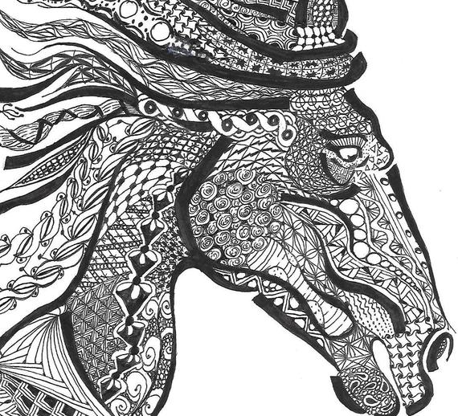
Unit 1: The elements and principles of design
Content: Reviewing the elements and principles of design.
Major task: creating a Zentangle portfolio cover.

Slide 3
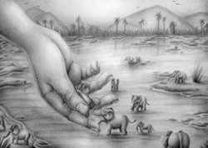
Unit 2: drawing
Content: Reviewing drawing techniques and the perceptual skills required for high realism drawing.
Major task: Creating a Surrealist handscape using graphite pencils.

Slide 4
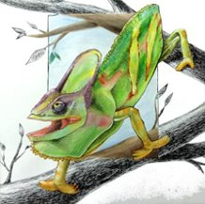
Unit 3: Painting
Content: learning about various watercolour and ink techniques.
Major task: creating an ink and watercolour creature using India ink and watercolour paints.

Slide 5
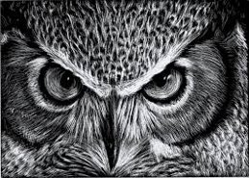
Unit 4: Prehistoric and Ancient Egyptian history & etching
Content: Prehistoric and Ancient Egyptian art and practices.
Major task: creating scratchboard art.

Slide 6
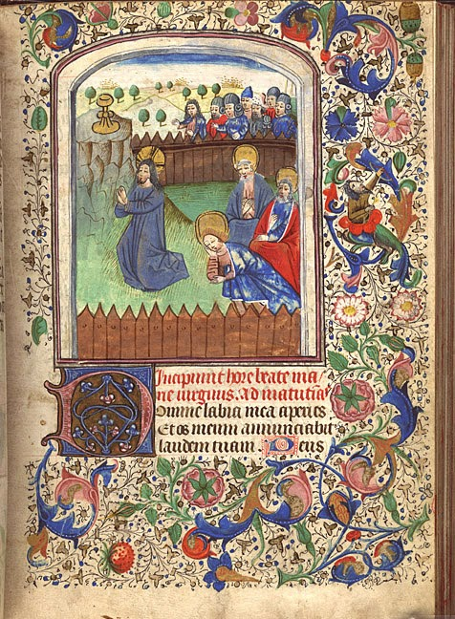
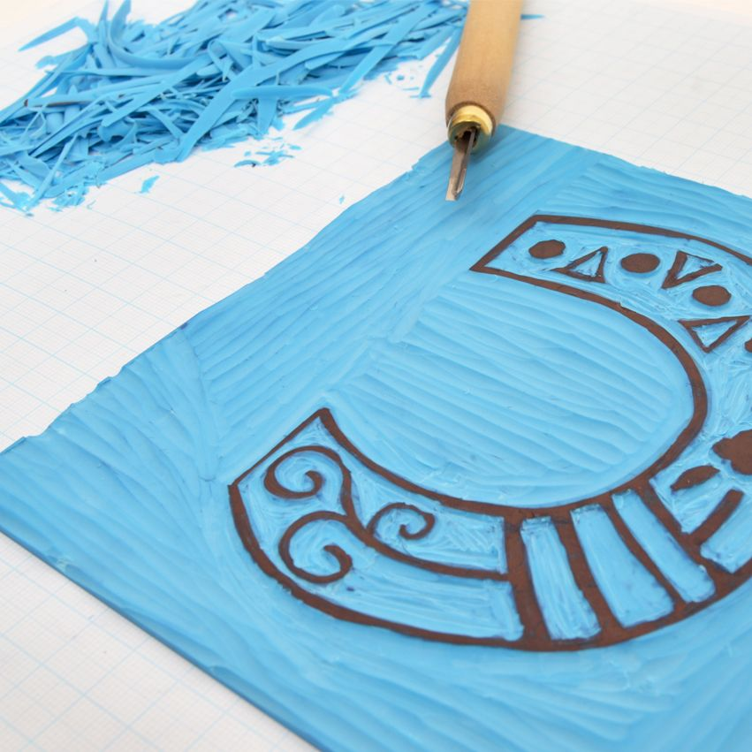
Unit 5: Ancient Greece, Ancient Rome, Medieval Times, & Print making
Content: Ancient Greek, Ancient Roman, and Medieval art and practices.
*Major task: The task is your culminating assignment. It involves creating an illuminated Medieval manuscript. You will learn the art of print making.

