Slide 1
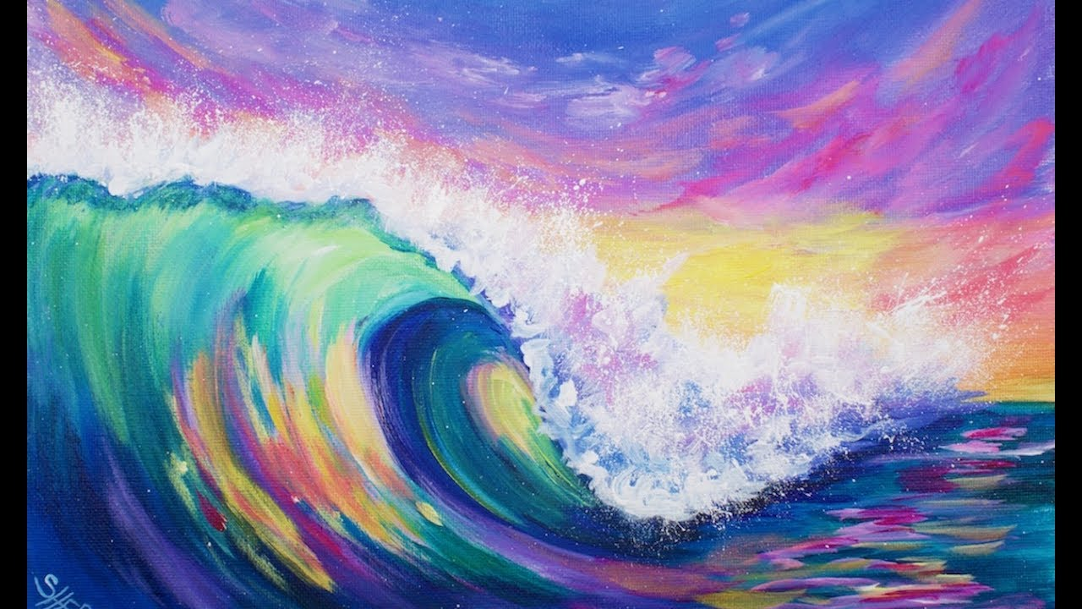
Acrylic Painting techniques

Slide 2
Wet-on-wet
This involves mixing acrylic paint with water until the paint has a similar consistency to watercolour paint.

Slide 3
Paper towel blotting
This involves blotting paper towel over the paint that you have applied to the surface.
It works best if your paint was mixed with water.
It can create interesting textures.

Slide 4
Tissue paper Crumple
This involves crumpling up a piece of white tissue paper, flattening the tissue out, and then gluing it to your surface.
Once the glue has dried, you apply acrylic paint over the tissue.

Slide 5
Impasto
This involves using a palette knife or brush to apply larger amounts of acrylic paint to your surface.
This technique allows the artist to create a sense of depth.
It creates some interesting textures because the knife or brush marks are usually visible.

Slide 6
Sgraffito
After applying paint to your surface, use the end of your paintbrush to draw interesting lines, patterns, or shapes over the paint.

Slide 7
Dry Brushing
This does not involve adding any water to your paintbrush.
You apply paint to your brush and lightly dab or drag the brush/paint on the surface.
It can help you create texture and combine colours.

Slide 8
Sources
https://craftwhack.com/acrylic-painting-techniques-to-try/
https://en.wikipedia.org/wiki/Impasto

