Slide 1
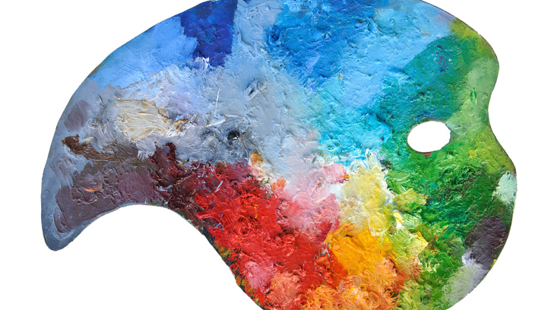
An Overview of the Element of Colour

Slide 2
Why do you think colour is an important element of design?

Slide 3
Why bother with colour?
Colour is one of the most expressive elements of design.
Colour can evoke various emotions and ideas.
Colour can also trigger our senses.

Slide 4
Pigments vs. Hues
Pigment: The colouring material used in making painting and drawing media, dyes, inks, and toners.
Hue: The name of a colour, determined by its position in the spectrum.

Slide 5
What are the properties of colour?
1. Hue: The name of a colour, determined by its position in the spectrum.
2. Value: An element of design that refers to the lightness or darkness of grays and colours.
3. Intensity: The strength, brightness, or purity of a colour.

Slide 6
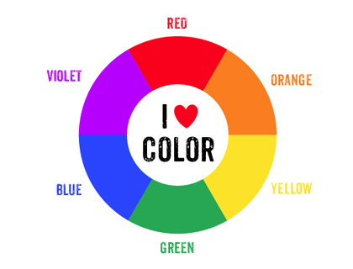
Primary vs. Secondary Colours
Primary colours: They include red, blue, and yellow. All other pigment hues are made by mixing different amounts of these three colours.
Secondary colours: They include orange, purple, and green. They are created by mixing two primary colours.

Slide 7
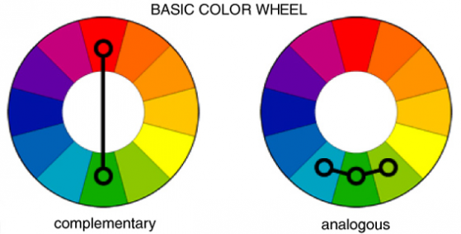
Analogous vs. Complementary Colours
Analogous colours: They are any 3 colours located next to each other on the colour wheel.
Complimentary colours: They are located across from each other on the colour wheel.

Slide 8
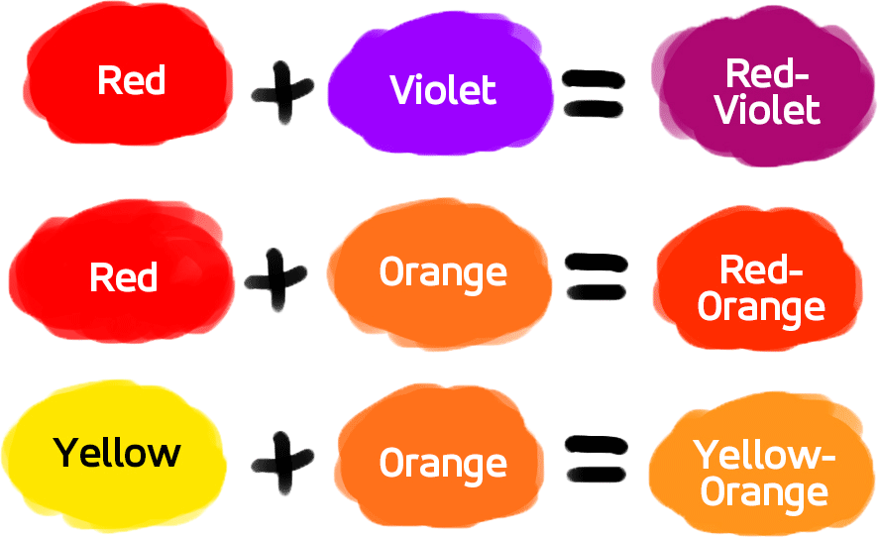
Tertiary Colours
A tertiary colour is achieved when a primary and secondary colour are mixed together.

Slide 9
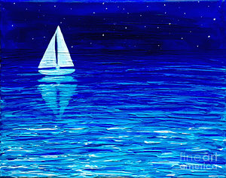
Monochromatic Painting
A monochromatic painting is one made using only one hue, plus black and white.

Slide 10
What things do you associate warm and cool colours with?
Warm colours
These are the hues that range from yellow to red-violet.
Cool colours
These are the hues that range from yellow-green to violet.

Slide 11
Warm Colours

Slide 12
Cool Colours

Slide 13
Source
Gatto, Joseph, et al. Exploring Visual Design. Massachuesetts: Davis Publications, Inc.

