Slide 1
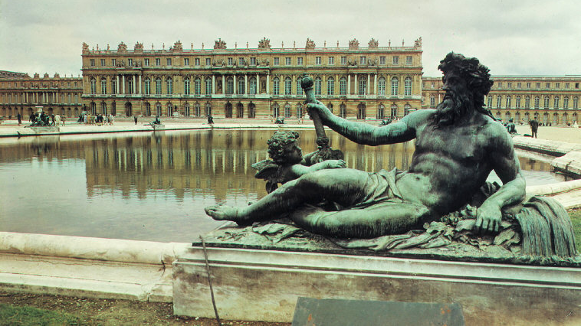
The Baroque period

Slide 2
What characterized the baroque period?
This period in art history occurred between 1600-1730.
The art that was produced during this movement was "characterized by movement, vivid contrast, and emotional intensity."
The Baroque period commenced during the Counter-Reformation.
This was when the Catholic Church was in the midst of cleaning up its image after the Protestant Reformation.
Artists were frequently hired by the Church to "restore the religious spirit and make [Rome] the most beautiful [city] in the Christian world."

Slide 3
What was the counter or Catholic reformation?
https://www.youtube.com/watch?v=wNjLkvVAxO0

Slide 4
How to recognize baroque art- video
https://www.khanacademy.org/humanities/monarchy-enlightenment/baroque-art1/beginners-guide-baroque1/v/how-to-recognize-baroque-art

Slide 5
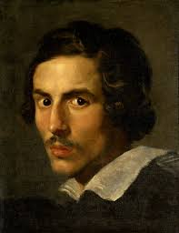
Gianlorenzo Bernini
Gianlorenzo Bernini was one of the most celebrated artists during the Baroque period.
Bernini was born in Naples, Italy and lived between 1598-1680.
He produced a lot of artwork for Pope Gregory XV and Pope Urban VIII.
He was best known for his sculptures, but he was also a "painter, playwright, and costume and theatre designer."
One of his most famous works of art is his sculpture titled, The Ecstasy of St. Theresa.
The sculpture honors St. Theresa, a 16th century Spanish saint.
This sculpture captures "St. Theresa's vision in which an angel pierced her heart with a fire-tipped golden arrow symbolizing God's love."

Slide 6
The Ecstasy of St. Theresa - Bernini, 1645-52
Discussion: What words would you use to describe this sculpture?

Slide 7
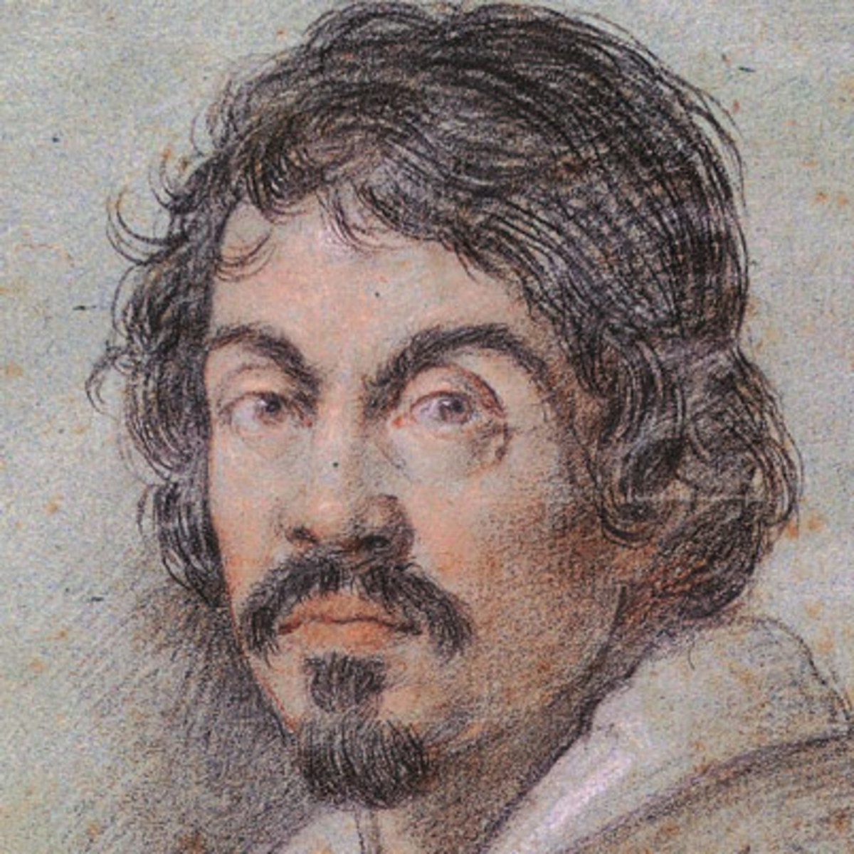
Michelangelo da caravaggio
Another artist who defined the Baroque period was Michelangelo da Caravaggio.
Caravaggio was born in Caravaggio, Italy and lived between 1571-1610.
He was best known for his paintings.
Caravaggio tried to make his subject matter appear as authentic as possible.
He tried to "paint the world around him instead of reworking the subjects of Renaissance artists."
He chose not to draw his artistic concepts first but instead, "took the more direct approach of painting directly onto the canvas."

Slide 8
The Conversion of St. Paul (1601) - Caravaggio
Discussion: Why do you think this painting was controversial when it was released?
Video from Khan Academy:
https://www.khanacademy.org/humanities/monarchy-enlightenment/baroque-art1/baroque-italy/v/caravaggio-saul

Slide 9
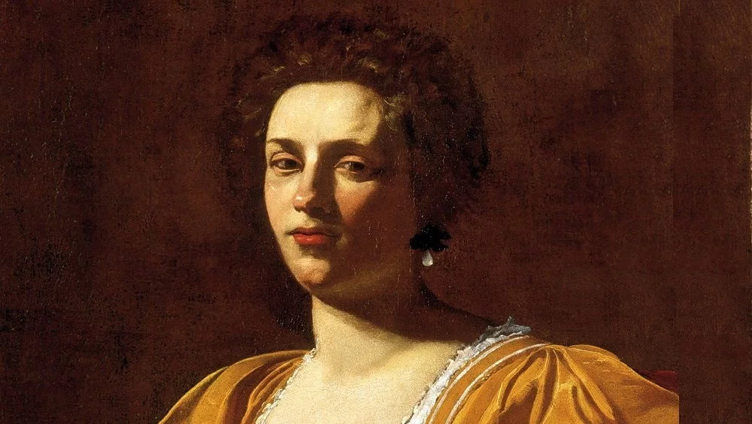
Artemisia Gentileschi
Artemisia Gentileschi was born in Rome and lived between 1593-1653.
Her father was a painter who embraced the Baroque movement.
She was one of the few female artists who garnered significant attention in the Western world.
During her life, women were expected to embrace motherhood or join a religious order.
Gentileschi defied the social norms of her society and received many contracts from wealthy families and prominent leaders.

Slide 10
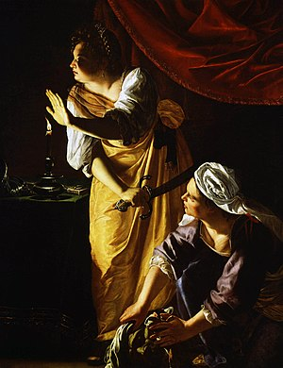
Judith and Maidservant with the head of Holofernes
This painting was completed by Gentileschi in 1625.
It portrays the Biblical story of Judith.
Judith "used her charms to capture the fancy of Holofernes, an important general and an enemy of the Jewish people."
While Holofernes was sleeping, Judith used her knife to decapitate him.
Think-pair-share: What elements and principles of design did she use? How does it tie in with the Baroque style?

Slide 11
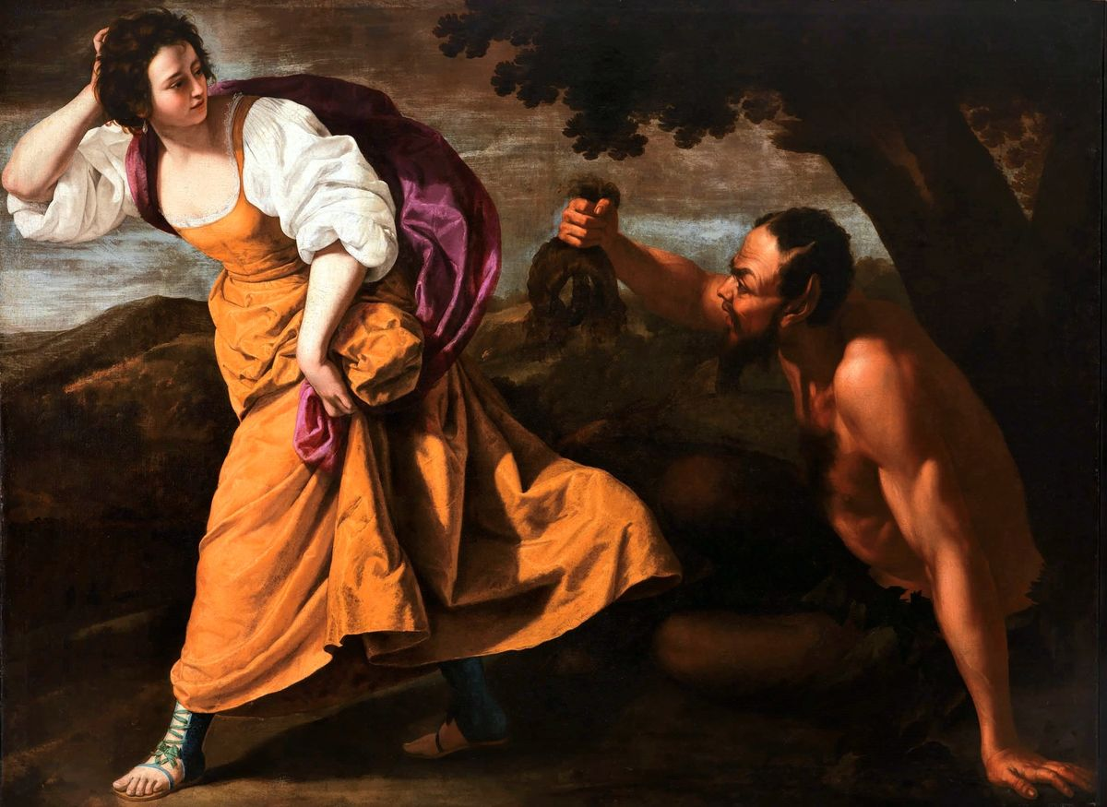
Me too vibes
Gentileschi was sexually assaulted by her painting instructor.
She found the courage to report the crime and the case went to the courts.
The trial lasted 7 months and her instructor was found guilty.
Overall, the "ruling helped preserve Gentileschi’s reputation as an honorable woman and secure a marriage to a Florentine man named Pierantonio Stiattesi."

Slide 12
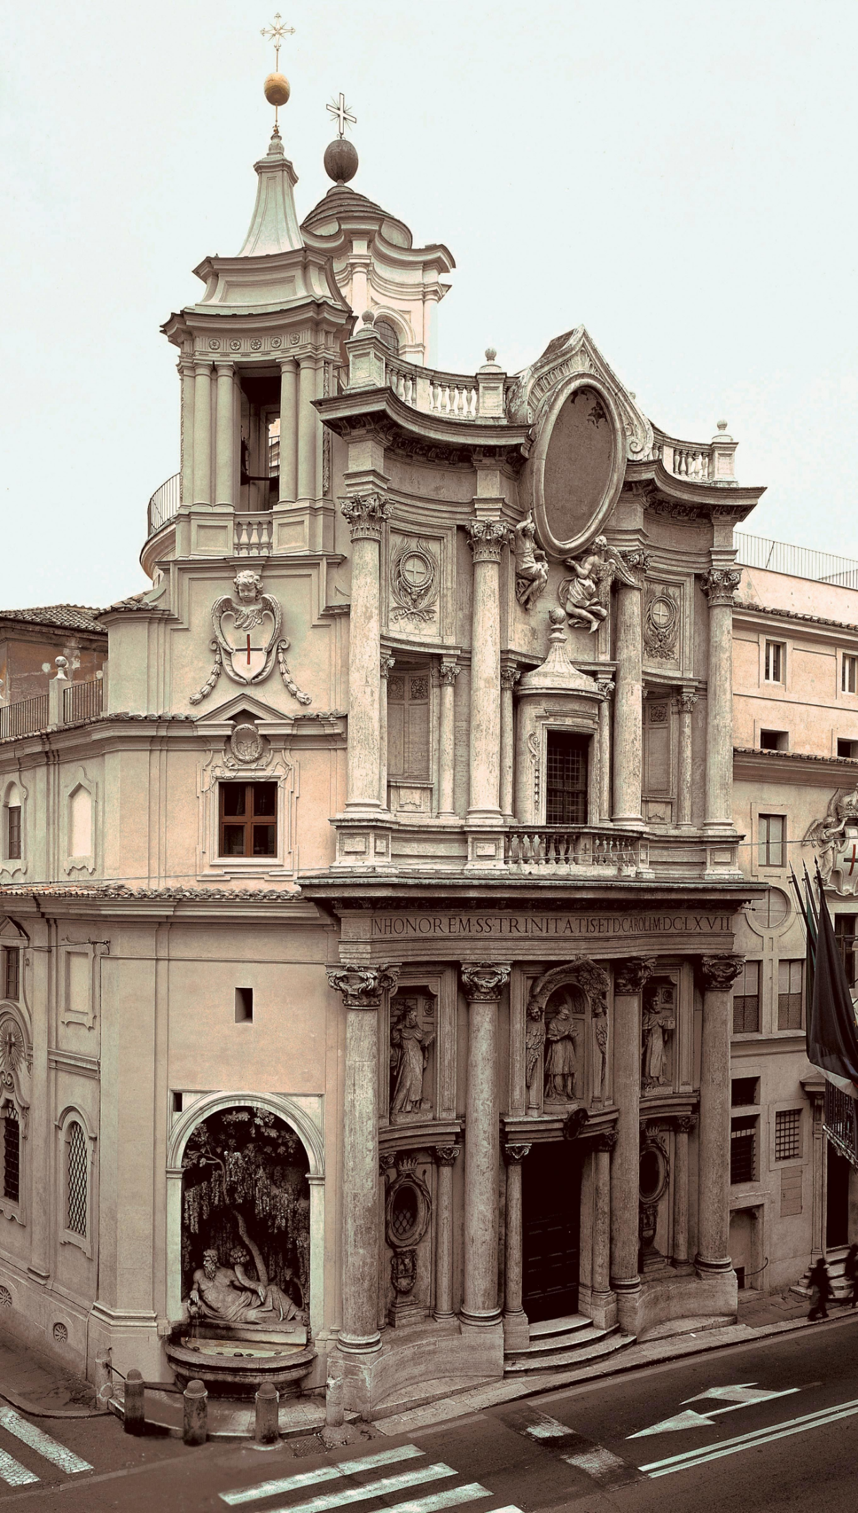
Francesco Borromini
Besides painters and sculptures, the Baroque period also inspired a new generation of architects.
Francesco Borromini was an architect who embraced the Baroque style.
He lived between 1599-1667.
His most famous design was the San Carlo alle Quattro Fontane church (featured on the right).
It is a small Roman church that "seems elastic and pulled out of shape."
Discussion: How would you describe Borromini's style?

Slide 13
Sources
http://smhs.bgcdsb.org/our_school/school_directory/mr__arnett_s_courses/avi3m_-_grade_11_visual_arts
https://www.artsy.net/article/artsy-editorial-baroque-master-artemisia-gentileschi
Mittler, G. (2006). Art in Focus. McGraw-Hill.

