Slide 1
Clay Techniques

Slide 2
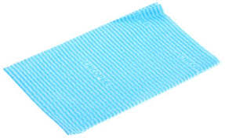
How to protect your clay
Keep clay that you are not working with covered with a DAMP J-cloth or paper towel.
To add water, dip your two fingers into water and rub your hands together. This is enough water. Too much will make your clay slimy and will cause it to lose its strength and stability.
At the end of each class: remember to wrap all clay in a damp J-cloth or paper towel and place it in a plastic bag with no holes.

Slide 3
Step 1 for BUilding a clay Gargoyle
Build 2 pinch pots that have the same diameter.
They can be different heights; this is not a concern.
They should be at least 1cm in width, but not exceed 1.5 cm.
The following slides explain and show how to build a pinch pot.

Slide 4
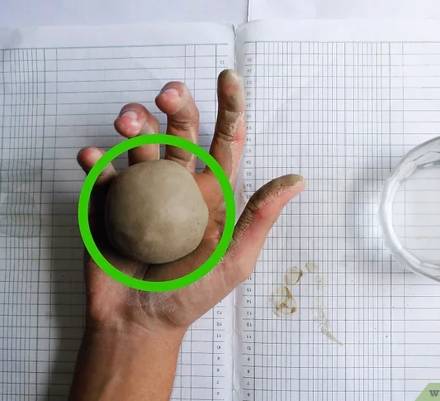
Creating Your pinchpot:
1. Use your palms to mold a ball.
*Wiki how tip: "Make sure you don’t create pockets in the surface of the ball by pressing with your fingers."

Slide 5
Creating an opening for your pinch pot
2.Create an opening in your pinch pot.
Gently push your thumb or finger into the centre of the ball.
Make sure the width is the same on all sides – consistency is important.
https://www.wikihow.com/video/5/55/Make%20a%20Pinch%20Pot%20Step%205%20Version%204.360p.mp4

Slide 6
Pinch pot Video
https://www.youtube.com/watch?v=KjhnLu36j4A

Slide 7
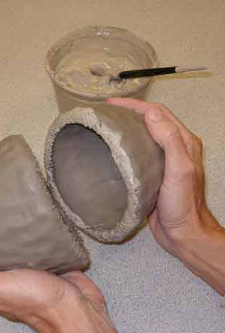
Step 2 for building a clay gargoyle
Attach the two pots together by the “slip and score” method.
Give them a “wiggle” to help them to stick.
“Marry” the clay together with your fingers or a wooden tool so the seam is not visible.
It is incredibly important to always REMEMBER where your seam is since this is the weak point of your sphere.
NEVER lay the sphere on its seam. This will cause the sphere to crack—a crack that cannot be repaired.

Slide 8
Slip and Score videos
https://www.youtube.com/watch?v=2FmELXN0W_M
https://www.youtube.com/watch?v=MYcqtiCwK5c

Slide 9
Step 3 for Building a clay gargoyle
Cut out a hole in the bottom, large enough for you to use a wooden tool to marry the clay together on the inside.
This will create a stronger bond for your sphere.

Slide 10
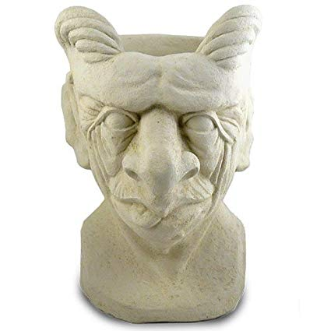
Step 4 for building a clay gargoyle
Using the rolling pin and slats (1 cm thickness) to roll out a slab for the neck.
Use a piece long enough to create a neck wide enough to hold the base of the sphere.
Bevel cut the edges to create a clean joint. Slip and score together.
You may wish to make the neck angled (taller at the back) so it allows the sphere to fit in more “naturally”.
Let this “set up” before attaching the head, otherwise the neck will collapse.
Sometimes it is helpful to stuff the neck with newspaper to help stabilize the structure. The newspaper can stay in the sculpture the entire time you are working on it.

Slide 11
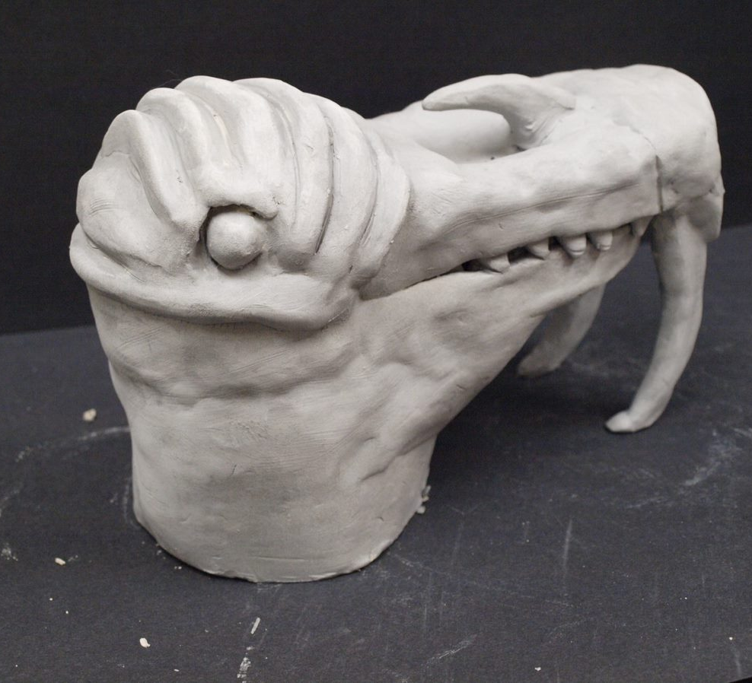
Step 5 for building a clay gargoyle
Now comes the creative part! Using different clay methods- pinch, coil and slab – create all the features.
For example, you may use a pinch pot to create the muzzle or snout of a lion, tiger, or dog. You may use a slab to create a beak. You may use a slab construction to create the ears or a horn. You may use the coil construction method to create the brow or ridges of the forehead and eyes. This is where you need to be creative.

Slide 12
The coil technique
https://www.youtube.com/watch?v=fanYZJM48As

Slide 13
One caution
Be careful not to get too thick with your clay.
You may have to hollow out sections before attaching them to the head.
DO NOT ALLOW ANY AIR POCKETS TO EXIST! If you have any of these, your piece will blow up in the kiln.
Worst case scenario, you take out someone else’s gargoyle with yours!
Therefore, when attaching hollow horns, be sure to use a needle tool to put in a small hole into the air pocket to release air. Just a small hole will do it!

