Slide 1
Getting familiar with faces

Slide 2
Your tasks:
You will be completing some simple drawing exercises in preparation for the photorealism project.
Your first task is to view the following images of the human face and then draw the outline of each face in your sketchbook or notebook.
Next, write down what type of face shape you think you have drawn for each facial outline.

Slide 3
Face # 1

Slide 4
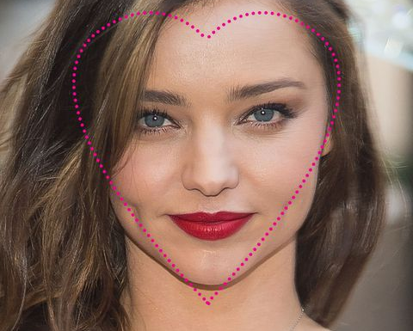
Answer for face #1:
Heart

Slide 5
Face # 2

Slide 6
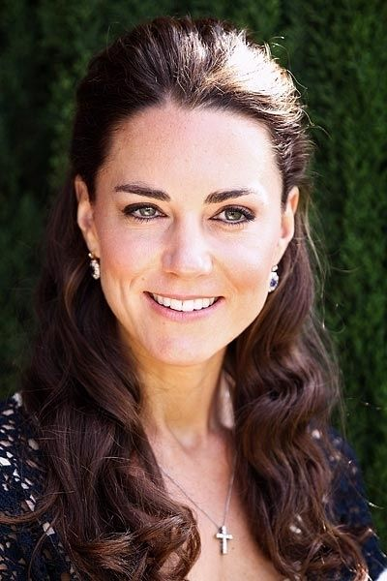
Answer for Face # 2
Oval

Slide 7
Face # 3

Slide 8
Answer for face # 3
Square

Slide 9
Face # 4

Slide 10
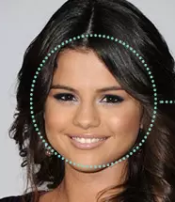
Answer for face # 4
Round

Slide 11
Face # 5

Slide 12
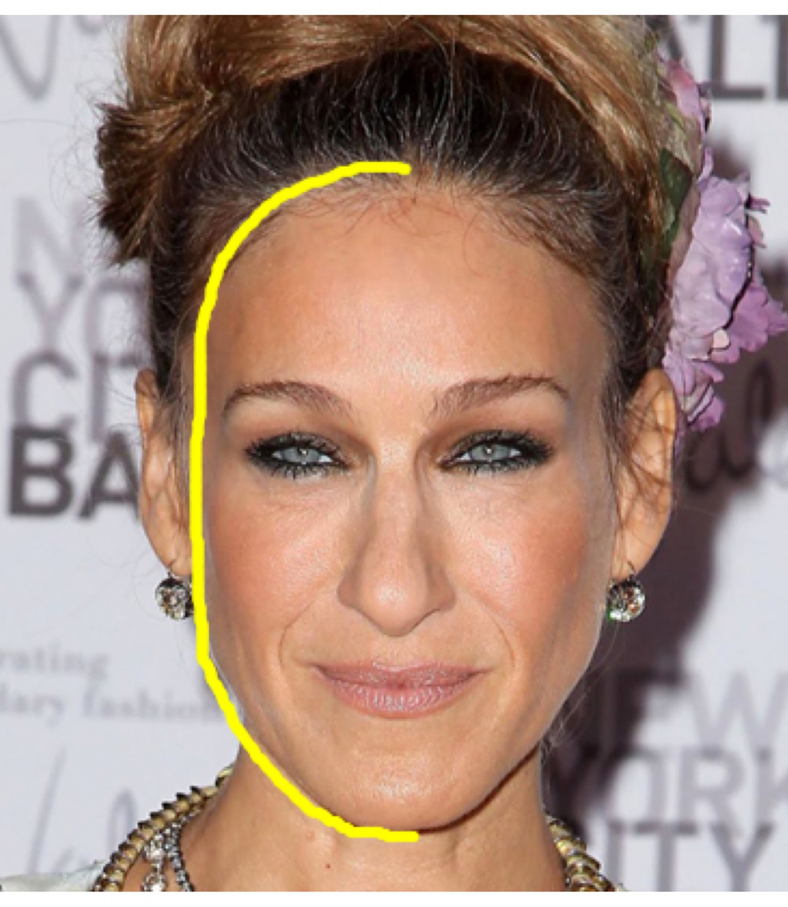
Answer for Face # 5
Oblong

