Slide 1
Romanticism

Slide 2
Think-Pair-Share:
What does it mean to call something romantic?
Discuss this question with your elbow partner.
Write down any ideas that come to mind.

Slide 3
Activity
I am going to read you a series of Romanticism statements.
If you agree with a statement, move to the "agree" side of the classroom.
If you disagree with a statement, move to the "disagree" side of the classroom.

Slide 4
Statement 1
The answers to life's most puzzling questions can be found through discussions with a simple person who lives in the country close to nature – not with a sophisticated, well-educated person from the city.

Slide 5
Statement 2
The answer to life's most puzzling questions can be found through a connection with nature.

Slide 6
Statement 3
The use of one's imagination is more important than rational thought.

Slide 7
Statement 4
Subjectivity is more important than objectivity.

Slide 8
Statement 5
Knowledge is gained through gut reactions and subjective hunches rather than level-headed, objective, deductive thought.

Slide 9
Statement 6
Nature is more important than art.

Slide 10
Statement 7
Experimental trial and error is a better process than the conventional scientific method.

Slide 11
Statement 8
Poetry should be spontaneous and full of emotion, not planned and straightforward.

Slide 12
Statement 9
Sensitivity, feelings, and spontaneity are more important than intellectualism.

Slide 13
Statement 10
"Dare to be" is a better battle-cry than "dare to know."

Slide 14
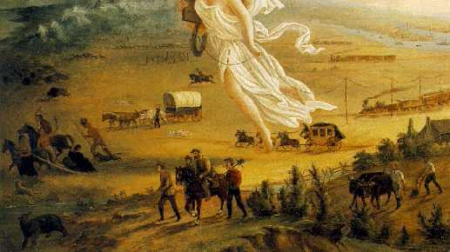
Characteristics of Romanticism

Slide 15
1. An interest in the common man and childhood
Romantics believed in the natural goodness of humans which is hindered by the urban life of civilization.
They believed that the savage is noble, childhood is good, and the emotions inspired by both beliefs causes the heart to soar.

Slide 16
2. Strong senses, emotions, and feelings
Romantics believed that knowledge is gained through intuition rather than deduction.
This is best summed up by Wordsworth who stated that "all good poetry is the spontaneous overflow of powerful feelings."

Slide 17
3. Awe of nature
Romantics stressed the awe of nature in art and language and the experience of sublimity through a connection with nature.
Romantics rejected the rationalization of nature by previous thinkers of the Enlightenment period.

Slide 18
4. Celebration of the Individual
Romantics often elevated the achievements of the misunderstood, heroic individual outcast.

Slide 19
5. Importance of imagination
Romantics legitimized the individual imagination as a critical authority.

Slide 20
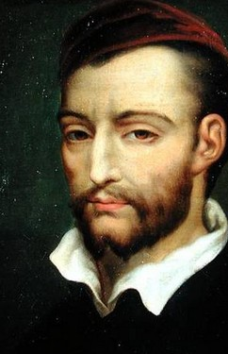
Theodore Gericault
Gericault was a French artist who lived between 1792 and 1824.
His painting, The Raft of The Medusa, helped trigger the birth of Romanticism.
The painting depicts the plight of the passengers and crew of the ill-fated French ship Medusa in 1816.
According to historical records, "when the French ship Medusa was wrecked, 149 passengers and crew members tried to reach safety on a large raft towed by officers aboard a lifeboat. Only 15 men on the raft survived, and claims were made that the officers had cut the raft adrift."

Slide 21
The Raft of the Medusa
What images do you see in Gericault's painting?
What do you think Gericault's purpose was in depicting this event?
What do you like about the painting? Why?

Slide 22
Eugene Delacroix
Delacroix became the leader of the romantic movement after Gericault died suddenly at the age of 33.
Delacroix was a French painter who lived between 1798 – 1863.
His style was marked by "glowing colours and swirling action."
One of his best-known works of art is The Lion Hunt.
"A six month trip through Morocco, Tangier, and Algiers in 1832, fired up his enthusiasm for the Near East and provided the inspiration and subject matter for many of his works, including The Lion Hunt."

Slide 23
The Lion Hunt – 1860-1861
Why do you think this is a Romantic painting?
What words would you use to describe this piece?

Slide 24
Sources
Mittler, G. (2006). Art in Focus. McGraw-Hill.
Read-Write-Think. (2008). "Characteristics of Romanticism."

