Slide 1
The early renaissance

Slide 2
Think-Pair-Share:
What comes to mind when you think of the Renaissance?
With your elbow partner, write down any words or names that come to mind.

Slide 3
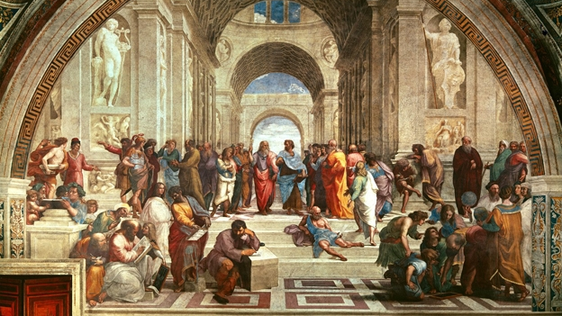
What was the Early Renaissance?
This was a period of art that originated in Florence, Italy in the 15th century and then expanded to other parts of Europe.
The term 'Renaissance' means 'rebirth.'
Areas of focus: human beings, the human environment, science, mathematics, and philosophy.
Religion was no longer the main source of inspiration for artists.
Artists were interested in "creating works that mirrored the people, places, and events of the real world."

Slide 4
Advancements during the early renaissance

Slide 5
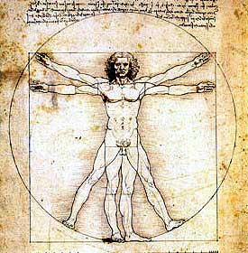
The Growth of Humanism
During the Early Renaissance, many artists and intellectuals were drawn to Humanism.
It was based on ideologies that were popular during ancient Greece and Rome.
Humanism was "a philosophical way of thinking [that involved] placing Man at the center of all things, with less importance on God."
Humanism also "led to a close study of the human figure and a return to the nude."

Slide 6
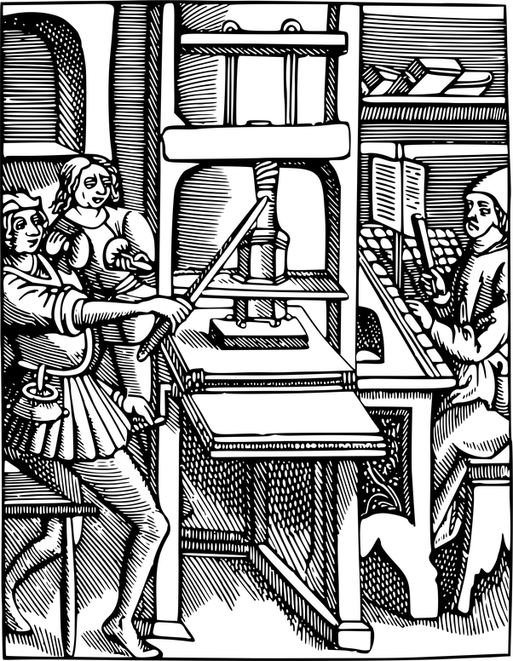
The Evolution of the Printing Press
In the mid-15th century, a German man named Johannes Gutenberg perfected the printing press.
This played a key role in advancing the Early Renaissance.
It gave people greater access to the works of "ancient Greek and Roman writers, religious books, and volumes of poetry and prose."

Slide 7
The Birth of Linear Perspective
Linear perspective was discovered by an architect by the name of Filippo Brunelleschi.
Linear perspective is "a graphic system that showed artists how to create the illusion of depth and volume on a flat surface."
It gave artists the opportunity to "paint figures and objects so that they seem to move deeper into a work of art rather than across it."

Slide 8
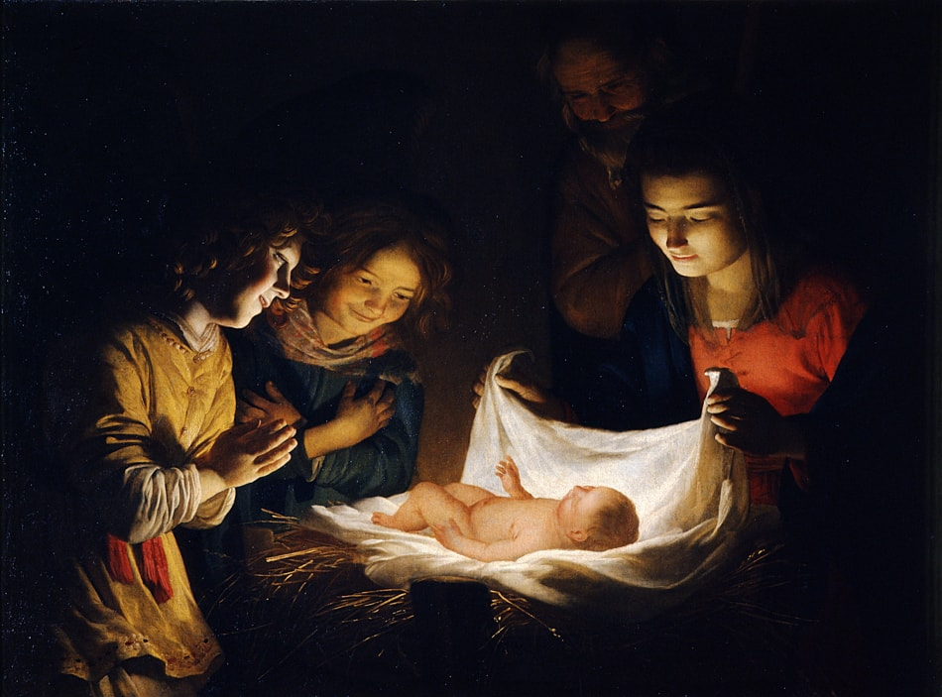
Chiaroscuro
In Italian, chiaro means "bright" and scuro means "dark."
Chiaroscuro is "the arrangement of dramatic contrasts of light and dark value."
This style became popular during the Early Renaissance.
“The Adoration of the Child” by Gerard van Honthorst [Public domain], via Wikimedia Commons

Slide 9
Historical events during the early renaissance

Slide 10
Major Historical Events During the Early Renaissance
1397: Giovanni de Medici Moves to Florence: Medici (the papal banker) moved the headquarters of his business to Florence and became involved in Florentine public life & patronage of the arts.
1420: The Papacy Returns to Rome: The Papacy (The system of church government headed by the pope), having been located in Avignon since 1305, returns to Rome, bringing with it the prestige and wealth necessary to rebuild the city.
1429: Cosimo de Medici Takes Over his Father's Business- Cosimo becomes head of the bank after his father dies, using his economic power to consolidate political power.

Slide 11
Major Historical Events During the Early Renaissance
1447: Pope Nicholas V Ascends to the Throne: Pope Nicholas V takes the first steps toward turning Rome into a Renaissance city, undertaking many construction projects & strongly encouraging the arts.
1453: Constantinople Falls: The center of the Byzantine Empire, Constantinople falls to the Ottoman Turks, provoking an exodus of Greek people and works of art and literature into the Italian city-states.
1464: Lorenzo de Medici Ascends to Power in Florence: After Cosimo's death in 1464, power falls into the hands of Lorenzo, who rules until 1491, raising Florence to its greatest heights of the Renaissance.

Slide 12
Significant artists during the early renaissance

Slide 13
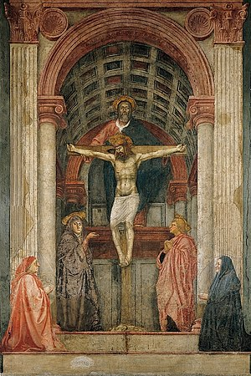
Masaccio: An Early Influence During Italian Renaissance
An artist by the name of Masaccio played an important role in shaping the Early Renaissance in Italy.
He lived between 1401 and 1428.
Masaccio was known for using the fresco technique.
Fresco: "A method of painting in which pigments are applied to a thin layer of wet plaster so that they will be absorbed and the painting becomes part of the wall."
The image on the right is one of Masaccio's most celebrated works of art. It is titled, The Holy Trinity. Masaccio worked in fresco when he created this piece in 1428.

Slide 14
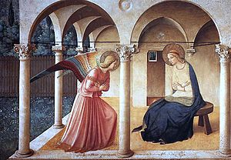
Fra Angelico (1400 –1455)
Fra Angelico was known for his painting and his strong faith.
He made a conscious effort to "not retouch or try to improve a painting once it was finished. He felt that to do so would be to tamper with the will of God."
One of his most famous works of art is titled, The Annunciation (1440-45).
This piece depicts the angel Gabriel announcing to Mary that she is to be the mother of God's Son.
Think-Pair-Share: How would you describe Fra Angelico's style?

Slide 15
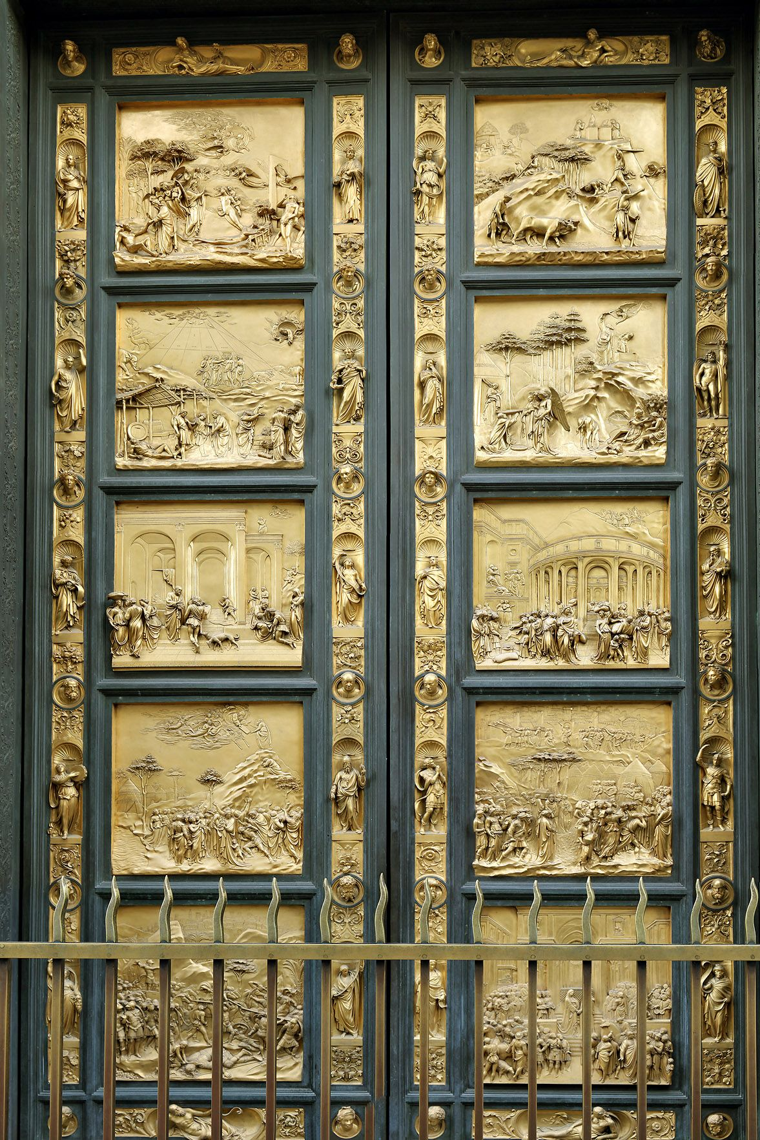
Lorenzo Ghiberti (1378- 1455)
Lorenzo Ghiberti was a sculptor.
Ghiberti's artistic style was a combination of the new Renaissance style and the Gothic style that had dominated in previous years.
He produced several works for the Baptistry of the Florence Cathedral.
Ghiberti devoted 21 years to completing 28 bronze panels used on the doors of the Baptistry.
The doors are known as "The Gates of Paradise."
The doors depict the sacrifice of Isaac.

Slide 16
Video: Ghiberti's Gates of Paradise
https://www.khanacademy.org/humanities/renaissance-reformation/early-renaissance1/sculpture-architecture-florence/v/ghiberti-gates-paradise

Slide 17
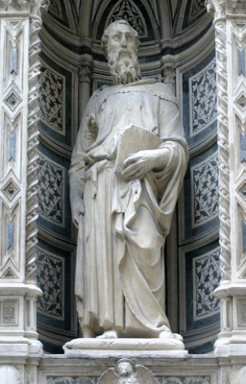
Donatello (1386 – 1466)
Donatello started off his career as an assistant for Ghiberti.
He was concerned with realism and perspective.
He was known for his sculptures.
The sculpture on the left is Donatello's St. Mark.
He often made the upper section of his sculptures longer if the sculptures were going to be placed at eye level in churches.
Think-Pair-Share: Why do you think Donatello took this approach?

Slide 18
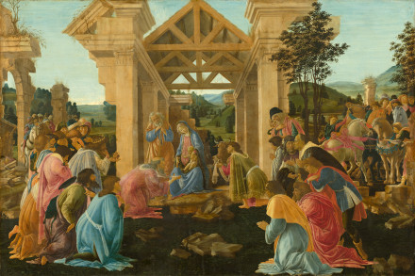
Sandro Botticelli (1445 – 1510)
Sandro Botticelli was a painter.
His paintings "are now ranked among the most admired of the Renaissance period.
The figure on the left is Botticelli's Adoration of the Magi (1481). It depicts the Holy Family.
What elements and principles of design did Botticelli use in this work?

Slide 19
Brunelleschi: Designing the Dome of the Florence Cathedral
Recall: Filippo Brunelleschi discovered linear perspective.
He pursued a career in architecture after losing the opportunity to design the doors for the Baptistry in Florence.
He was given the chance to create the dome of the Florence Cathedral.
The project took 16 years to complete.
Video:
https://www.khanacademy.org/humanities/renaissance-reformation/early-renaissance1/sculpture-architecture-florence/v/brunelleschi-pazzi-chapel-santa-croce-florence-completed-1460s

Slide 20
Sources
Mittler, G. (2006). Art in Focus. McGraw-Hill
http://www.webexhibits.org/sciartperspective/raphaelperspective1.html
https://www.dictionary.com/browse/early-renaissance
Collins, Neil. MA LLB (Editor).”Early Renaissance”. Art Encyclopedia, 2011. 20 March 2011 www.visual-arts-cork.com/history-of-art/early-renaissance.htm
Delahunt, Michael R. "Renaissance." & “Chiaroscuro” ArtLex Art Dictionary . 14 March 2011. 20 March 2011 <www.artlex.com>.
"Early Renaissance." Collins English Dictionary – Complete and Unabridged. 1991, 1994, 1998, 2000, 2003. HarperCollins Publishers. 20 March 2011. 20 Mar. 2011 <www.thefreedictionary.com/Early+Renaissance>
"Early Renaissance." Dictionary.com Unabridged. Random House, Inc. 20 Mar. 2011. <dictionary.reference.com/browse/Early Renaissance>.
SparkNotes Editors. “SparkNote on Italian Renaissance (1330-1550).” SparkNotes.com. SparkNotes LLC. n.d.. Web. 17 Mar. 2011. 20 Mar. 2011 www.sparknotes.com
Strickland, Carol. The Annotated Mona Lisa. 2nd. Kansas City, Kansas: Andrews McMeel Publishing, 2007.

