Slide 1
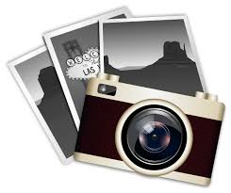
Three image challenge

Slide 2
The mission of artists
According to Pope Francis, artists of every kind should use their art to highlight the beauty of our world.
Pope Francis reinforced this idea when he said, "Architects and painters, sculptors and musicians, filmmakers and writers, photographers and poets, artists of every discipline, are called to shine beauty especially where darkness or gray dominates everyday life.”
In a sense the Pope sees artists as “the custodians of beauty, heralds and witnesses of hope for humanity.”
He believes that seeing the beauty of the world can help us develop a clearer understanding of the meaning of life.

Slide 3
Your Three Image Challenge
Select three images that you believe represent beauty in our world.
After choosing your images, determine how you can bring them together to form one cohesive composition.
You may use as much or as little of each original picture as long as all three are included in your final concept in some way.
You must create at least one rough drawing of your final concept idea prior to creating your good copy.
For this assignment, you will use graphite pencils.
You should create a high realism drawing.
After completing your drawing, you must do a short write-up, explaining how your drawing fulfills the mission Pope Francis gave artists.
Your reflection should be at least 250 – 300 words in full and complete sentences.

Slide 4
Source
Brockhaus, H. (2016, December). "Through Beauty Artists can Make the World Better." Catholic News Agency. Retrieved from: https://www.catholicnewsagency.com/news/pope-francis-through-beauty-artists-make-the-world-better-89502

