Slide 1
Islamophobia

Slide 2
Discussion Questions
Do you know what Islamophobia is?
Can you think of any examples of Islamophobia in Canada?

Slide 3
What is islamophobia?
The Oxford dictionary defines Islamophobia as the “dislike of or prejudice against Islam or Muslims, especially as a political force.”

Slide 4
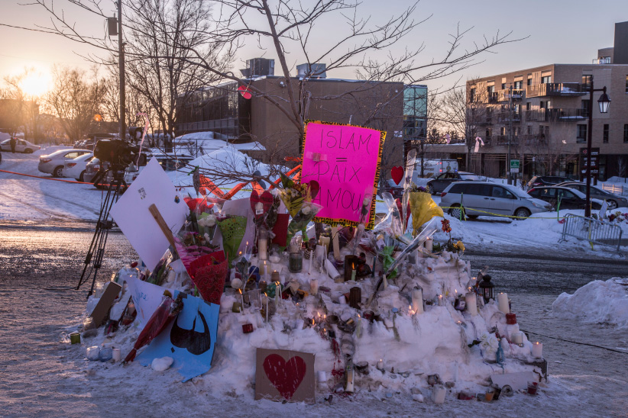
Islamophobia is on the rise in Canada
A 2016 poll found that 54 % of Canadians have an unfavorable opinion of Muslims.
There has also been an alarming increase in the number of hate crimes that have been committed against Muslim-Canadians. Some reports suggest that the number of incidents has doubled over the last 3 years.

Slide 5
The effects of racism
“I am Muslim and I have decided to cover my head. I abide by my traditions. There are people who laugh at me because I cover my head. The other day, when I was in the classroom, everybody was eating pepperoni except me. In my religion, we do not eat pork. The pepperoni is made from pork and I cannot eat it. They (my classmates) wanted me to eat it. At some time, they told me: “You have no hair!” because I was covering my hair and they pulled the veil. I did not like it because it hurt my feelings. And I was feeling lonely.” – Saadia, a young Canadian Muslim

Slide 6
WWYD? A Muslim Woman Needs Help
https://www.youtube.com/watch?v=NrbnnEZnMOU

Slide 7
Sources
Glavin, T. (February 2, 2015). We Need to Understand What Islamophobia Really Means. Macleans. Retrieved from http://www.macleans.ca/news/canada/we-need-to-understand-what-islamophobia-really-means/
Kohut, T. (February 1, 2015). Muslim Misconceptions: The Everyday Islamophobia Facing Canadians. Global News. Retrieved from http://globalnews.ca/news/3216963/muslim-misconceptions-the-everyday-islamophobia-facing-canadians/
Racism in Our Schools…Canadian Children Speaking Out! Retrieved from www.crr.ca/divers-files/en/pub/fash/ePubFaShRacScho.pdf.

