Slide 1
Catholics and the Study of World Religions
Empathy and Genuine Tolerance
Do you recognize this flag?

Slide 2
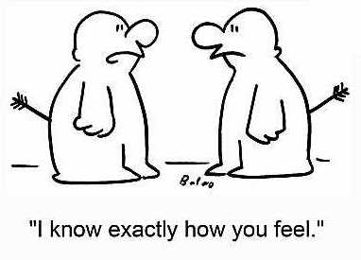
Attitude is Everything
Catholics are encouraged to study other religions with an attitude of empathy.
Empathy is the capacity to understand or feel what another person is experiencing from within the other person's frame of reference.
i.e., the capacity to place oneself in another's shoes.

Slide 3
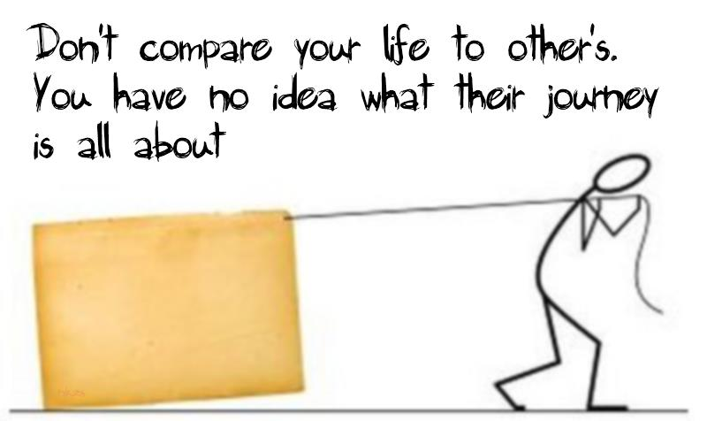
Attitude is Everything
Important Points:
Empathy requires that we use our imagination.
Empathy is not sympathy or feeling sorry for someone.
Empathy leads to compassion.

Slide 4
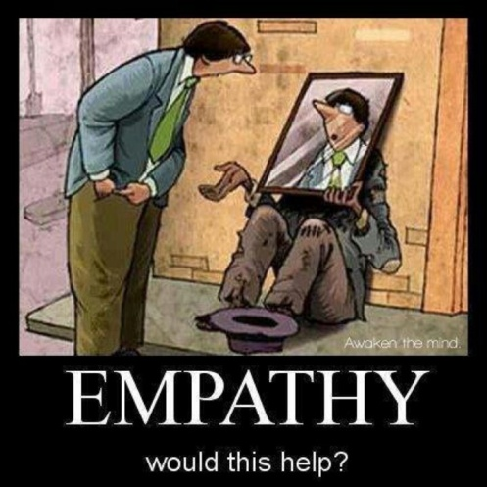

Slide 5
What is genuine tolerance?

Slide 6
TOLERANCE IS… | TOLERANCE IS NOT…
Respecting others and human dignity Showing empathy Celebrating differences Asking questions of each other Interacting and dialoguing with each other To learn from one another | Avoiding tension or disagreements Always agreeing with someone Pretending that you don’t have an opinion Relativism Avoiding diversity

Slide 7
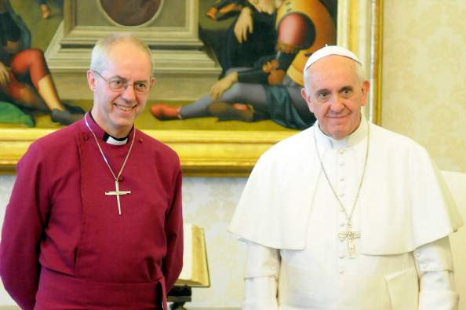
Interreligious/Interfaith Dialogue
If we have the attitude of empathy and we seek genuine tolerance, then people who follow different religions can dialogue with each other.
Interreligious/Interfaith dialogue is dialogue between people or groups of people from different faith traditions.
Pope Francis meets with the leader of Anglicans (Archbishop of Canterbury, Justin Welby)

Slide 8
Think, Pair, and Share
What would you consider to be some of the benefits of interreligious dialogue?
Why do you think some people/or religious groups would prefer not to engage in interreligious dialogue?

Slide 9
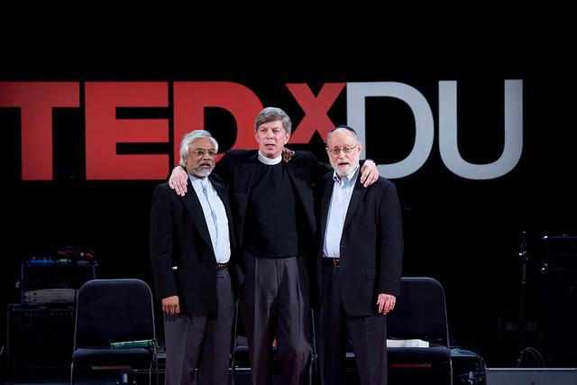
The Interfaith Amigos
Interfaith Dialogue TED TV Clip

Slide 10
4 Ground Rules for Dialogue
1. Respect the faith and religion of others
To respect a person means to respect who they are.

Slide 11
4 Ground Rules for Dialogue
2. There is no neutral stance
To enter into dialogue with people of other faiths, Catholics need to be firmly grounded in their own faith.
We do not have to pretend that we don’t have opinions or ideas when we dialogue with others.

Slide 12
3. The truth of other religions
Despite the differences in our beliefs, it is important to appreciate and respect what others hold to be true.

Slide 13
4. Accept the importance of religion
Religious difference is a sign of human diversity.
Christianity celebrates this diversity while recognizing our oneness as children of God.

Slide 14
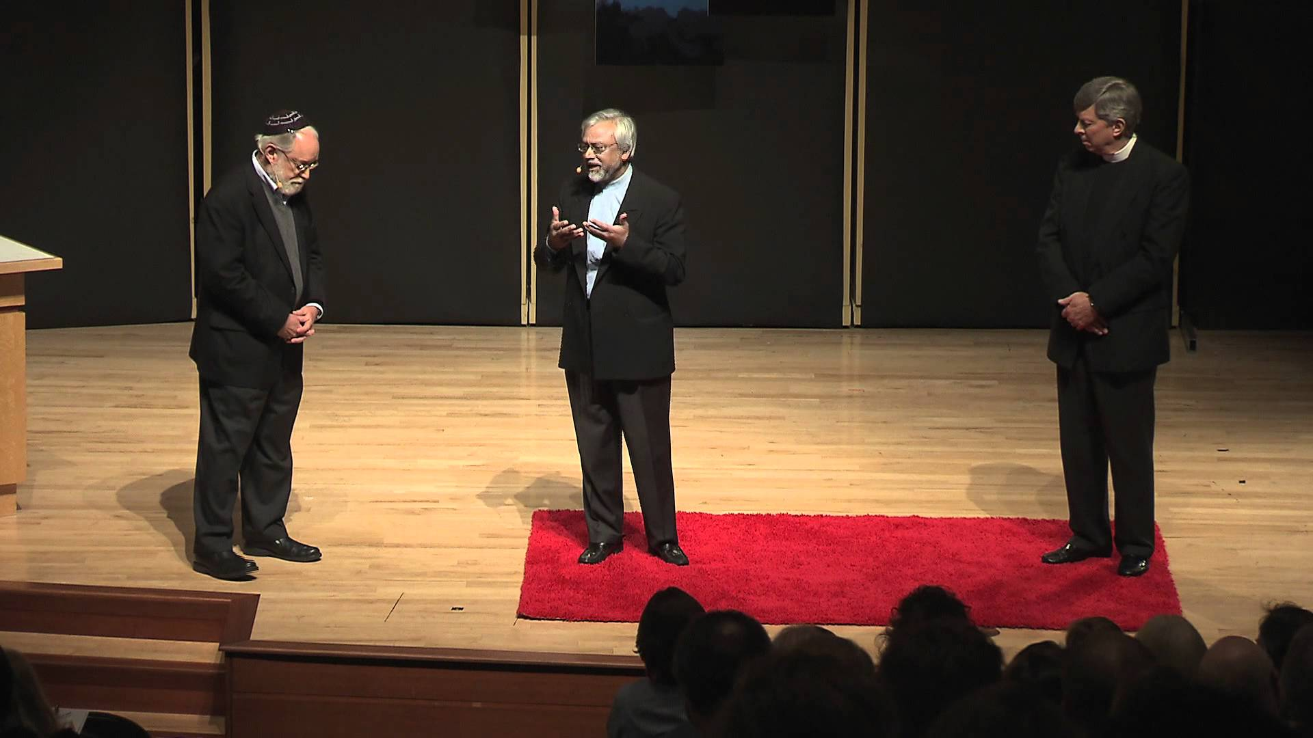
The Abrahamic Faiths
The Interfaith Amigo Clips

Slide 15
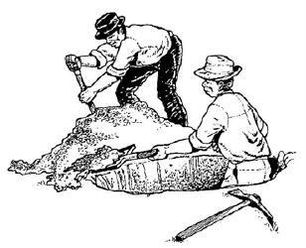
God’s Love Embraces all Denominations
Read Father Ron’s article (title above) and respond to the questions on the next slide in your notebook.

Slide 16
What images of God did you grow up with? Or if you did not grow up with any particular images of God, what are some of the images of God that you see in the media or portrayed by others. Explain with detailed examples.
What does it mean to say that God is ineffable?
What is the only thing that is absolute? Explain why this is.
How does Fr. Ron define Proselytism?
Why does the image of digging a well fit with the notion of interfaith dialogue leading to unity among religious people?
What aspect of Fr. Ron’s article do you find most challenging or most valuable? Explain your reasoning.

