Slide 1
Causes of the great depression

Slide 2
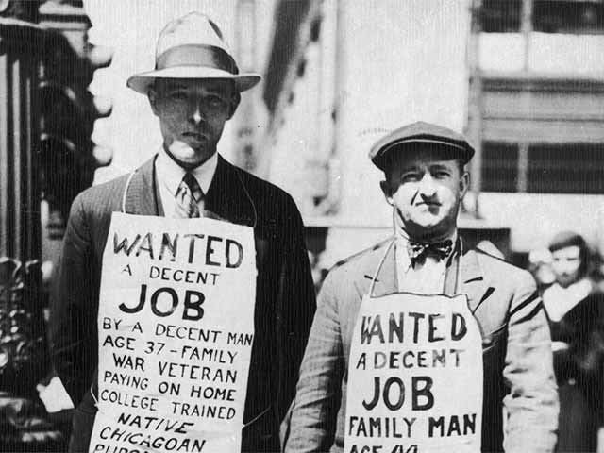
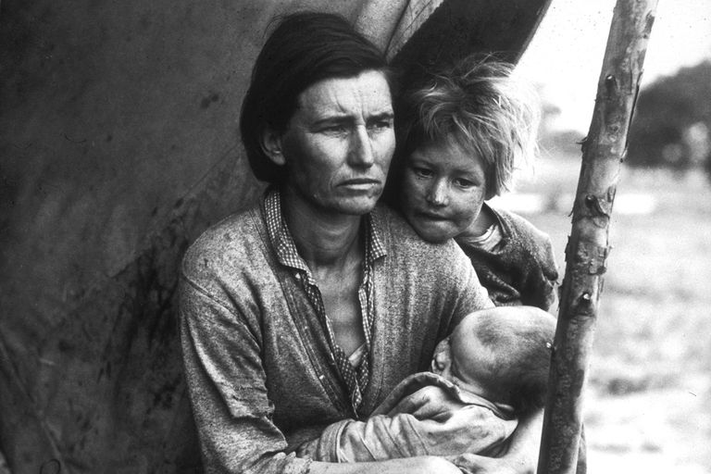
What was the Great Depression?
The Great Depression lasted from 1929 - 1939 and was the worst economic disaster to hit the modern world.
Millions of people suffered as they lost their jobs and living conditions deteriorated.

Slide 3
Major Immediate Causes

Slide 4
The Stock Market Crash of 1929
The Great Depression was triggered by this collapse of the market on October 29th, 1929.
It became known as “Black Tuesday.”
Prices for shares collapsed in the U.S. and Canada.
Investors realized that their shares were overpriced and tried to sell them all at once.
16, 419, 030 shares were traded and lost half their value ($9 billion)
Many investors lost all savings and went bankrupt.

Slide 5
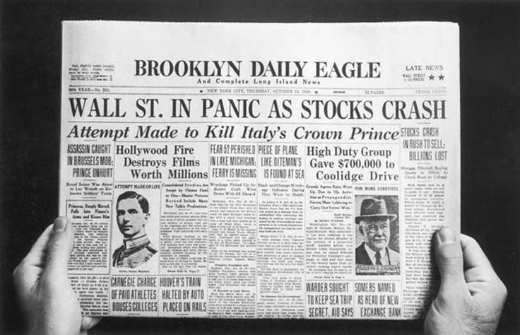

Slide 6
History Brief: Black Tuesday (Stock Market Crash)
https://www.youtube.com/watch?v=ehy2jEeNuWk

Slide 7
Prairie Drought of 1929
The drought lasted for 10 years.
A grasshopper plague destroyed many crops.
A lack of rain turned sections of the west into dust bowls.
The economies of Ontario and Quebec suffered as the farmers could no longer afford to buy factory goods.
While prairie farmers were struggling to survive, Australia, Russia, and Argentina had huge harvests of wheat.
This forced the price of wheat down from $1.29/bushel in 1928 to 34 cents in 1932.
Things went back to normal by 1939, but 250, 000 farmers had abandoned their farms in the West and went unemployed throughout Canadian cities.

Slide 8
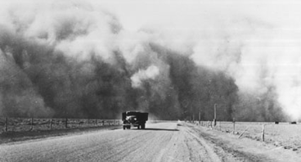
Dust Bowls
A dust bowl is “an area of land where vegetation has been lost and soil reduced to dust and eroded, especially as a consequence of drought or unsuitable farming practice.”

Slide 9
Major underlying causes

Slide 10
Natural Resources
Canada’s economy depended on the sale of exports to other countries, mainly to the U.S., and natural resources made up most of these exports.
Wheat, fish, minerals, coal, and wood made Canada prosperous.
The good times were dependant on the continued sale of these products.

Slide 11
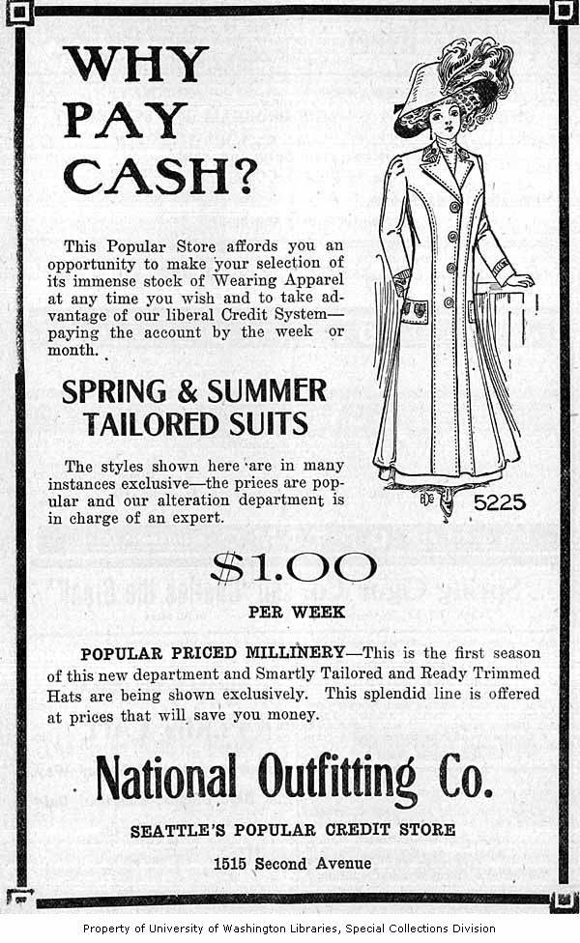
Buying on Credit
Buying on credit became very popular in the 1920s (spending money that you do not have).
Most people and businesses in the 1920s were overly optimistic about the future.
Farmers, businesses, and individuals borrowed money and went into debt as long as they could afford to make their monthly payments.
Some people bought shares of company stock on credit.

Slide 12
Overproduction of Goods
Many businesses overproduced and stockpiled their goods in warehouses in the 1920s.
There was not enough demand for all the products.
Businesses bought more machines and hired more workers for the factories in the 1920s.
Farmers purchased more land as they were optimistic like everyone else about the future.

Slide 13
High Tariffs
To protect Canadian businesses and their workers, the government raised tariffs on imported goods.
Other countries also raised tariffs and this resulted in less trade and fewer sales of Canadian goods.
Demands for goods from Canada began to fall after 1928, and Canadian workers were laid off.
The tariff increase further damaged economies.

Slide 14
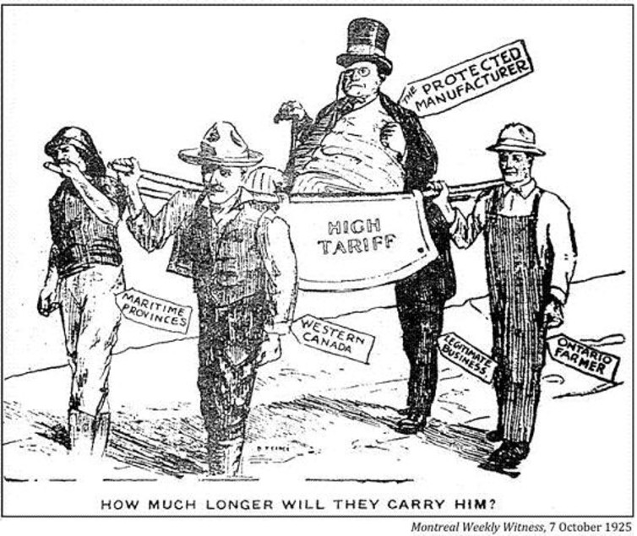
What do you think the message is behind this political cartoon?

Slide 15
Low Incomes of Some Canadians
Contrary to belief, not all Canadians shared in the prosperity of the 1920s.
Some people remained in poor paying jobs and had low standards of living.
Farmers who did not produce grain did not receive high prices for their crops.
Some regions, such as the Maritimes, did not share in the economic boom of the 1920s.
All of these factors lessened the demand for Canadian goods and services.

Slide 16
Summary
All of these factors played a role in the causes of the Depression.
The collapse of the stock market made companies realize that they had overspent and overproduced.
The results were unemployment and less money in the economy.
People could not meet credit payments and lost houses, cars, appliances, etc.
There was less money to spend and the economy went downhill.

Slide 17
Source
Bolotta, Angelo, and Charles Hawkes, Fred Jarman, Marc Keirstead, and Jennifer Watt. 2000. Canada: Face of a Nation. Toronto: Gage Educational Publishing Company.

