Slide 1
Key Christian Beliefs

Slide 2
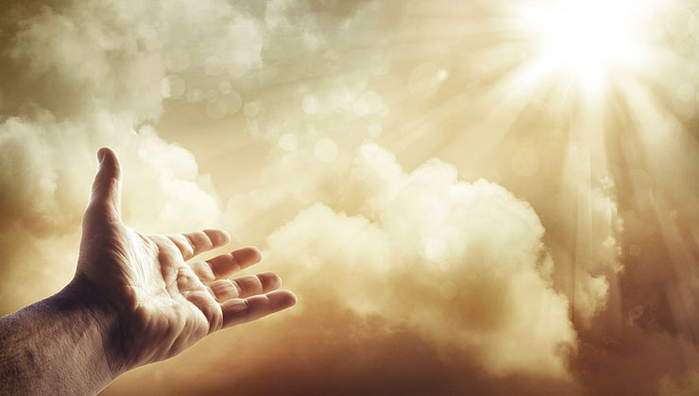
Christianity is a Monotheistic Faith
Christians believe in one God.

Slide 3
Who is the Christian God?
Can you think of any words that Christians often use to describe their God?

Slide 4
The Key Characteristics of God
Christians view God as:
Love
All-knowing
Powerful
Omni-present (present everywhere)
The creator of all
Infinite and eternal

Slide 5
The Trinity
Christians believe that God is three persons who share the same substance.
These three persons are God the Father, the Son, and the Holy Spirit.
The three persons who form God are called “The Trinity.”

Slide 6
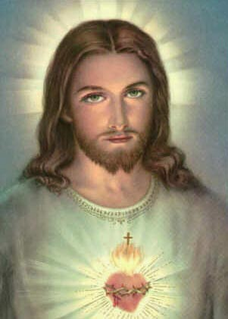
The Incarnation
The Incarnation is God becoming
human and revealing Himself to us.
Christians believe that God
became human through Jesus.

Slide 7
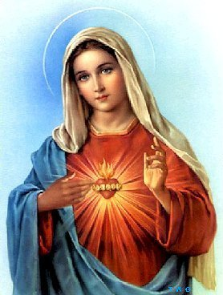
Mary and the Church
What words, symbols, actions, or events come to mind when you think about Mary?

Slide 8
Mary: Mother of The Church
The Immaculate Conception: Mary was conceived by her parents without the guilt or the stain of original sin.
The Annunciation: The Angel Gabriel appeared to Mary and announced that Mary would conceive the Son of God through the power of the Holy Spirit.
The Assumption: Mary was assumed body and soul into the Kingdom of Heaven.

Slide 9
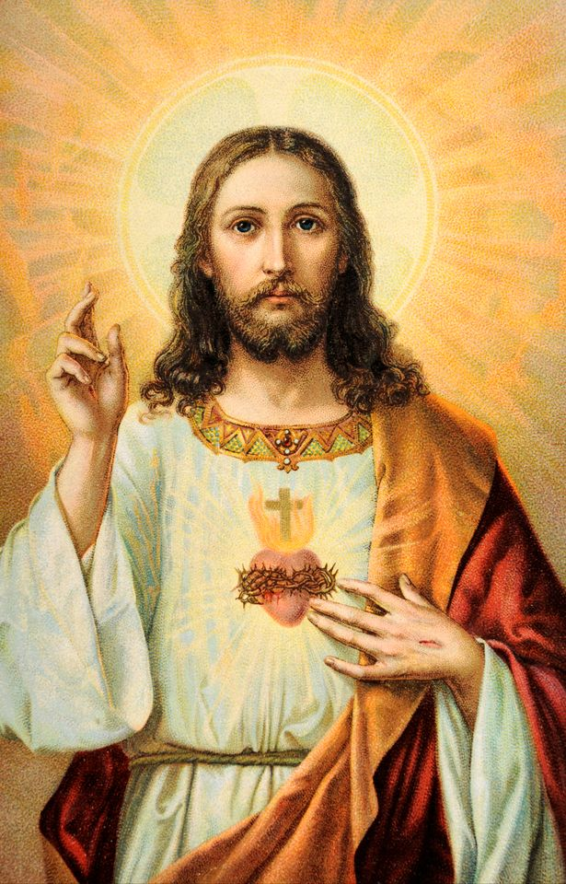
Jesus’ Humanity and Divinity
Christians believe that Jesus is both
100 % human and 100 % divine.

Slide 10
Jesus’ Mission
God became human through Jesus to connect more deeply with humans and teach humans about His great love for them.
Jesus is the Messiah – the saviour of humans.
Jesus gave up his life on the cross for the sins of every human.
Jesus was resurrected from the dead.
Jesus ascended into Heaven.
Jesus will return and judge the living and the dead.
Those who are righteous will have an eternal place in God’s Kingdom.

Slide 11
Christmas and Easter
Christmas is the time when Christians remember and celebrate the birth of Jesus.
Easter is the time Christians use to remember and celebrate the resurrection of Jesus.

Slide 12
Pentecost
This event took place 50 days after Jesus’ resurrection.
On this day, Christians believe that Jesus sent the Holy Spirit to earth.
The Spirit descended upon Jesus’ disciples.
The Spirit helped Jesus’ followers become courageous witnesses of Jesus’ life, death, and resurrection and is seen as the birthday of the Church.

Slide 13
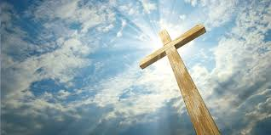
Humanity and God’s Grace
Christians believe that humans were made in the image and likeness of God.
Sin is an inevitable part of being human.
We cannot save ourselves- we need God’s help.
Humans can attain salvation through the grace of God.
An important way that humans can receive God’s grace is through receiving the sacraments.

Slide 14
The Sacraments
The Church teaches that the sacraments are outward signs of an invisible, spiritual grace.
Christians believe that Christ (Jesus) instituted the sacraments.
The number of sacraments that Christians recognize varies.
Most Christians recognize 2 sacraments: Baptism and the Eucharist.

Slide 15
The Bible
Christians believe that the Bible was divinely inspired (by the Holy Spirit).
Christians recognize that there may be minor errors in the Bible (ex. Names, dates).
However, Christians believe that there are no errors in the messages in the Bible.

Slide 16
Sources:
http://www.bbc.co.uk/religion/religions/christianity/beliefs/basics_1.shtml

