Slide 1
Levels of Government in Canada

Slide 2
The 3 Levels of Government
Canada has THREE levels of government. These include:
Federal government
Provincial government
Municipal government

Slide 3
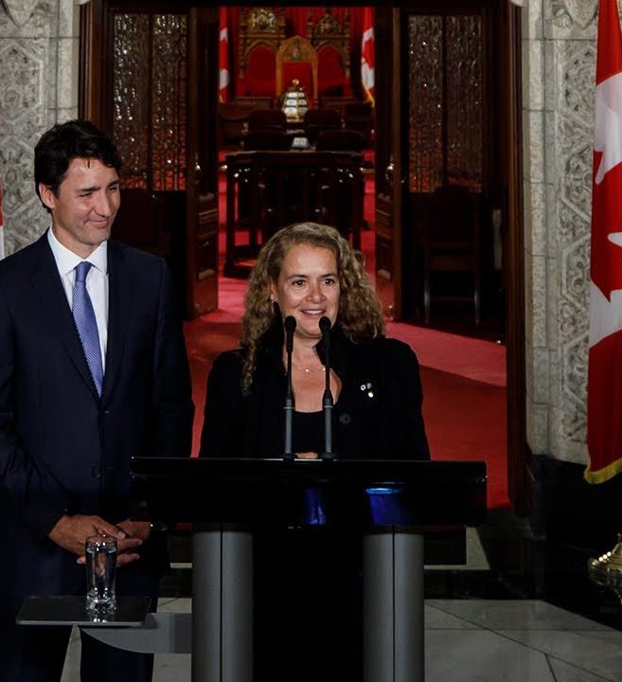
Federal Government
Jurisdiction: the entire country
How many? ONE federal government in Canada
Location: Ottawa
Head of government = Prime Minister (Justin Trudeau)
Queen’s representative = Governor General (Julie Payette)

Slide 4
Federal Responsibilities
national defence
foreign affairs
employment insurance
banking
federal taxes
the post office
copyright law
criminal law

Slide 5
Provincial Government
Jurisdiction: Deal with matters that affect provinces
How many? 10 provincial governments in Canada (and three territorial governments)
Location: in provincial capitals (Toronto)
Head of government = Premier (Doug Ford)
Queen’s representative = Lieutenant Governor (Elizabeth Dowdeswell)

Slide 6
Provincial Responsibilities
provincial taxes
hospitals
prisons
education
marriage
property and civil rights
rules of the road
age of majority

Slide 7
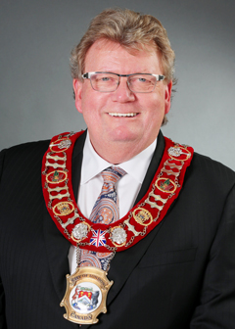
Municipal Government
Jurisdiction: matters that affect cities and towns
How many? Hundreds of municipal governments in Canada
Location: individual cities/towns (London)
Head of government = Mayor (Ed Holder)
There is no official representative of the Queen

Slide 8
Municipal Responsibilities
building permits and zoning
city parks
public transportation
collection of garbage and recycling
water and sewer services
fire prevention
city roads and sidewalks
licensing and control of pets

Slide 9
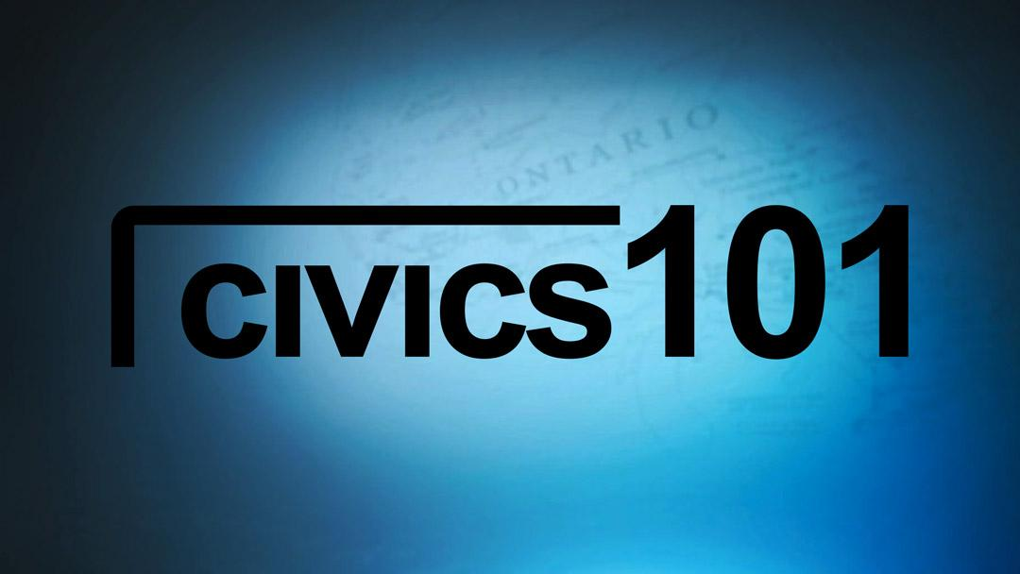
Let's Review
https://www.youtube.com/watch?v=AVE3OsR5W-0

Slide 10
Source:
https://bdp.parl.ca/About/Parliament/Education/ourcountryourparliament/section2-e.aspx

