Slide 1
Rights, Freedoms, and Responsibilities

Slide 2
Think-Pair-Share:
With your neighbour (elbow partner), discuss the following questions:
What are rights and freedoms?
How would you describe a responsibility?

Slide 3
Definitions
Rights | Freedoms | Responsibilities
- A right is something to which a person is morally or legally entitled to. - Rights impose duties on the government. | - Freedoms may be viewed as rights. - However, freedoms do not impose duties on the government. | - Responsibilities are things that you are accountable for.

Slide 4
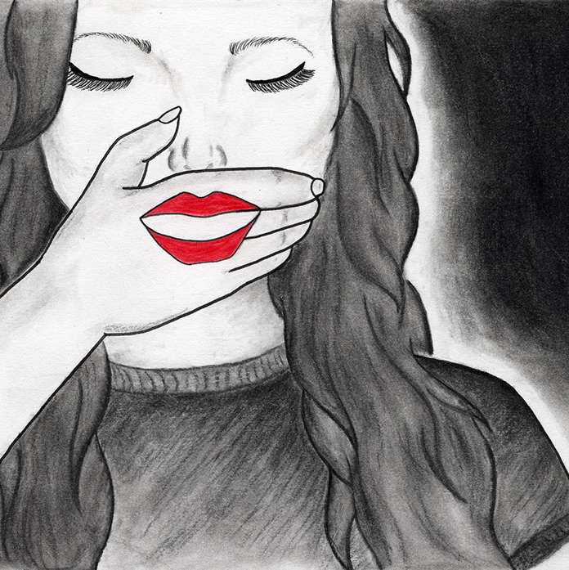
Reasonable Limits on Rights and Freedoms
In a democratic society, individual rights and freedoms need to be balanced with the needs of society.
In other words, rights and freedoms are not absolute.
They have reasonable limits.
You are free to do anything NOT prohibited by the law.
Example: We have the right to free speech in Canada. However, we cannot use our voice to racially discriminate someone in our place of work.

Slide 5
The Canadian Charter of Rights and Freedoms
The Canadian Charter of Rights and Freedoms outlines the rights and freedoms we are entitled to as Canadian citizens.
It was created in 1982.
It is part of Canada's Constitution.
It deals with a citizen's relationship with the government.
The Canadian courts interpret the Charter to determine exactly what those rights and freedoms mean.
*The Canadian Human Rights Act and the Provincial Human Rights Codes also address our rights and freedoms.

Slide 6
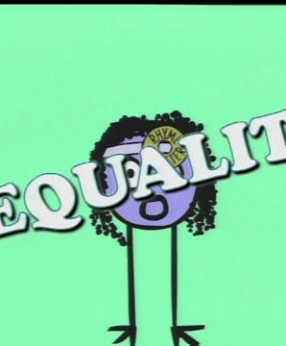
Video: Rights and Responsibilities Animation
https://www.tvo.org/video/rights-and-responsibilities-animation

Slide 7
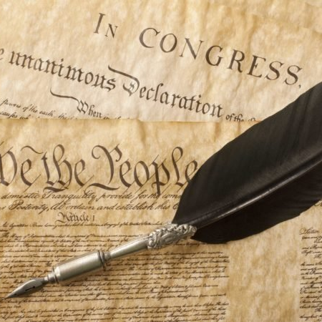
Constitution
A Constitution is a written document that sets down all the important rules for how a country operates.

Slide 8
Current Issue: Rail Blockades
https://www.youtube.com/watch?v=tU-hDybMXXs

