Slide 1
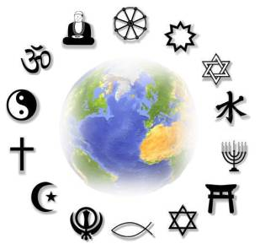
How Can We Define Religion?
*Copy the information that is yellow.

Slide 2
How can we define religion?
How do you define “beauty” or “wisdom?”
It is difficult to define religion because religion is so complex and there are so many different views on religion.
Usually a definition of religion is either too narrow or too broad.

Slide 3
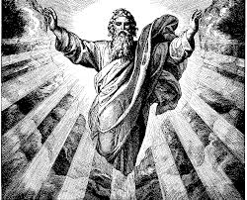
Two definitions for religion are:
1. An institution designed to help its members express their beliefs in a divine power(s).

Slide 4
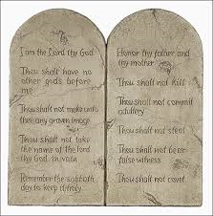
2. A way of seeing, thinking, and acting inspired by questions about what things mean.
Where did we come from?
What is our destiny?
How should we live?

Slide 5
Religio = “To Bind”
Our word “religion” comes from the Latin word “religio” which means “to bind.”

Slide 6
So…
Religious people bind themselves to each other and to God (or spiritual being(s)).
Religious belief includes obligations like worshiping God and living a moral life.
Community is essential in Religion.

Slide 7
Authentic Religion vs Cults/Extremism
Authentic Religions:
Cults/Extremism:
A strong sense of family, community, and justice.
Concern is expressed for unity, peace, the environment, the welfare of others, etc.
Most cults require members to sever ties with those who don’t follow the teachings and only socialize with people from the group.
They are usually isolated in one area and try to foster a “family” atmosphere.
Members must devote inordinate amounts of time to the group.

Slide 8
Authentic Religion vs Cults/Extremism
Authentic Religions:
Cults/Extremism:
Have a creed (outlines their belief system and gives believers a guideline for living).
Have apocalyptic beliefs:
the leader’s preaching is heavily dependent on the end of the world
not to be questioned
Suicide is offered as an escape
Intense personal training into the dogma of the cult is often involved.
Cult leader’s teachings = good & outside world = bad.

Slide 9
Authentic Religion vs Cults/Extremism
Authentic Religions:
Cults/Extremism:
Code of conduct/ethics that guides believers.
Offer set of answers to important life questions.
Focus on a conduct that involves altering the members’ behaviour (not always for the better).
Mind-numbing techniques are used to influence followers (supress questions/doubts).
Leaving the “faith” is physically difficult.

Slide 10
Authentic Religion vs Cults/Extremism
Authentic Religion
Cults
A significant founder who introduced the development of the faith.
Religious leaders are the authority of the faith and are humble (ex. Pope Francis).
Leaders do not control or dominate the followers of the faith.
Most cults are focused on a living leader who is:
Charismatic (compelling charm)
Called to save humanity (false prophet)
Dominant and demanding (followers have little independent thinking)

Slide 11
Time for a Kahoot!
Now you are invited to participate in a short Kahoot review game to see if you can distinguish between authentic religion and cults/extremism.
Take out your phone, visit the kahoot site for students, and then wait for the group ID to pop up and then join in!

Slide 12
Cult Video Clips
https://www.youtube.com/watch?v=Eqs3BeCxLe8
https://www.youtube.com/watch?v=qS7mBbXxJYA

Slide 13
Source
Institute for Catholic Education. Retrieved from https://iceont.ca/ontario-catholic-curriculum/

Slide 14
Video Introduction to the World Religions

