Slide 1
Escapism and the Depression

Slide 2
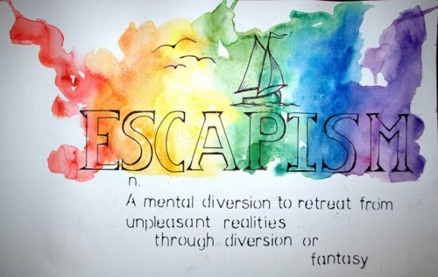

Slide 3
Jokes
Humour helped take peoples’ minds off the tough economic times.
“Knock knock” jokes and “Little Audrey” jokes were quite popular during the 1930’s.
The basic format of Little Audrey jokes: “Little Audrey is involved in some terrible catastrophe but always finds some humour in every situation.”

Slide 4
Baseball Cards
Baseball cards were collected by many individuals during the Depression.
They were usually sold with chewing gum.

Slide 5
Superman
Toronto-born cartoonist Joe Shuster and his best friend, Jerry Siegal, created Superman when they were 17 years old in 1933.
Action Comics introduced Superman to the public in 1938.
Fun fact: “Mild-mannered Clark Kent (Superman) worked for the Daily Star, modelled after the Toronto Star.”

Slide 6
Think-Pair-Share:
Why would a figure like Superman inspire people during the 1930’s?

Slide 7
Movies and the Depression
Movies were becoming a much more common form of entertainment in the 30’s.
Most were purely for entertainment and distraction from everyday life.
Motion pictures sparked “feelings of romance, glamour, and luxury – the very things that were lacking in the lives of many people.”
Most films had a happy ending.
Popular movies included: Mickey Mouse, Snow White and the Seven Dwarfs, Frankenstein, Dracula, and Gone with the Wind.

Slide 8
“The tallest darkest leading man in Hollywood”
Canadian film star Fay Wray played the love interest of a giant ape in the popular 1933 movie, “King Kong.”

Slide 9
“The Darling Moppet”
Shirley Temple was a popular American movie star in the 30’s.
Film scouts first noticed her when she was 3 years old.
The Depression-era movie, Stand Up and Cheer, thrust Temple into the spotlight.
Temple starred in 43 feature films and 25 storybook movies from 1931 until 1961.

Slide 10
Mac n’ Cheese!
Kraft macaroni and cheese was a fad during the Depression years.
Canadians could not get enough of it.
It was launched in 1931.

Slide 11
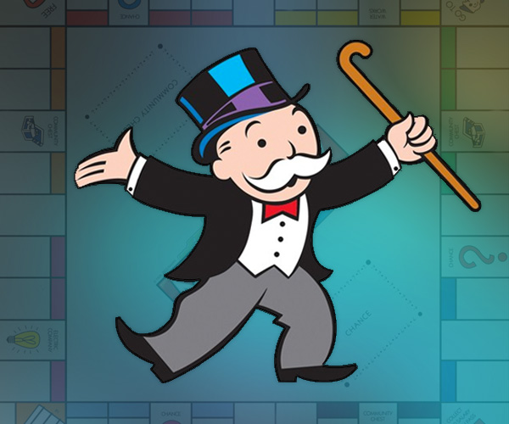
Mr. Monopoly Entered the Scene…

Slide 12
Board Games
Board games were enjoyed by many Canadians during the 1930’s.
They momentarily took one’s mind off the less than stellar economic times.
Monopoly: one of the most popular board games in Canada.
Invented by Charles B. Darrow in 1933.
Now sold in 80 countries in 26 languages.

Slide 13
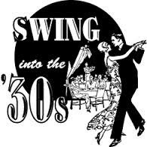
The Swing Era
A.K.A. “Swing Jazz.”
Lasted from 1935-1945.
It was upbeat music.
The trumpet, saxophone, flute, and piano helped give swing music its distinctive style.
Canadians frequently gathered in dance halls to dance and listen to swing bands.
Popular swing bands included: Bert Niosi (Canada’s King of Swing), Trump Davidson, Joan Fairfax, and Duke Ellington.

Slide 14
Sports
Sports helped lighten the mood in Canada.
Hockey and baseball were arguably the most loved sports in Canada.
The Maple Leafs were treated like royalty after winning the Stanley Cup in 1931.
Howie Morenz: hockey hero.
Played for the Montreal Canadians.
Babe Ruth: popular baseball icon.
Canadians frequently listened to boxing matches on the radio.

Slide 15
The Quints
The first quintuplets to survive birth.
Became wards of the state as babies.
Caused a media frenzy.
Robbed of having a normal childhood.
Exploited by the Ontario government.
A “Quintland” theme park was developed
The park generated a lot of money for Ontario during the Depression.
Later received $2.8 million in compensation.

Slide 16
“There’s gold in them thar quints!” – Toronto Star Weekly, August 22nd, 1936

