Slide 1
Forms of Judaism

Slide 2
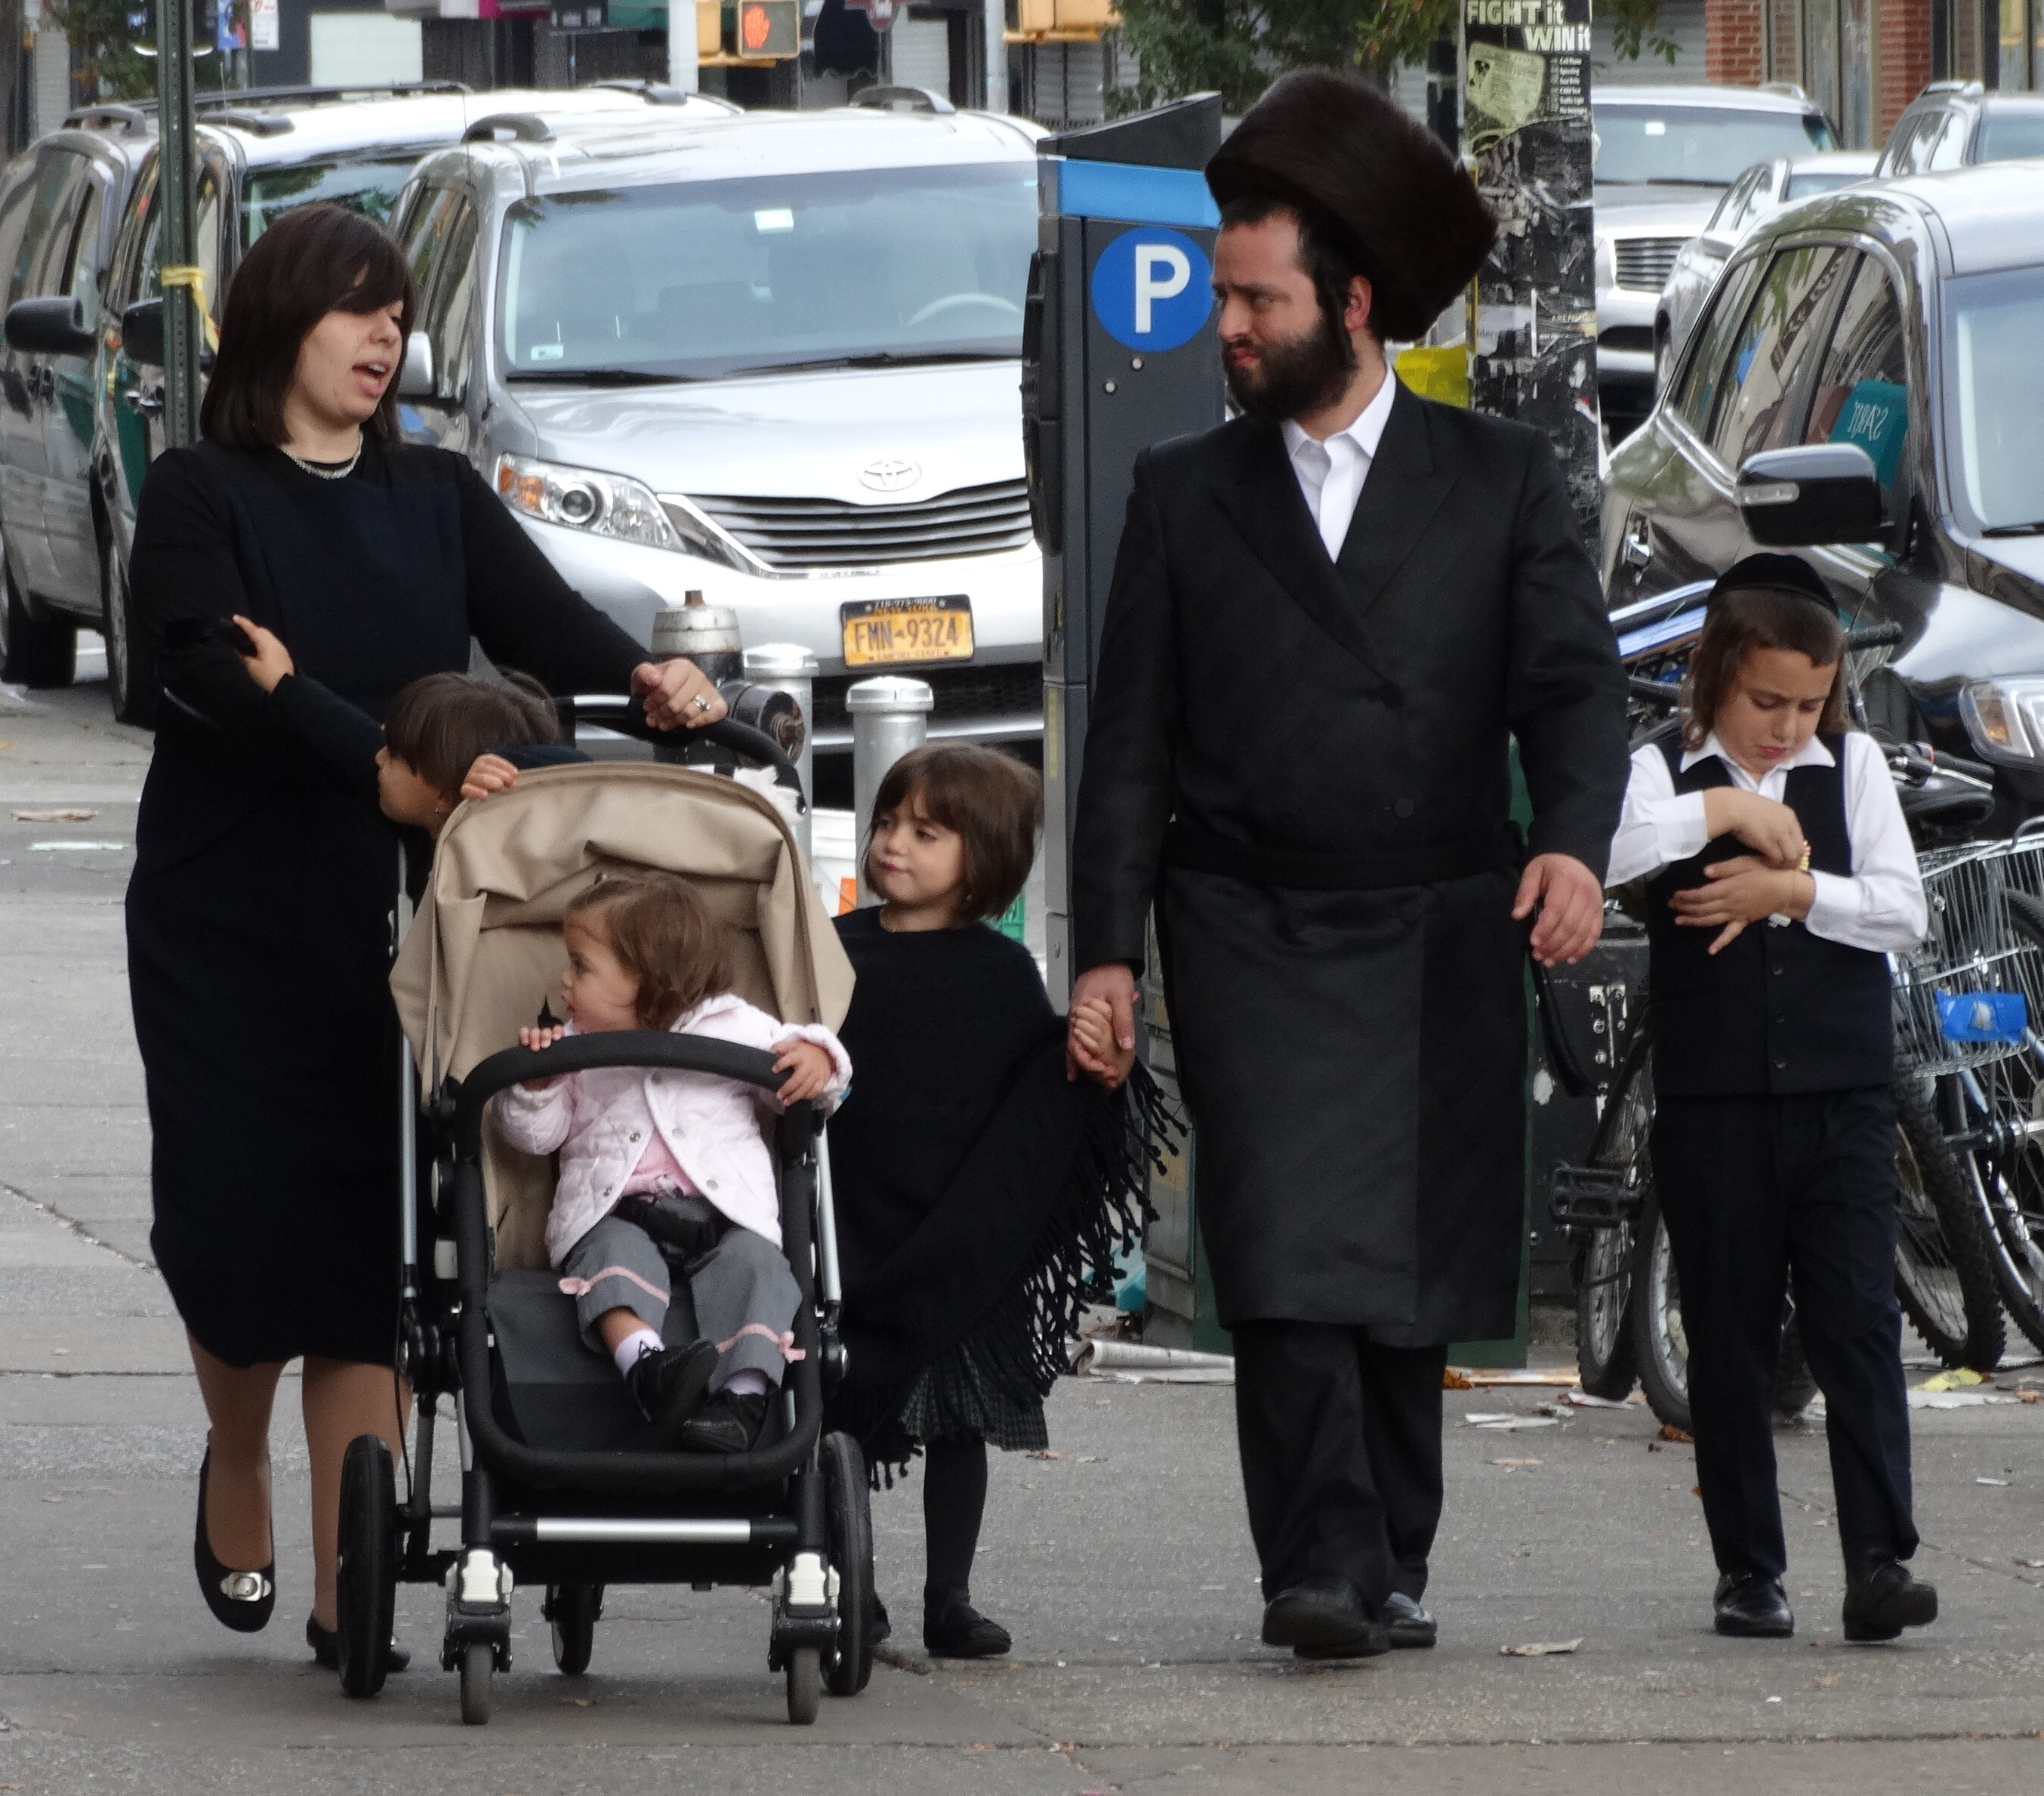
Hasidic Judaism

Slide 3
Hasidic Judaism:
Hasid means “pious one.”
It began in Eastern Europe in the 18th century.
Hasidic Judaism stresses personal experience in worship.
Hasidic Jews follow all Orthodox laws.
Each Hasidic group is centered on the teachings of a particular Rebbe, or spiritual master.
A Rebbe is a spiritual master who councils people in the community.
They read the Bible as the literal word of God.
Hasidic Jews are recognized by their distinctive style of dress (eg. men wearing full beards, hats, and dark clothing and women dressing modestly)

Slide 4
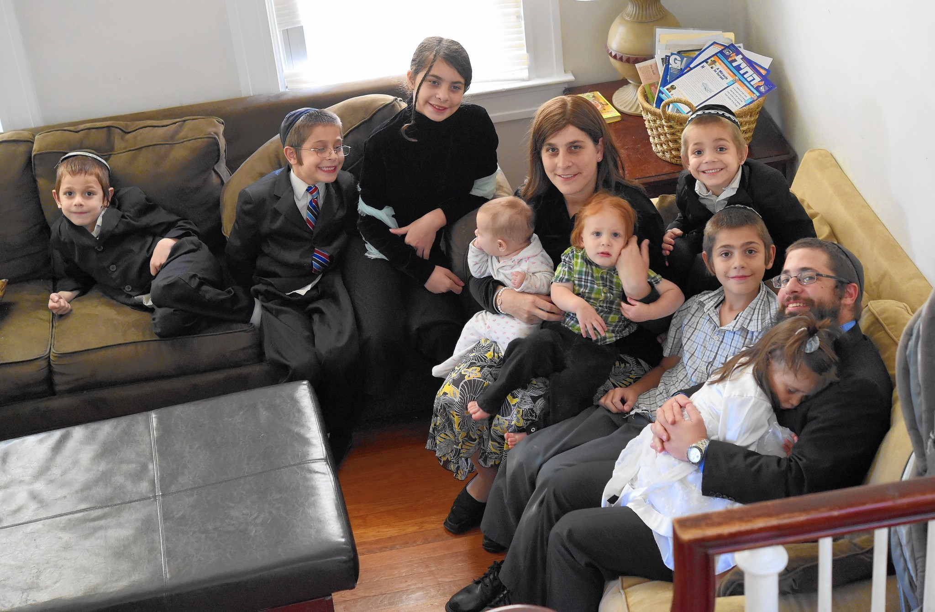
Orthodox Judaism

Slide 5
Orthodox Judaism
Orthodox Jews interpret the Torah literally.
They accept Jewish law and teachings as binding.
Strict observances of dietary laws and kosher.
They use Hebrew prayers.
Men wear skull caps and prayer shawls.
Men and women must worship separately.

Slide 6
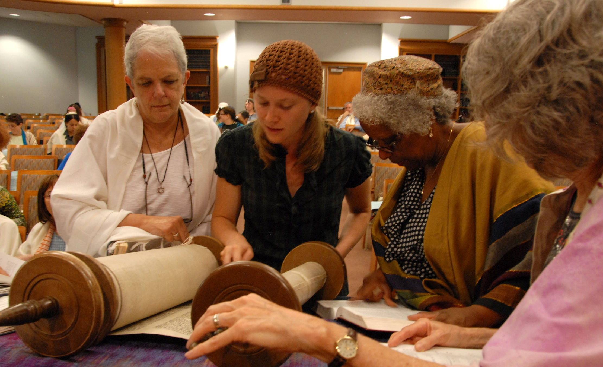
Conservative Judaism

Slide 7
Conservative Judaism
Conservative Jews subscribe to the divine authority of the Torah but they also accept biblical scholarship.
Conservative Judaism believes that Jewish law should be continually examined to meet the needs of every new generation.
They will dress traditionally just during services.
They use more Hebrew than the vernacular.
There is no separation of men and women during services.
Conservative Jews accept most Jewish laws and teachings as binding.

Slide 8
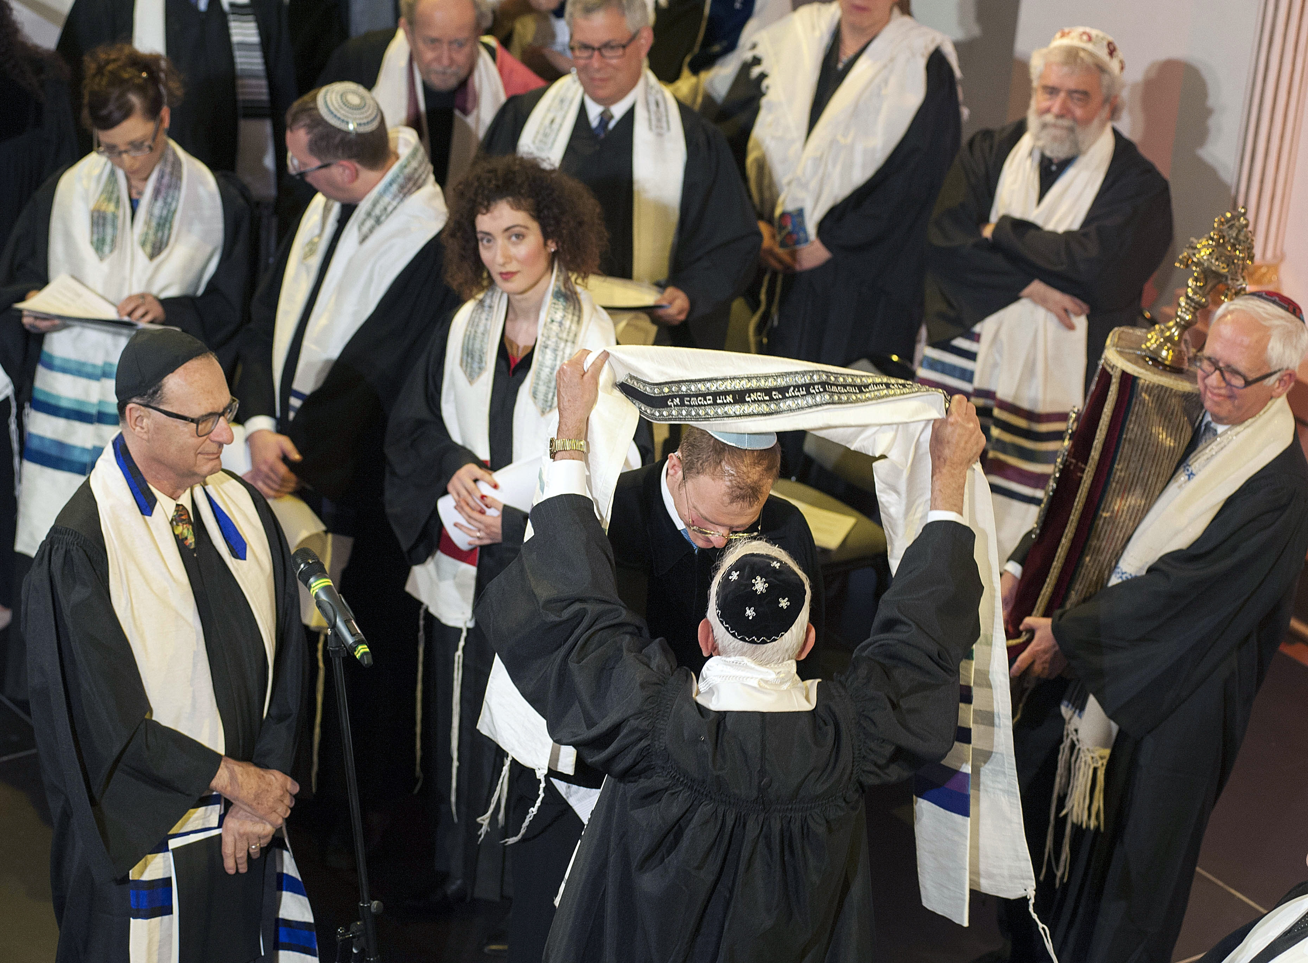
Reform Judaism

Slide 9
Reform Judaism
The emphasis in Reform Judaism is on ethics: how a Jew should behave.
The Torah is not considered as divinely revealed.
They have introduced musical instruments into their services.
Limited use of the Hebrew language.
No strict observances of dietary laws.
Reform Judaism encourages women and men to conform to the same standards of ethical practice, ritual, behaviour, and study.
It pioneered the ordination of women as rabbis.

