Slide 1
The Four Stages of Hindu Life

Slide 2
Introduction
The four stages of life represent the social aspect of karma since they define the actions for which people are responsible for in society.
Women do not enter the last two stages.
Very few men enter the stage of ascetic.

Slide 3
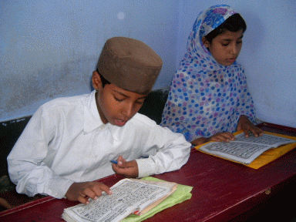
Stage 1: Student
Discipline the mind and body
Gain knowledge
Learn rules and rituals of Hinduism
Show respect toward elders

Slide 4
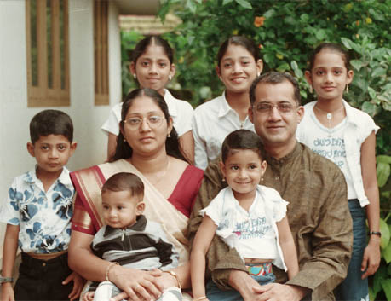
Stage 2: Householder
Marry and have a family
Provide for the family
Care for family elders
Practice social and religious traditions

Slide 5
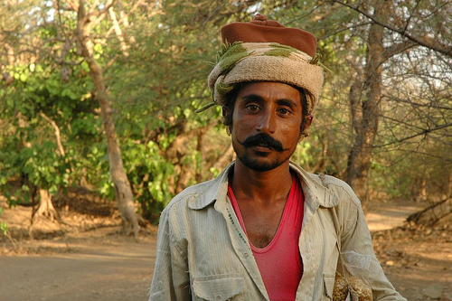
Stage 3: Forest Dweller
Retire and transmit household duties to wife or son
Read and study
Participate in religious pilgrimages

Slide 6
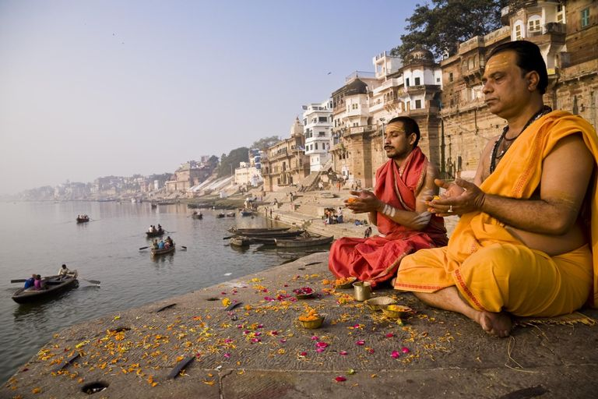
Stage 4: Ascetic
Give up worldly life
Wander
Meditate
Attain salvation

