Slide 1
Paths to Salvation in Hinduism

Slide 2
What is the ultimate goal in Hinduism?
The ultimate goal of Hinduism is moksha – freedom from the endless cycle of rebirths.
In Hinduism, there are four paths to achieving moksha (salvation).
Each path can lead to salvation if the follower is sincere and consistent.

Slide 3
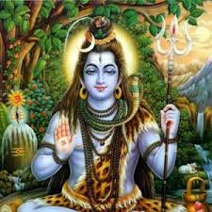
The Path of Devotion (Bhakti Yoga)
It is a simpler path of salvation, involving devotion and love towards a personal deity (eg. Shiva, Vishnu, Lakshmi).
This path provides Hindus with an opportunity to worship Brahman in a more concrete way.

Slide 4
The Path of Action (Karma Yoga)
It involves doing good deeds and thinking good thoughts.
It leads to the accumulation of good karma.

Slide 5
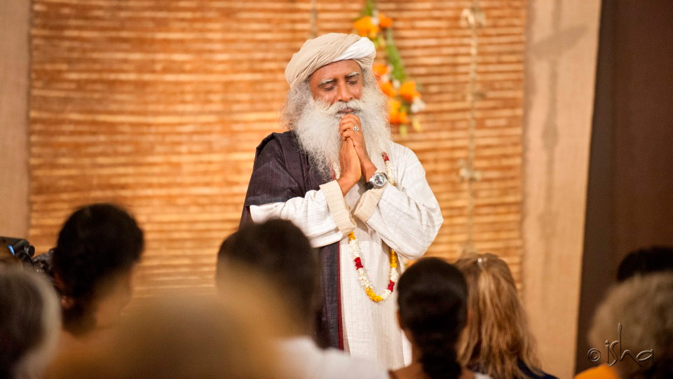
The Path of Wisdom (Jnana Yoga)
It is a complex path involving a teacher (guru).
Followers learn about the relationship between the Brahman and atman, the nature of the universe, all explained by the scriptures.
It involves following all of the traditional Hindu teachings and meditating regularly.

Slide 6
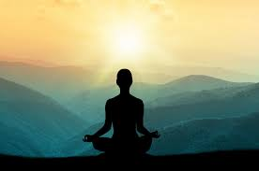
The Path of Meditation (Raja Yoga)
It is a path that involves achieving salvation through meditation on Brahman, the ultimate reality.

Slide 7
Sources:
Deslippe, C., Harrison, M., van den Hengel, J., Miller, L., Stokes, S., & Way Skinner, M. (2011). World Religions: A Canadian Catholic Perspective. Toronto, ON: Novalis Publishing Inc., p. 248.
“Figures and Terms: Hinduism (Unit 2-a).” Retrieved from http://www.markville.ss.yrdsb.edu.on.ca/history/religion/unit2lp.html

