Slide 1
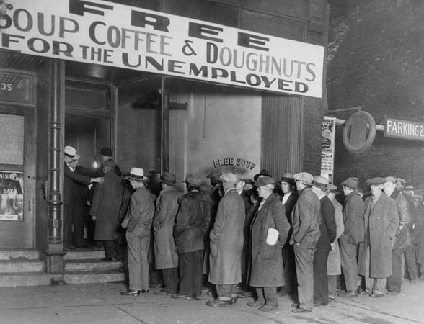
How did the Depression Affect Canadians?

Slide 2
Canada and the Great Depression
In 1933: 1.5 million Canadians could not support themselves.
Farmers were one group that endured a lot of pain and hardship.
Problems farmers faced: low wheat prices, drought, and locust plagues.
Many farmers had to give up their land and became dependant on relief vouchers.

Slide 3
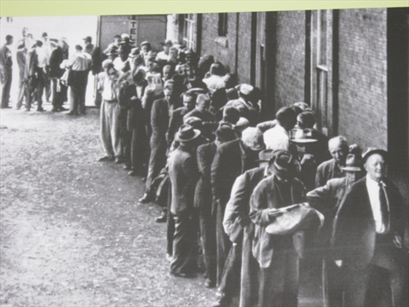
Food and Relief Vouchers
Food and relief vouchers were “documents for specified amounts given by the government to those who were unemployed during the Depression years.”

Slide 4
Relief
Relief was often restricted to individuals who had lived in a community for a period of at least 6 months.
Relief was only given to those who publicly admitted that they could not financially support themselves and had no property of significance (ex. Car).
Relief users were often stigmatized.

Slide 5
Surviving
Many young, unemployed men were transients.
Transients lived in deplorable conditions, frequently moved from one place to another, and were not always given relief.
Canadians had to be resourceful (ex. Use old curtains to make clothing).
Married women with working husbands were not encouraged to work.
Long “bread and soup lines” were a common sight.

Slide 6
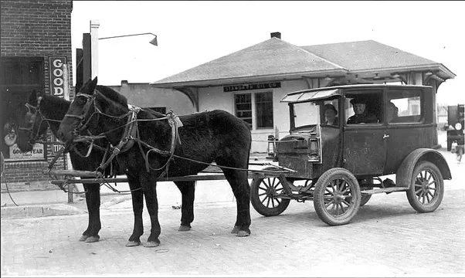
Bennett Buggies
Gas was considered a luxury in Canada.
Many Canadians had horse-drawn cars or “Bennett Buggies,” as they were also known.

Slide 7
Unemployment Relief Camps
They were created by the Federal government in 1932.
Essentially, relief camps were places where young, destitute men worked for the government in exchange for room and board, medical care, clothing, and 20 cents per day.
Over 170, 000 men stayed at these camps during the Depression.

Slide 8
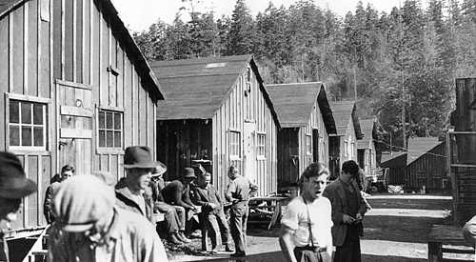
The Royal Twenty Centres
This was another name for relief camps.
There had been concern that single, unemployed men would become dangerous if they were not contained and kept busy.
These camps were often dirty, rough, tiresome, and unpleasant.
P.M. Bennett received a lot of criticism from relief workers.

Slide 9
Thoughts?
“Our father, who art in Ottawa, Bennett be thy name.
Give us this day our bowl of soup and forgive us our
Trespasses on the CPR and the CNR as we forgive the
bulls from chasing us. Lead us not into the hands of the
RCMP, nor yet to the relief camp, for thine is the kingdom,
the power and glory, until there’s an election. – Amen.”

Slide 10
Sources
Canadian Encyclopedia. “Unemployment Relief Camps.” http://www.thecanadianencyclopedia.ca/en/article/unemployment-relief-camps/
Bolotta, Angelo, and Charles Hawkes, Fred Jarman, Marc Keirstead, and Jennifer Watt. Canada: Face of a Nation. Toronto: Gage Educational Publishing Company, 2000.

