Slide 1
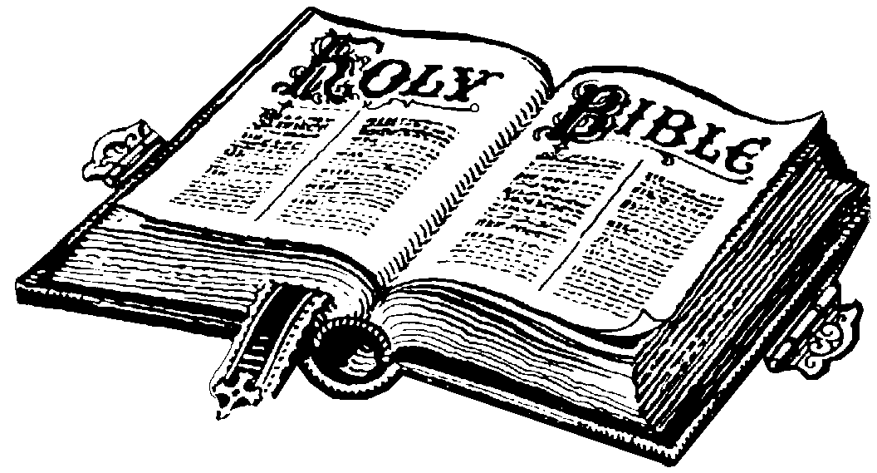
Background to Scripture

Slide 2
What is the Bible?
Bible means “the books”
The Bible was written by many different authors who were inspired by the Holy Spirit
It is divided into major parts: the Old Testament and the New Testament
Testament means covenant or promise
The Bible consists of 73 books
46 books in the Old Testament
27 books in the New Testament

Slide 3
The Old Testament
Christians call books written before Jesus’ time the Old Testament
These books are based on the Jewish religion
It is concerned with showing God’s love for us
These were the books Jesus was taught from
All of the Apostles also followed these books

Slide 4
The New Testament
It is concerned with showing Jesus’ love for us.
It also tells the story of the early followers of Jesus and the early Church.
It includes the Gospels, the Acts of the Apostles, the letters, and Revelation

Slide 5
Is Scripture Really True?
Catholics believe in 2 principles:
Divine Inspiration: This refers to a divine influence upon humans. It resulted in the writing of the Scriptures. The Scriptures were written through the inspiration of the Holy Spirit. Scripture reveals truths.
Inerrancy: There are minor errors in Scripture (eg. dates and names) but there are NO errors in the messages.

Slide 6
Development of the Bible
The Bible teaches us the religious experience of the people of Israel. It shows the development of their understanding of their relationship with God.
The Bible has 3 types of History:
1. ORAL HISTORY: stories told, songs sung, history recounted and memorized
2. WRITTEN HISTORY: recorded history, instructions, guidelines
3. EDITED HISTORY: a selection of the best of what was written and told.
*all 3 types happened at the same time

