Slide 1
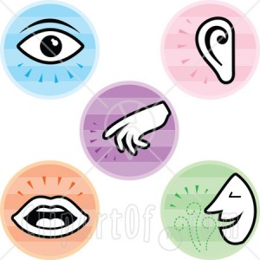
Real People: Healthy Body, Healthy Body Image

Slide 2
Questions:
What does body image mean?
How is body image connected to our self-image?
How do family members affect our body image?
Do friends and peers have a strong influence over our body image?
When it comes to body image, why does the media exert such a powerful influence?

Slide 3
Questions:
6. What are the effects of steroid use?
7. Why is it so easy to get into a vicious cycle with overeating and weight gain?
8. What factor(s) contribute to the development of anorexia?

