Slide 1
Jesus: The New Covenant

Slide 2
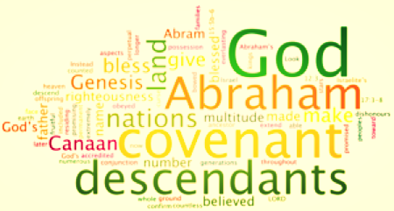

Slide 3
Contracts:
Covenants:
Deal with things
Engages the services of people
Made for a stipulated period of time
Can be broken with material loss to the contracting parties
Deal with people
Engage people
Are forever
Cannot be broken, but if violated, they result in loss and broken hearts

Slide 4
Contracts:
Covenants:
Are secular (non-religious) affairs and belong to the market place
Are best understood by lawyers
Are witnessed by people with the state who carries out the action
Are sacred affairs and belong to the heart, the temple, or the church
Are appreciated by people who study God
Are witnessed by God, who carries out the action

Slide 5
God’s First Covenant
God promises Adam and Eve:
Their descendants will fill the earth and subdue it.
Condition/Curse - Do not eat from the tree of knowledge of good and evil/death will result.
The Sign - The Sabbath - Keep it holy
The Family Form - Marriage

Slide 6
God’s Second Covenant
God promises Noah and his family:
He will never flood the entire earth again.
The Condition/Curse - Do not drink the blood of animals or shed human blood
The Sign - A Rainbow
The Family Form- Traditional Family

Slide 7
God’s Third Covenant
God promises Abraham:
Land and many blessed descendants
Condition/Curse- Circumcision
Sign- Circumcision
Family Form - Tribe

Slide 8
God’s Fourth Covenant
God promises Moses:
Israelites will become God's chosen people
Condition/Curse- They MUST keep God's law and the Commandments
Sign- The Passover
Family Form - A holy nation

Slide 9
God’s Fifth Covenant
God promises David:
He will become our Father, and we will become His child
Condition/Curse- Chastisement with the rod of men
Sign- Solomon's Temple
Family Form - An eternal royal kingdom

Slide 10
Jesus is the New Covenant
The relationship with God that Jesus proclaimed is different from the one that came through Moses
Like Moses, Jesus went up a mountain and spoke to his disciples but his language was radically different
Jesus introduced the Beatitudes
In the Beatitudes, Jesus declared certain people to be blessed
With Jesus there was a shift from obligation to generosity

Slide 11
The Highest Principle
Love is the highest principle of the new covenant
God’s agape love (unconditional)
God’s love dwells in our midst because of Jesus
We must live out that love
Jesus shows us how life can be lived at its most generous

Slide 12
Sources:
“Covenants in the Bible.” Retrieved from Catholic Bible 101: http://www.catholicbible101.com/covenantsinthebible.htm
Christ and Culture. Canadian Conference of Catholic Bishops.

