Slide 1
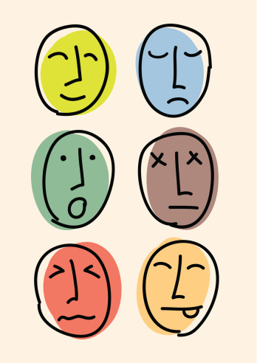
Emotions

Slide 2
Think-Pair-Share!
With your elbow partner, examine the following emotions. For each emotion, determine why one might experience that emotion (eg. think of situations that might bring about the emotions).
Love
Hate
Anger
Fear
Joy
Sorrow
Desire

Slide 3
How do you think we can manage our emotions?

Slide 4
How Can We Manage Our Emotions?
We must strive to develop emotional awareness.
Emotional awareness is a skill.
It involves recognizing your emotions and understanding why you are experiencing those emotions.
It demands that we not play the blame game (eg. don’t put the fault on yourself or others).

Slide 5
Sources:
Kids Health. “Emotions 101.” http://kidshealth.org/teen/your_mind/relationships/emotional-reactions.html?tracking=T_RelatedArticle#

