Slide 1
Forms of Prayer

Slide 2
Defining Prayer
Prayer is an expression of faith that allows us to communicate with God.

Slide 3
Q: What are some types of prayer that you know of?

Slide 4
Prayer Categories
Most prayers fall into one of the following two categories:
Formal prayers: based on traditions and teachings (eg. Our Father).
Informal prayers: based on experiences and moments in our life (eg. praying before a soccer game).

Slide 5
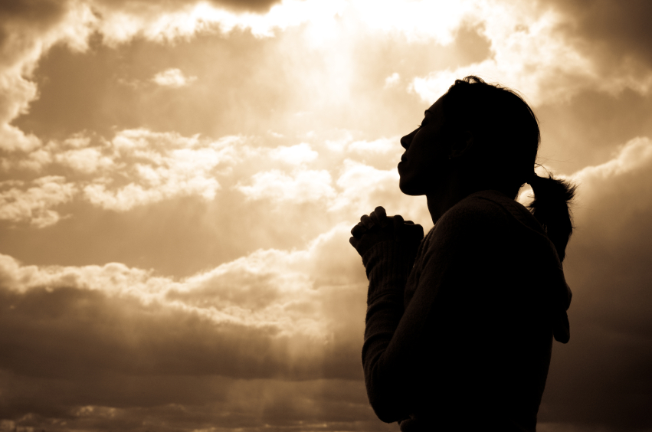
Prayer of Petition
In these prayers, we ask God for things we need (eg. spirituality).

Slide 6
Prayer of Thanksgiving
These prayers express gratitude for what we have.
Eg. the gifts of life
and love.

Slide 7
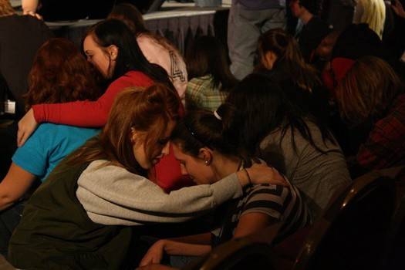
Prayer of Intercession
These are prayers that we offer on behalf of other people (eg. friends, family, coworkers)

Slide 8
Prayer of Blessing
This form of prayer involves admitting that all of creation comes from God and that we should follow God’s will throughout our life.
It can also involve praying to a saint, to help us become more virtuous.

Slide 9
Prayer of Praise
In this form of prayer, we recognize the nature of God.
We praise God for how all-knowing, all seeing, and all powerful He is.
We also recognize that our life depends on God.

Slide 10
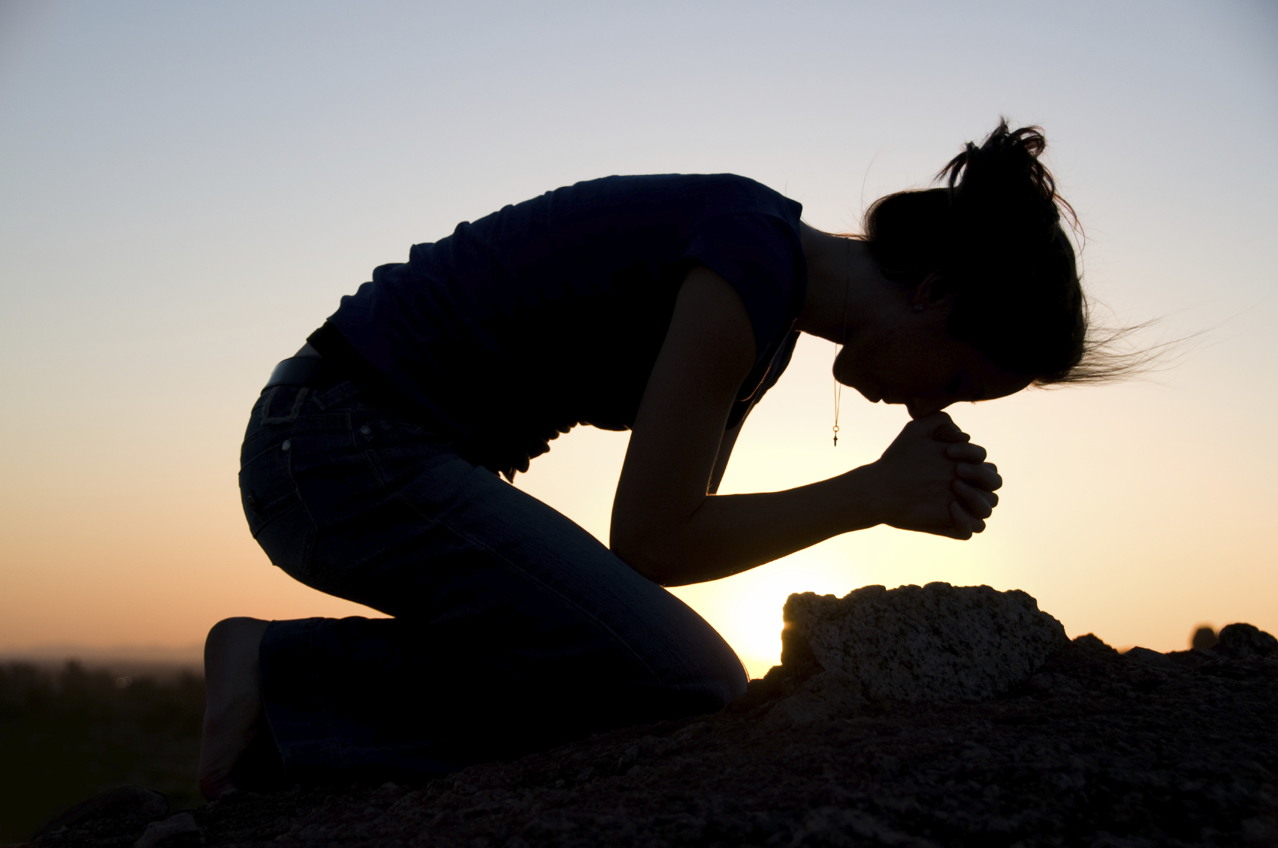
Kneeling to Pray
This tradition was a symbol of humbleness and honor when coming before a king or ruler.
In recognition and honor to God, it may
have been the
appropriate position
to come before Him.

