Slide 1
Why Wait?
A lesson about the consequences of Premarital Sex

Slide 2
What are the risks connected with premarital sex?

Slide 3
Risks Connected with Teen Sex
STIs
Pregnancy
Pregnancy panic
Loss of reputation
Break ups
Conflict with parents

Slide 4
Risks Connected with Teen Sex
Shame and guilt
Sin
Weakened relationship with God
Mental health issues (eg. Depression, suicide)
Preoccupation and distraction
Loss of respect

Slide 5
Risks Connected with Teen Sex
End of adolescence
Devaluing the sexual experience
Jeopardy of future happiness in marriage

Slide 6
What does STI stand for?
Sexually
Transmitted
Infection
Examples include: HIV/AIDS and herpes.

Slide 7
What are HIV and AIDS?

Slide 8
What is HIV?
Human
Immunodeficiency
Virus

Slide 9
What is HIV?
HIV attacks the immune system
It increases the victim’s chance of getting all kinds of diseases, including flu, diarrhea, pneumonia, TB, and certain types of cancer

Slide 10
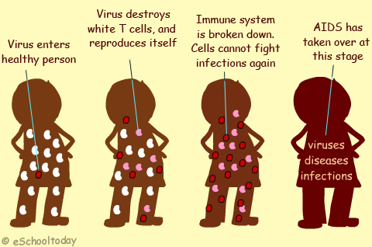
How does one get HIV?
HIV can be spread when blood, semen, vaginal fluid, or breast milk from an infected person enters the bloodstream of someone who is not infected
Eg. Through sex, sharing needles and razors, and breastfeeding

Slide 11
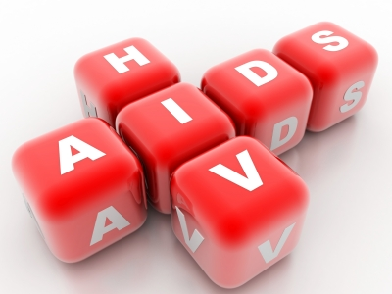
Who can get HIV?
Anyone can get HIV
It does not matter if you are young or old, rich or poor, big or small, and male or female

Slide 12
Risks
At any time, your risk of getting HIV may be increased if you have another sexually transmitted infection, an open sore or breaks in the mucosal lining (eg. Vagina, anus, and or mouth)

Slide 13
How do you know if you are infected with HIV?
Often there are no symptoms for many years
Usually the first symptoms are like those of many other common illnesses (eg. Swollen glands, fatigue)
Different people have different symptoms
The only way to find out for sure if you have HIV is to have a blood test

Slide 14
What is AIDS?
Acquired
Immune
Deficiency
Syndrome

Slide 15
How does one get AIDS?
AIDS is the advanced form of HIV
If HIV is left untreated, your immune system will no longer be able to defend your body from infections, diseases, or cancers

Slide 16
Myths
What myths have you heard about how HIV and AIDS are spread?

Slide 17
HIV is NOT Spread by:
talking, shaking hands, working, or eating with someone
hugs or kisses
coughs or sneezes
donating blood
Swimming pools
Toilet seats

Slide 18
HIV is NOT Spread by:
Bed sheets or towels
Forks, spoons, cups, and food
Insects and animals

Slide 19
Prevention
Prevention is your only defense
Protect yourself from HIV
Abstinence until committed marriage is the life giving choice

