Slide 1
Natural Law and Social Justice

Slide 2
What is natural Law?
Natural law is a moral code that God wants humans to abide by.
Natural law refers to all of the “fundamental rights and duties” God gave humans.
According to St. Thomas Aquinas, all humans were born with the ability to understand the “primary principles of natural law.”
St. Paul taught that the principles of natural law were written in our hearts and minds.

Slide 3
Hebrews 10: 16
"This is the covenant I will make with them after that time, says the Lord. I will put my laws in their hearts, and I will write them on their minds."

Slide 4
How do we respect natural law?
We can understand God’s expectations for us through listening to our conscience (God’s voice within us).
For example, when trying to foster healthy and loving relationships, we can look no further than our conscience for guidance.
We are all rational beings.
We can use our ability to reason to comprehend God’s goals for us.

Slide 5
Natural law and justice
Justice is an important virtue (good habit) that works hand in hand with natural law.
Justice involves striving to ensure the well-being of others as well as ourselves.
When we work towards justice, we are respecting the natural law that God established.
Although we have knowledge of God’s laws, we need to nurture our ability to identify and seek justice.

Slide 6
What are the catholic social teachings?
The Catholic social teachings are a “rich treasure of wisdom about building a just society and living lives of holiness amidst the challenges of modern society.”
The Catholic Church recognizes seven social teachings.
We are all called to work towards respecting and implementing these teachings in our society.

Slide 7
The 7 Social teachings of the church
Human dignity
Stewardship
Preferential option for the poor
Common good
Dignity of work and the rights of workers
Right and responsibilities
Call to family, community, and participation

Slide 8
Our focus
As we conclude our “Called to Love” unit, we will examine human dignity and the preferential option for the poor in greater depth.
These two principles, in particular, can really help us show love to God and our neighbour.

Slide 9
Human dignity
The Church also calls us to remember the principle of human dignity.
The Church teaches that every life has dignity from the moment of conception until death.
Every life is valuable and should be respected at all times.
We are called to make an extra effort to respect the dignity of the poor.

Slide 10
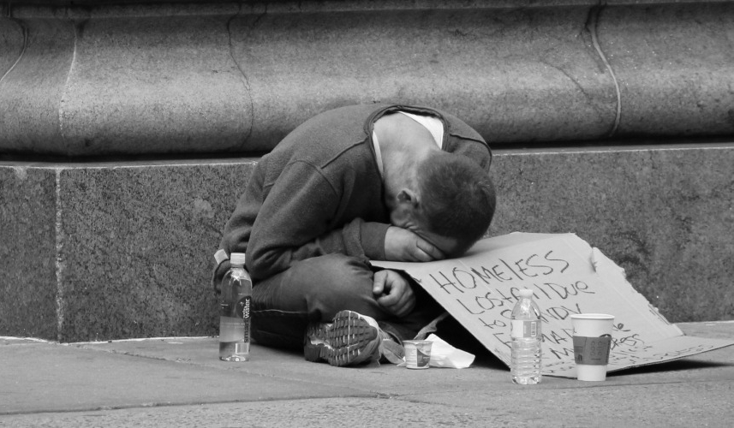
WWYD? Teens Harass and Humiliate the Homeless
https://www.youtube.com/watch?v=mt1JfmFb6Xg

Slide 11
The preferential option for the poor
Jesus tells us that solidarity with the poor is solidarity with God.
“As you did it to the least of these who are members of my family, you did it to me” – Jesus, Matthew 25: 40.
God’s special closeness with the poor is known as the preferential option for the poor.
The rich do not share in God’s closeness with the poor.

Slide 12
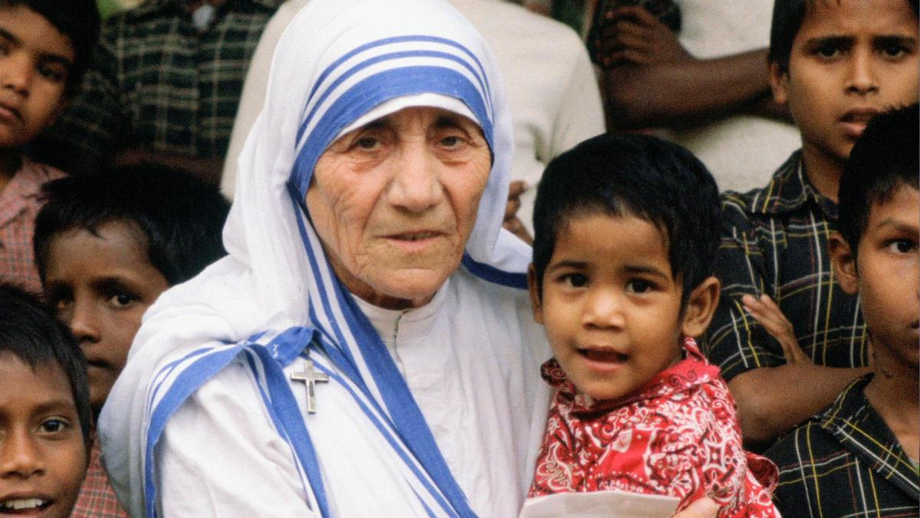
Mother Teresa and the poor
https://www.youtube.com/watch?v=IG9eMWNG2Z0

Slide 13
How can you respect human dignity and the poor in your community?

Slide 14
sources
YOUCAT
“The Way of the Lord Jesus.” Retrieved from www.twotlj.org
The United States Conference of Catholic Bishops. “Seven Themes of Catholic Social Teaching.” Retrieved from http://www.usccb.org/beliefs-and-teachings/what-we-believe/catholic-social-teaching/seven-themes-of-catholic-social-teaching.cfm

