Slide 1
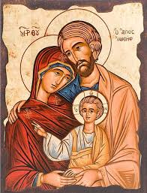
The Role and Importance of family

Slide 2
The holy family
Jesus did not always see things the way his parents did
He did not agree with his parents about everything, and he did not always do things the way they wanted
However, Jesus always showed respect for his parents and he always listened to what they had to say
Jesus was willing to do what his parents asked, even when it wasn’t what he wanted to do, as long as it did not go against his heavenly Father’s will

Slide 3
Following Jesus’ example
Jesus tells us that if we want to have life in abundance and joy in all its completeness, we should follow him
We should even follow him in our attitudes and responses toward our parents
Jesus calls us to love our parents
Jesus challenges us to look for the good and listen for God in the voice of our parents

Slide 4
Scripture activity
Read the Ephesians 5: 21- 6: 4 and Colossians 3: 12-21. Next, summarize the instructions contained in the passages. Create a chart like the one below.
Scripture passages: | Instructions:
Ephesians 5: 21 – 6: 4
Colossians 3: 12-21

