Slide 1
Multiple Intelligence C.S.I. & Reflection Assignment

Slide 2
What is a C.S.I.?
C = colour
S = symbol
I = image

Slide 3
Instructions:
1. Choose one colour that you can connect to the intelligence.
2. Create one symbol that you think best represents the intelligence.
Remember: a symbol represents something.
3. Sketch one image that you think best captures the essence of the intelligence (eg. A scene).
4. Explain why you chose the colour, symbol, and image.

Slide 4
Instructions Continued
Connect your colour, symbol, and image to different aspects of the intelligence.
eg. you should not link all 3 parts of your C.S.I. to the same theme, emotion, characteristic, etc.
Try to link each part of your C.S.I. to a few different aspects of the intelligence.
You should write one paragraph (5-6 sentences min) for each part of your C.S.I.

Slide 5
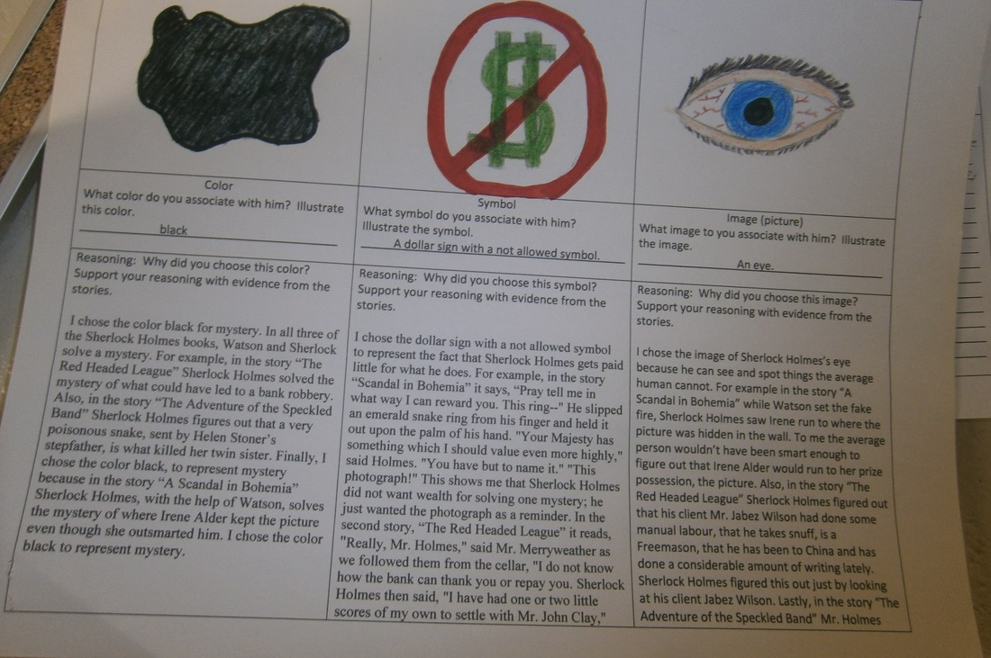

Slide 6
After Completing Your C.S.I.
After completing your C.S.I., write a reflection about how you can use your God-given gifts to serve others.
Should be at least 250 words.
Should be in full and complete sentences.

