Slide 1
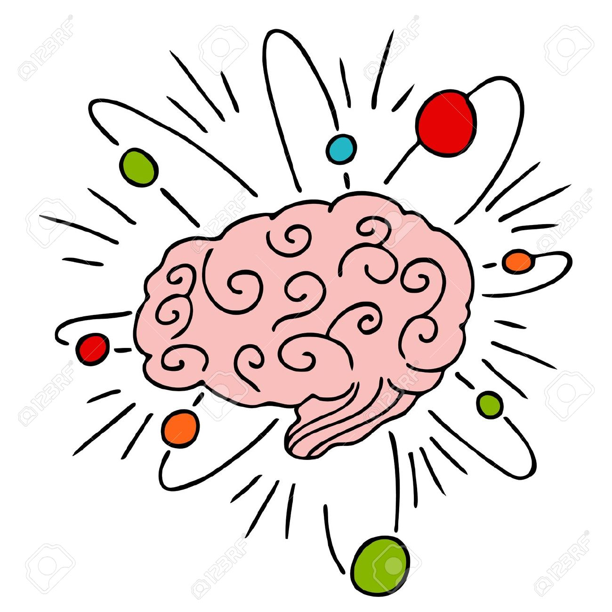
Seven Types of Intelligence

Slide 2
Word Smart
This is the intelligence of language, books, and stories
Reading, writing, and speaking come naturally to individuals who are word smart
Books, stories, and discussions are enjoyed by word smart people
Reading, writing, listening, debating, and discussing all help them to learn

Slide 3
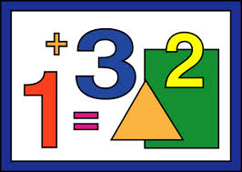
Numbers Smart
This is the intelligence of numbers, ordered sequences, and reasoning
Math and science come naturally to number smart people
Solving problems, finding patterns, making connections between ideas, and finding rational solutions to problems come easily to number smart people

Slide 4
Picture Smart
This is the intelligence of interpreting and creating images
Individuals who are picture smart have a “good eye” and can look at an object and imagine how it would look if you changed it in various ways
Spatial intelligence is a strength (eg. creating pictures, images and symbols and of moving things around in three-dimensional space)

Slide 5
Body Smart
This is the intelligence of the physical self
Being active is important to body smart people
Individuals who are body smart can often learn a new sport or a new dance move very quickly
These people use their bodies to express themselves
Activities that require strength, endurance, poise, grace or coordination come naturally to body smart people

Slide 6
Sound and Rhythm Smart
This is the intelligence of music
These individuals can hear, appreciate, mimic, and create different types of music and rhythms
Hearing, interpreting, and expressing sounds come naturally to sound and rhythm smart people
Rhythmic intelligence can also be used in athletic activities (eg. Needing a sense of rhythm to dribble and pass a basketball)

Slide 7
People Smart
This is the intelligence of relationships
People smart individuals are good at understanding other people
Making people feel comfortable, motivating, and leading come naturally to those who are people smart

Slide 8
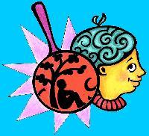
Self-Smart
This is the intelligence of the self
These individuals are good at figuring out why they feel and act the way they do
If they need to, they can often figure out ways to break bad habits and/or change the way they act
Thinking and meditating alone are preferred by self smart people

