Slide 1
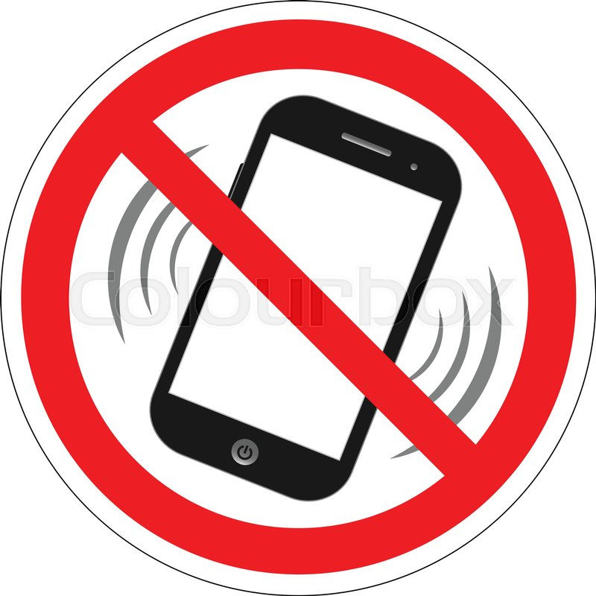
Understanding Sin

Slide 2
What is Sin?
Sin is a decision we make that goes against the truth that is God.
It is a deliberate refusal or failure to pay attention to the rules and guidelines set by the Ten Commandments and by the Church.
Sin is deciding to be less loving than we could be.
It is abusing the freedom God has given us.

Slide 3
How do we know we have sinned?
Does it go against God’s commandments or the teachings of Christ?
Does it weaken my love for God, my relationship with other people, or my growth as a human person?
Did I know that what I was doing was wrong?
Was I aware of what I was doing at the time?

Slide 4
Venial Sin
One commits a venial sin when he or she does not observe the standard of the moral law, but without full knowledge or without complete consent.
A venial sin strains one’s relationship with God.
Example: Using the Lord’s name in anger (without thinking or habitually).

Slide 5
Mortal Sin
A mortal sin is one that puts your soul in jeopardy.
It breaks one’s relationship with God.
Example: first-degree murder.
For a sin to be mortal, 3 conditions must be met:
It must be a grave matter
It must be committed with full knowledge
It must be committed with deliberate consent

Slide 6
Personal Sin
Personal sin is a form of individual sin that is committed by someone who “knowingly and deliberately violates the moral law.”
It involves turning away from God’s love and will.
Personal sin can fall into the category of mortal sin.

Slide 7
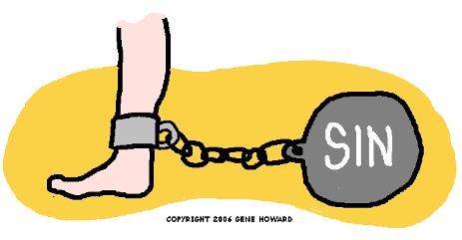
Social Sin
Social sin is the “sum of countless selfish actions and omissions.”
It can be understood as “collective blindness.”
It “resides within a group or a community of people. It exists within any structure in society that oppresses human beings, violates human dignity, stifles freedom and/or imposes great inequity.”
Example: Racist attitudes that prevent us from respecting the dignity of everyone or policies that keep people living in poverty.

Slide 8
What are the effects of sin?
It weakens our love for God, for others, and for our ourselves.
It damages our relationship with God, others, and ourselves.

Slide 9
Sources
Canadian Conference of Catholic Bishops. Be With Me. Ottawa.
Divine Mercy. “Sin: Original and Personal.” Retrieved from http://www.divinemercyinc.com/Beliefs10.htm
Social Gospel Blog spot. (2004). “What is Social Sin?” Retrieved from http://socialgospel.blogspot.ca/2004/08/what-is-social-sin.html
United States Conference of Catholic Bishops. (2018). “Social Sin.” Retrieved from https://www.wearesaltandlight.org/learn-together/understanding-social-sin/

